Slide 1
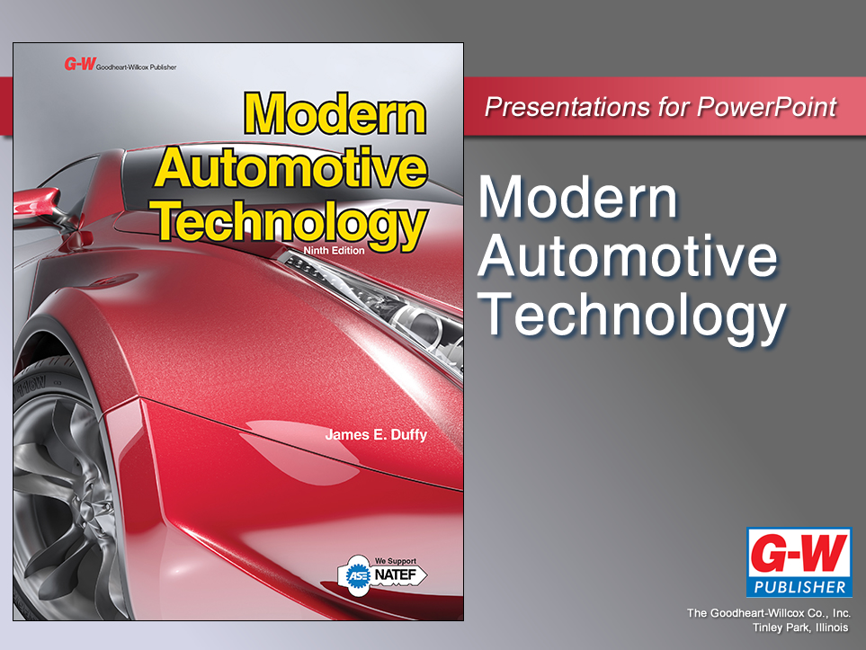

Slide 2
21
Chapter
Wiring Diagrams and Wiring Repairs

Slide 3
Objectives
After studying this chapter, you will be able to:
Compare wire types and sizes.
Explain the effects of wire size on resistance.
Identify wire protection devices.
Apply proper techniques to cut and strip wires.
Perform proper procedures to join components or wires by soldering.
Identify wire terminals and connectors.
Perform proper procedures for making connections using various types of connectors and terminals.

Slide 4
Objectives
Perform proper procedures for servicing factory connectors without damaging them.
Perform proper procedures for repairing wiring and fuse links.
Use component location charts and illustrations while troubleshooting problems.
Interpret wiring diagrams.
Use a grid to locate specific components on wiring diagrams.
Select and use the appropriate wiring diagrams to troubleshoot an electrical problem.

Slide 5
Types of Wire
Wire
  Consists of central metal conductor surrounded by plastic insulation
  Type of metal, insulation bundling, and shielding, varies depending on application

Slide 6
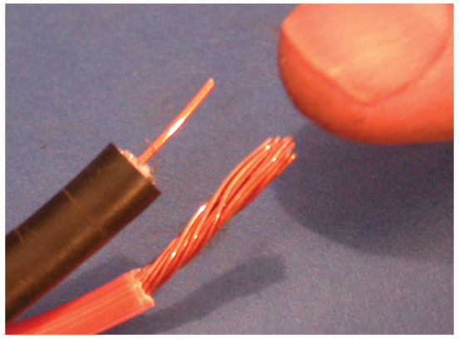
Solid and Stranded Wire
Solid wire
  Single conductor inside plastic insulation
Stranded wire
  Numerous individual metal strands twisted together inside insulation

Slide 7
Parallel Wire
Two or more individually insulated conductors or wires molded into one body of multicolor insulation
  Lays flat, stays organized for easy pinpoint testing

Slide 8
Primary and Secondary Wire
Primary wire
  Small wire carrying low voltage to components, circuits, and ECUs
Secondary wire
  Small conductor with thick insulation carrying high voltage/low current in ignition system

Slide 9
Primary and Secondary Wire (Cont.)
Secondary resistance or carbon-core wire
  Has internal resistance designed into metal conductor
Secondary nonresistance wire
  Stranded metal conductor with no extra carbon resistance used only in high-performance applications

Slide 10
Cables
Wire with large-diameter conductor
Cable’s outside diameter is generally much larger than that of a wire, and cables can contain one or more conductors
Battery cables
  Carry battery current to starting motor and return current to battery from ground

Slide 11
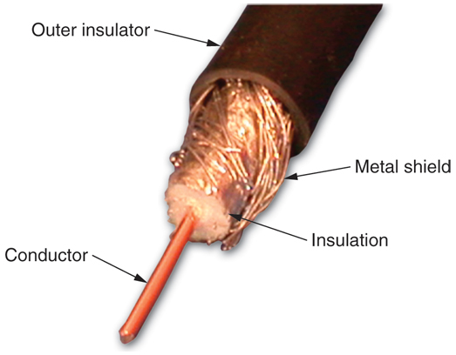
Coaxial Cable
Also called coax or shielded wire
Center conductor surrounded by braided metal shield
Insulation separates conductor and shield

Slide 12
Twisted and Shielded Twisted Pair Wire
Twisted pair wire
  Multiple insulated conductors spiraling each other
  Prevents unwanted magnetic fields from inducing into wire
Shielded twisted pair wire
  Sheath of metal around conductors to block radio interference

Slide 13
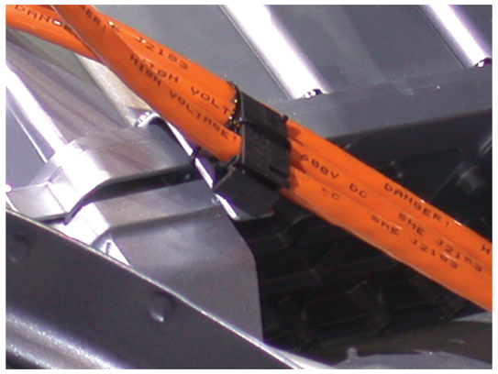
Hybrid Power Cables
Carry electric current to and from
  Motor-generator
  Power control unit
  HV battery
Normally orange for easy identification and safety

Slide 14
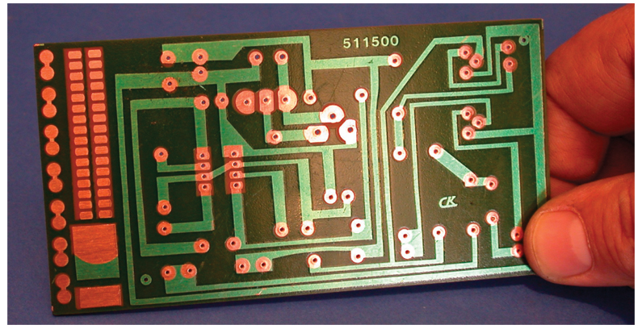
Printed Circuits
Copper foil bonded onto plastic or fiber base to form compact conductor
Used on back of instrument panel cluster and in circuits

Slide 15
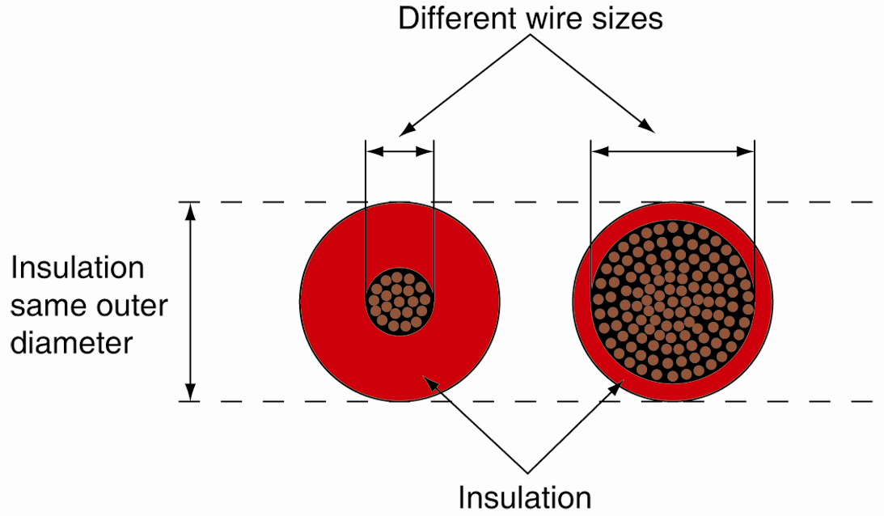
Wire Size
Wire size or wire gage
  Determined by conductor’s diameter
  Does not include insulation
  Limits how much current a wire can carry without overheating

Slide 16
Wire Size (Cont.)
American Wire Gage (AWG) system
  Rates wire size by gage numbers
    Used to indicate conductor diameters
  Wire gages range from gage 0 to gage 30
Wire diameters measured in mils or circular mils
  1 mil equals 0.001"
  1 circular mil equals area of circle with 0.001" diameter

Slide 17
Wire Size (Cont.)
Resistance in wire depends on several factors
  Ambient temperature
  Thickness of wire
  Type of metal used
  Type of wire (solid or stranded)
Resistance measured in ohms per 1000 feet

Slide 18
Wire Size (Cont.)
Metric wire size
  Given as cross-sectional area of wire in square millimeters (mm²)
  Unlike AWG gage numbers, metric wire sizes increase as wire’s diameter increases

Slide 19
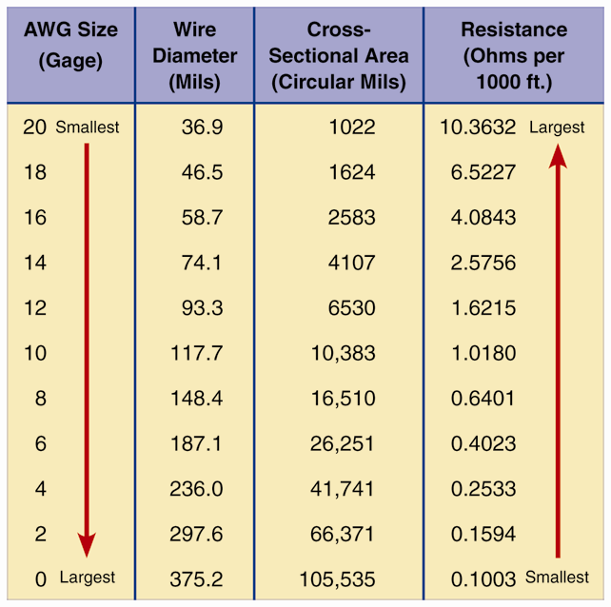
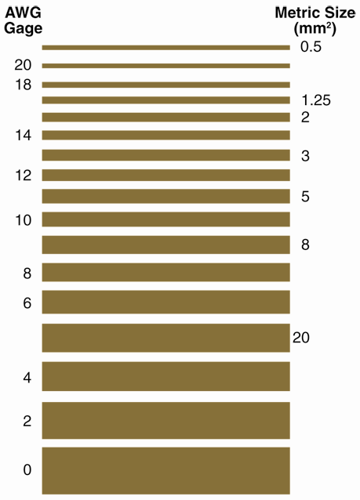
Wire Size (Cont.)

Slide 20
Wire Current-Carrying Rules
Wire resistance increases as conductor diameter decreases
Resistance depends on material used in conductor
  Silver has less resistance than copper; copper has less resistance than aluminum
Resistance increases as wire’s length increases
Resistance increases as temperature increases

Slide 21
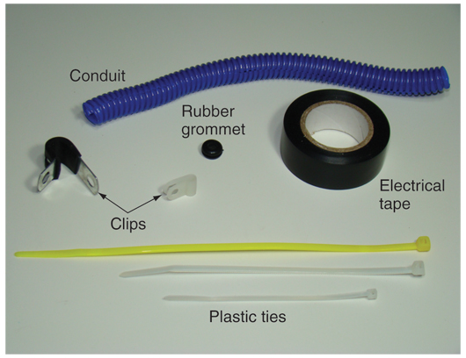
Wire Protection Devices
Electrical tape
Plastic tubing
Retainers
Clips
Boots
Straps

Slide 22
Wiring Harnesses
  Set of several wires enclosed together with tape or plastic
  Organizes and protects wiring
  Neater appearance than dozens of wires running separately
  Usually named after location in vehicle

Slide 23
Cutting and Stripping Wire
Cutting wires
  Use diagonal cutting pliers, electricians’ pliers, or wire stripping pliers
  Cut completely through wire on first try
Stripping wire
  Wire strippers used to remove insulation from wires
  Select stripping hole size that matches specific wire size

Slide 24
Soldering
  Involves using heat and solder to join electric components or wires
Solder
  Alloy (mixture of metals) with low melting point
  Most solder made of mixture of lead (Pb) and
  tin (Sn)

Slide 25
Soldering (Cont.)
Rosin-core solder
  Contains flux (lead-free cleaning agent) inside solder
  Designed for electrical repairs
Acid-core solder
  Internal acid flux
  Do not use for electrical repairs
  Sometimes used to repair radiators

Slide 26
Tinning
  Process of heating, cleaning, and preparing surface of soldering gun tip and electric components to accept molten solder
  If needed, wipe debris from tip using water-soaked sponge

Slide 27
Soldering Technique
Basic procedures for soldering
Preheat electric components with soldering tip or torch
Touch solder onto wires or component leads
  Apply a little heat to both wire leads and solder
    Causes solder to flow out onto metal surfaces of conductors

Slide 28
Soldering Technique (Cont.)
If solder does not bond
  Re-clean metal parts
  Re-cut and strip wires
  Brush on fresh paste-type flux and try again
After smooth puddle of molten solder forms
  Remove heat and solder
  Do not wiggle or move joint for a few seconds after heat removal

Slide 29
Covering Exposed Conductors
Electrical tape
  Covers and protects soldered conductors
Liquid electrical tape
  Liquid coating brushed over conductors to insulate them from moisture
Heat shrink tubing
  Hollow plastic tubing, shrinks when heated

Slide 30
Connectors
Wire-splicing devices for joining ends of two or more wires
Terminals
  Connection points

Slide 31
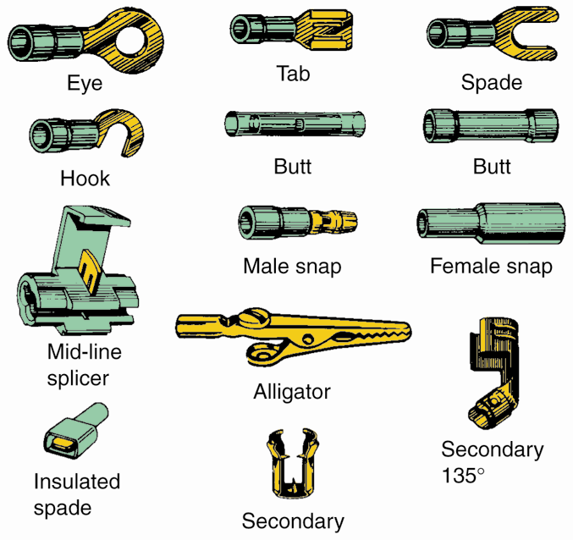
Crimp Connectors
Join wires
Install a terminal on wire
Crimping pliers crush metal part of connector around wire conductor
(Beldon)

Slide 32
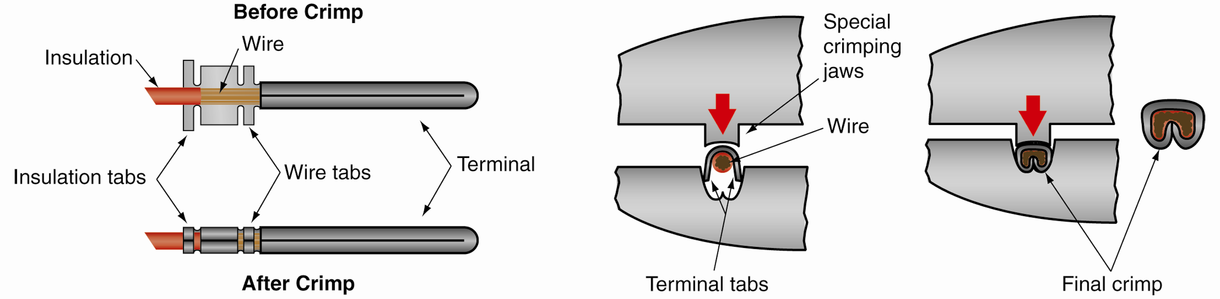
Crimp Connectors (Cont.)

Slide 33
Connectors (Cont.)
Self-stripping connector
  Cuts wire’s insulation and locks onto conductor
  Useful when connecting to existing wire in harness
Harness connectors
  Multi-terminal connectors that join several wires and with special locking feature
  Two-part plastic housing snapped together

Slide 34
Connectors (Cont.)
Require special methods or tools for disconnection
Disconnecting factory connectors
  Plastic latch holds two halves together
  If needed, squeeze or pry up on latch to free connector

Slide 35
Connectors (Cont.)
Terminal replacement
  Has small metal tab or lever locked inside plastic connector
  Use small screwdriver or special tool to free terminal
  When reinstalling, make sure small metal tab bends outward

Slide 36
Protecting Electrical Connections
Dielectric grease
  Special grease that blocks moisture and helps prevent corrosion
Some electrical connectors are equipped with soft rubber boot
  Keeps moisture from entering and contacting conductors

Slide 37
Wiring Repairs
Wiring repairs return circuit to its normal operating condition
Including
  Replacing burned wire or connector
  Soldering wire to terminal
  Crimping terminal over wire

Slide 38
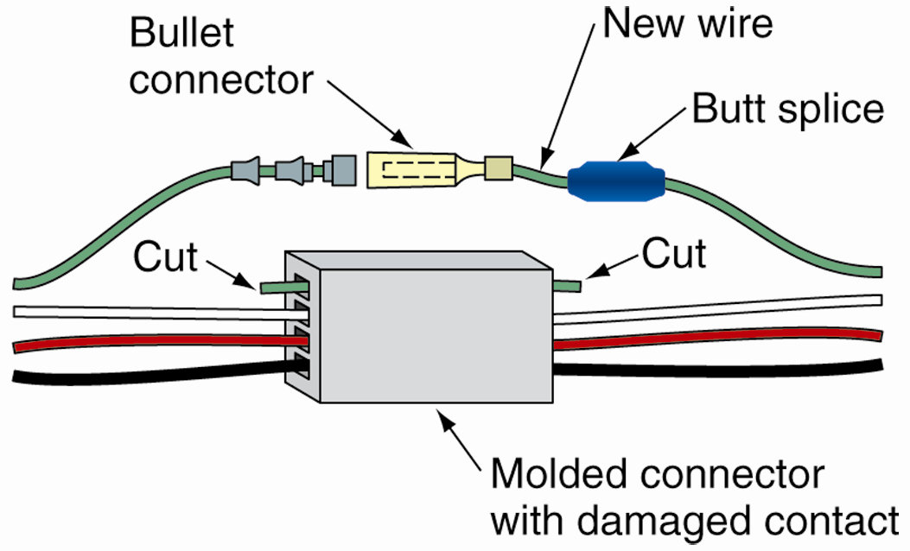
Bypassing a Connector
If connector is burned or damaged and new one is unavailable
Make new electrical path around terminal
Butt-splice new piece of wire to join cut ends

Slide 39
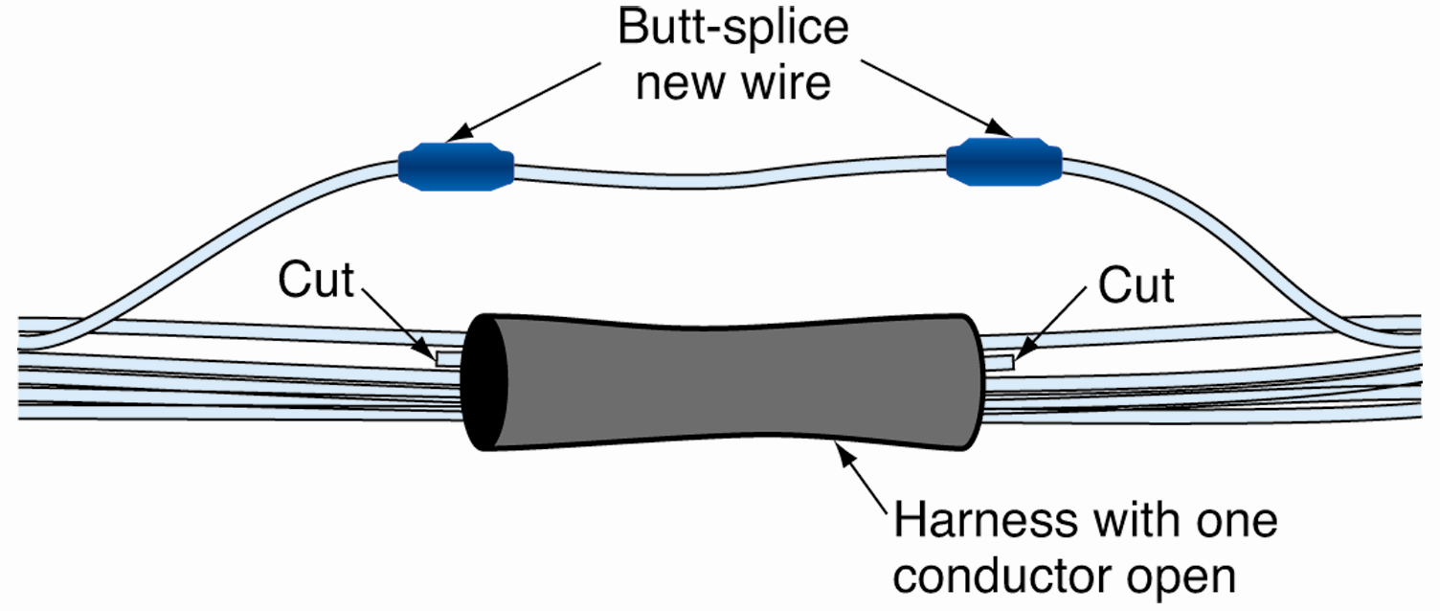
Bypassing a Wire
If tests find one wire to be broken or shorted inside wiring harness
Easiest solution might be to bypass wire
  Use new piece of wire to make electrical connection around bad section

Slide 40
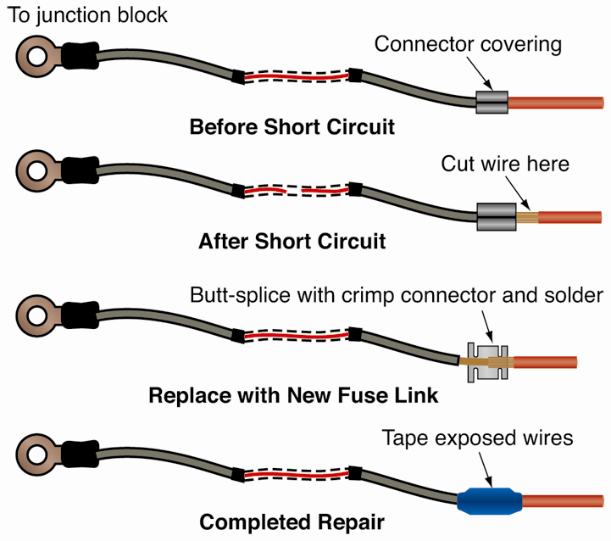
Fuse Link Service
Fuse link
  Protects wiring before it gets to fuse box
  Burns in half to protect circuit in event of a short
Make sure to correct problem before replacement

Slide 41
Adding Electric Accessories
Computer circuits have sensitive wiring
  Taping or splicing them could upset circuit operation
Avoid splicing into factory wiring
  Wire new fused electric circuit directly to 12-volt battery with new ground

Slide 42
Twisted Cable Service
Shielded twisted cable
  Prevents induced voltage from upsetting operation of computers or sensors
Follow service manual recommendations when replacing
Tightly twist wires in the same direction before soldering

Slide 43
Electrical/Electronic Symbols
  Used on wiring diagrams to show circuit components and wiring connections
  Clearly show relationship of components in circuit
  To save space and to simplify reading
Competent technicians must understand these symbols

Slide 44
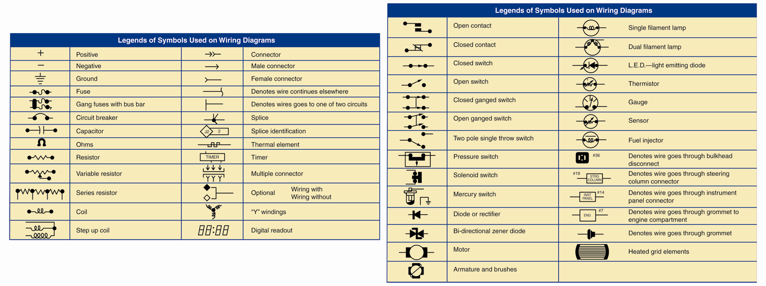
Electrical/Electronic Symbols (Cont.)

Slide 45
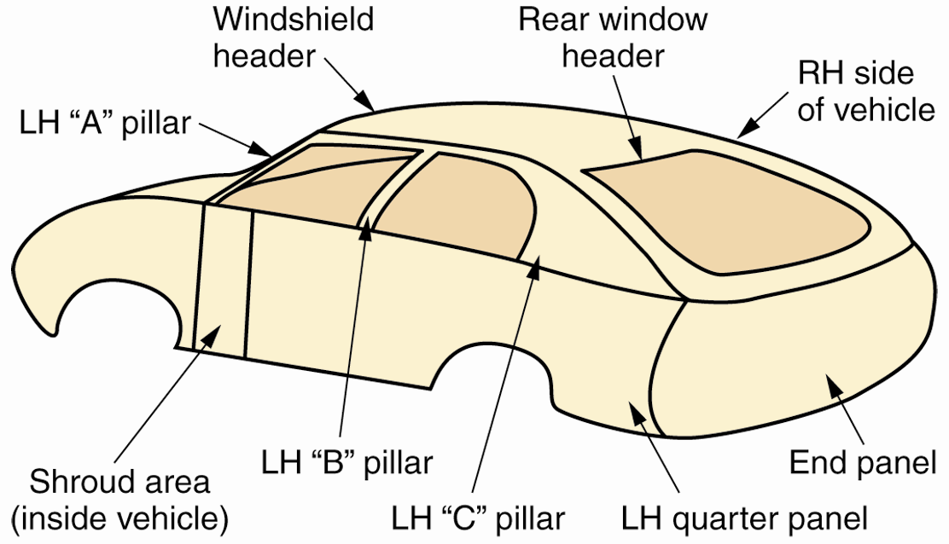
Wiring Harnesses Names
Most wiring harnesses are named after their location on a vehicle
Left side is driver’s side abbreviated “LH”
Right side is passenger side abbreviated “RH”

Slide 46
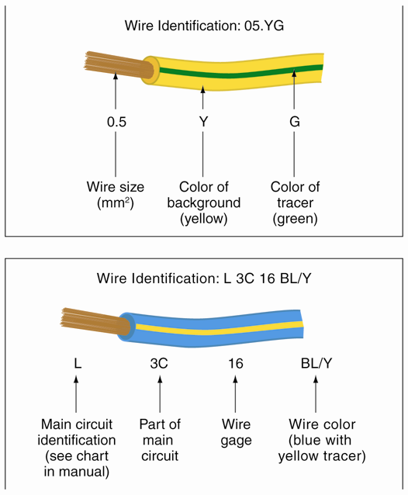
Wire Code Identification System
  Alphanumeric method of identifying wires on a diagram
Explain
  Color
  Location
  Gage size
Vary by manufacturer

Slide 47
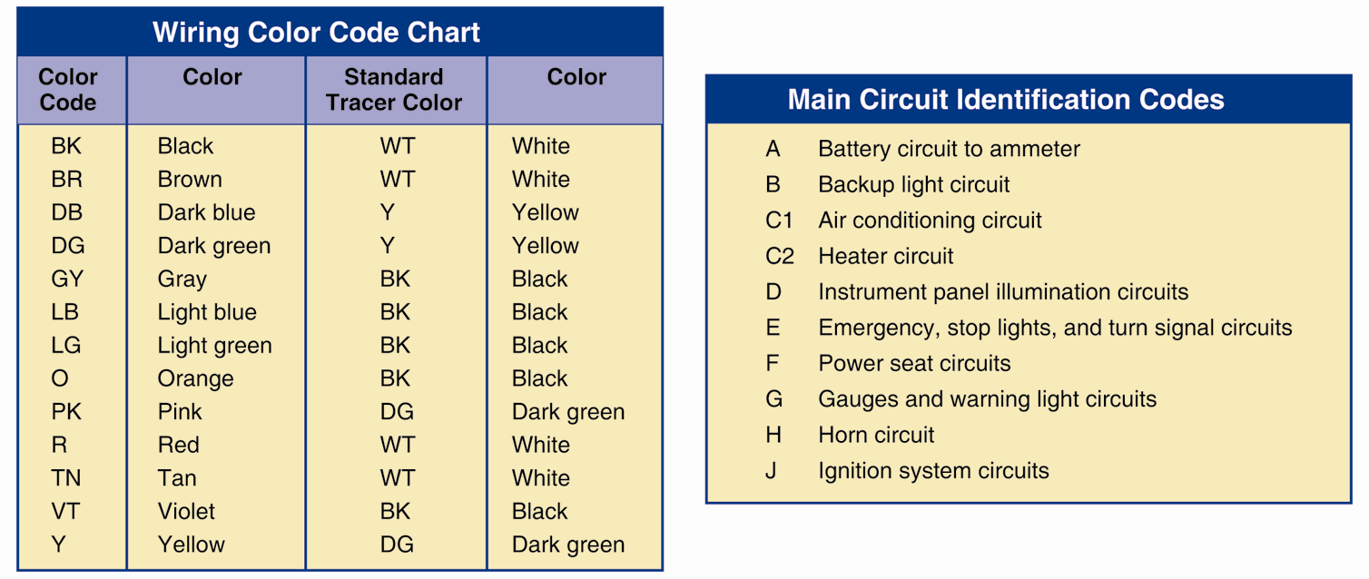
Wire Code Identification System (Cont.)
Wire color codes trace or follow one wire to different locations
Can have solid colors, stripes, bands, or hash marks

Slide 48
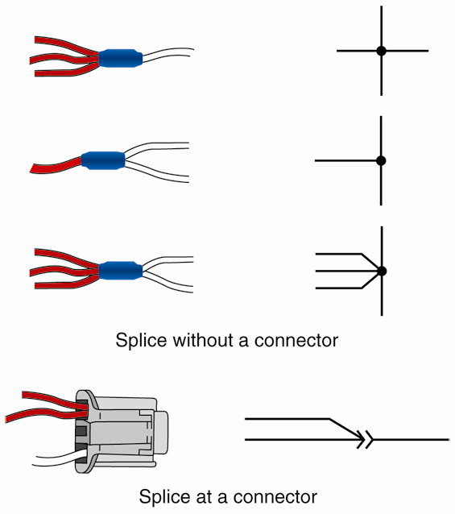
Wiring Splices
Places where two or more wires connect
Normally shown on wiring diagram as a dot

Slide 49
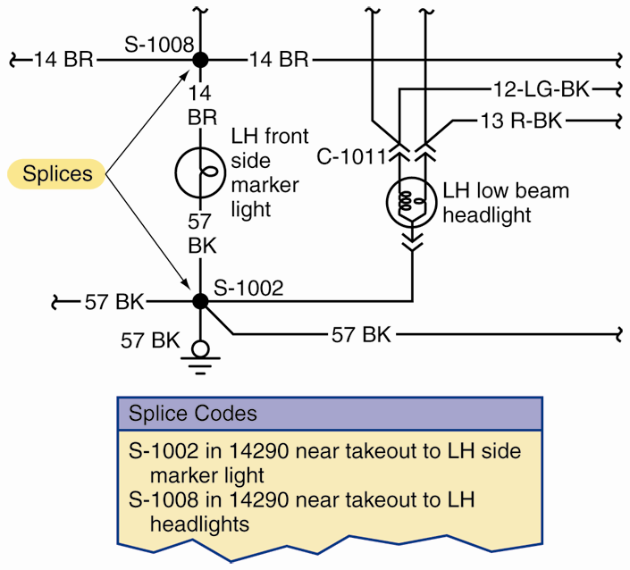
Splice Code Charts
Give additional information about circuits and splice locations
(Ford)

Slide 50
Electrical Grounds
Where circuits fasten to metal frame or chassis
Remote ground
  Extra wire running from circuit to ground
Chassis ground
  Uses metal part of component to attach to ground

Slide 51
Alternate Circuits and Optional Wiring
Alternate circuit
  Possible circuit variation given on wiring diagram
  Allows one diagram to serve as two diagrams
Optional wiring
  Wiring provided in a circuit that may not be in use
  Trailer light wiring even if package not installed

Slide 52
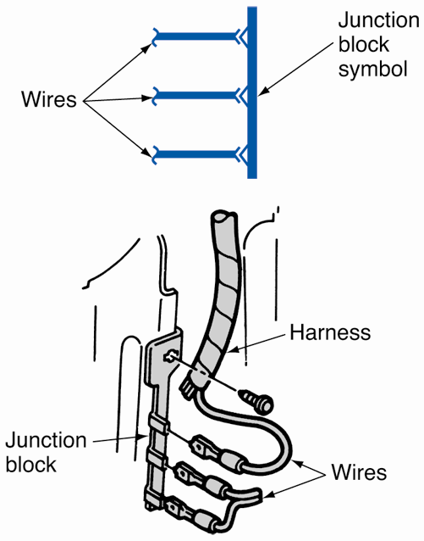
Junction Blocks
Component that allows several wires to connect to common conductor
Serves as splice
Wires can easily be removed

Slide 53
Connector Electrical Values
Electrical values of connector
  Voltage, current, and resistance specifications at connector for known good circuit
  Electrical value that should be present at each terminal in connector
Allows use of multimeter to check circuit for problems

Slide 54
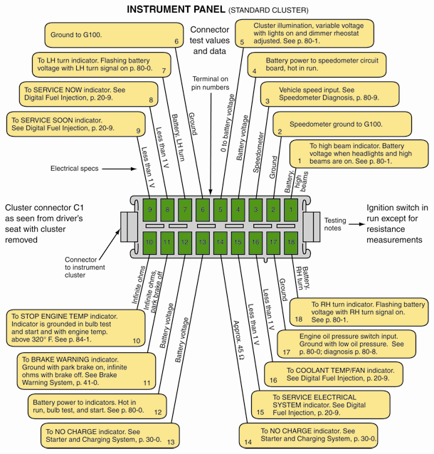
Connector Electrical Values (Cont.)

Slide 55
Steps for Using Wiring Diagrams
Learn abbreviations used in service information for specific vehicle
Study color codes and callouts on wiring diagram
Study types of symbols used on diagram
Learn to use any charts that accompany diagrams

Slide 56
Steps for Using Wiring Diagrams (Cont.)
Study only pertinent section of circuit diagram
Slowly trace section of circuit
Do not confuse overlapping wires with spliced wires
Visualize vehicle you are working on

Slide 57
Types of Wiring Diagrams
Wiring diagrams take different forms, depending on information contained
Harness routing diagram
  Shows how major wiring is arranged and located in vehicle

Slide 58
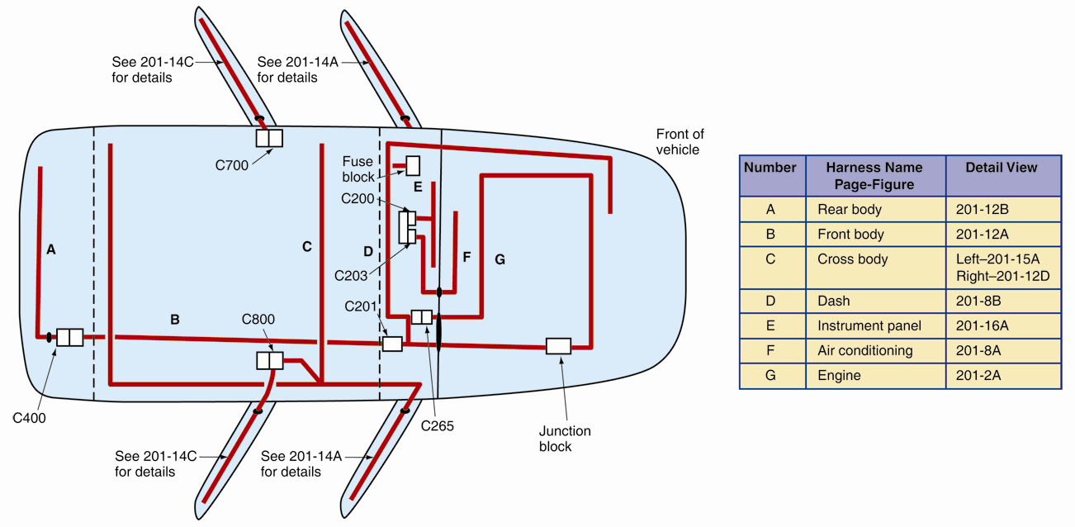
Harness Routing Diagram

Slide 59
Connector and Power Distribution Diagrams
Connector diagrams
  Shows connectors and identifies each terminal inside
Power distribution diagram
  Shows how 12-volt battery current feeds to electrical system’s main components or sections

Slide 60
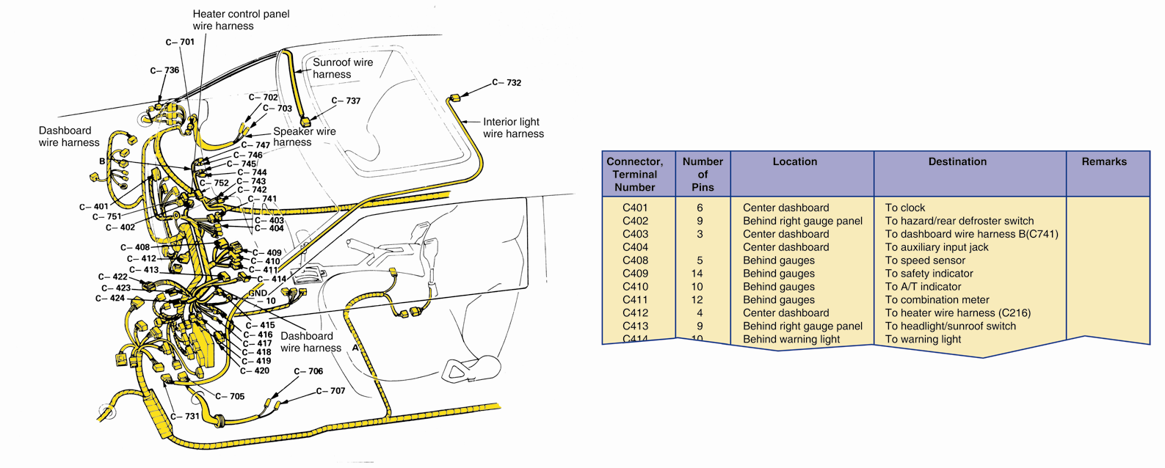
Connector Diagram
(Honda Motor Co.)

Slide 61
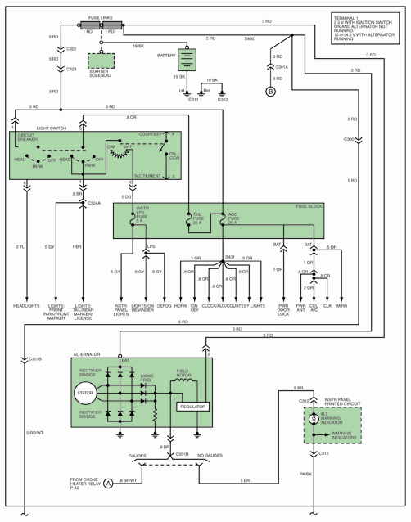
Power Distribution Diagram

Slide 62
Location Grid
  Locates components or connections quickly on large wiring diagram
  Alphanumeric system marked off around outside of wiring diagram

Slide 63
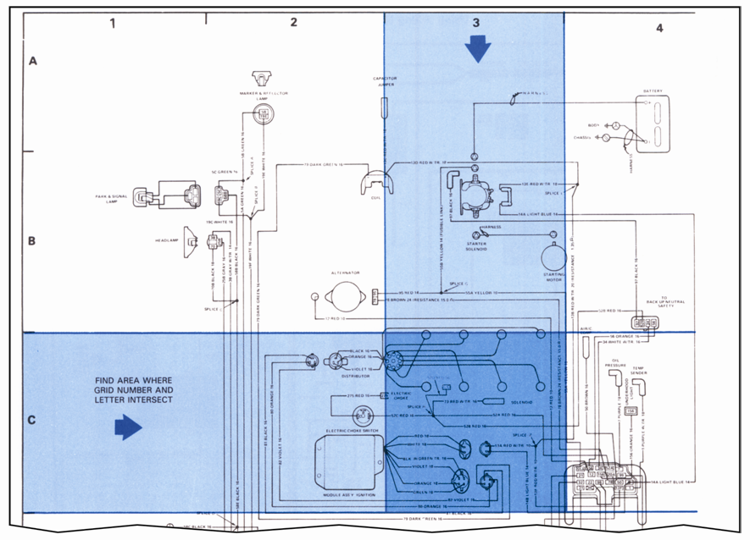
Location Grid (Cont.)
(Ford)

Slide 64
Main and System Wiring Diagrams
Main wiring diagram
  Large diagram with symbols for all major wiring and electric/electronic components
System wiring diagram
  Contains only components and wires for a particular circuit
  Section of main wiring diagram

Slide 65
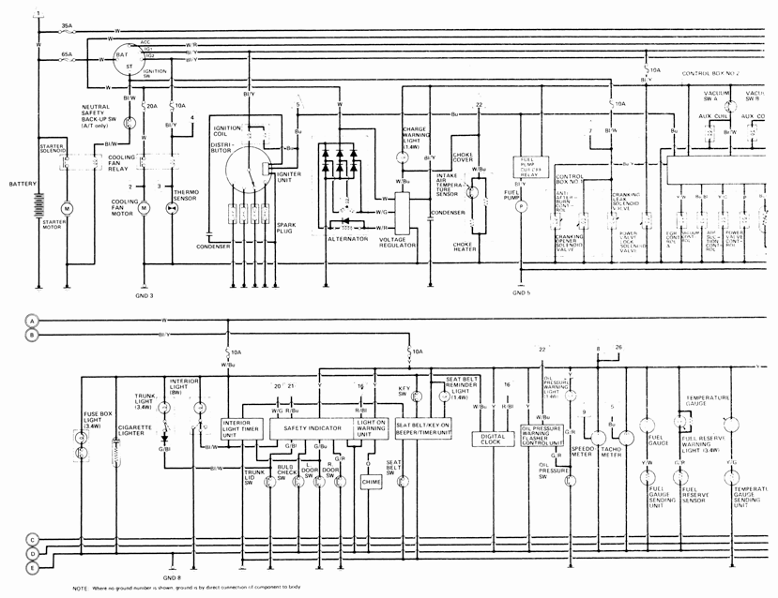
Main Wiring Diagram
(Honda Motor Co.)

Slide 66
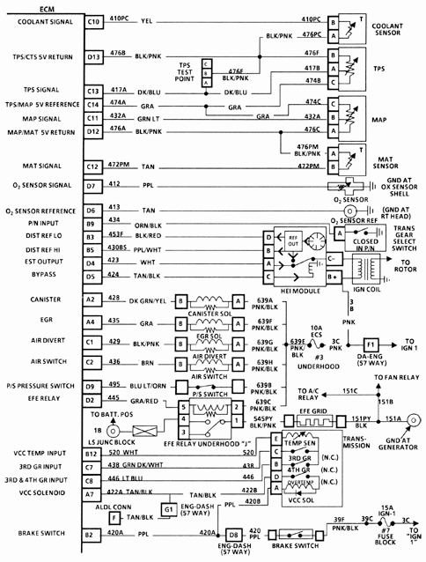
System Wiring Diagram

Slide 67
Block Diagrams
Boxes and symbols illustrate components
Lines represent wires and hoses
Simplifies system or circuit to illustrate how area operates and major components interact

Slide 68
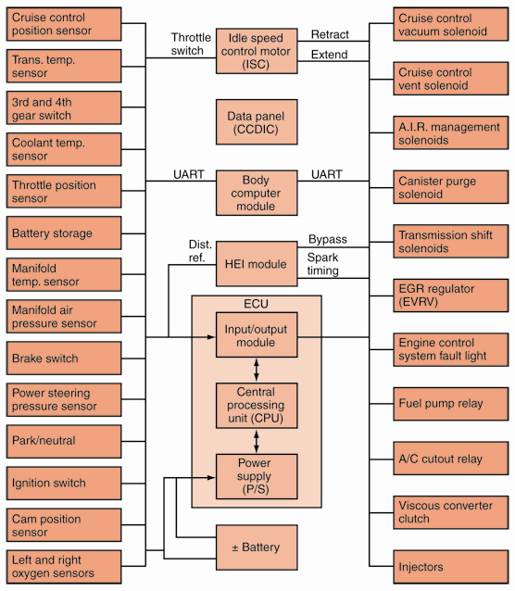
Block Diagrams (Cont.)

