Slide 1
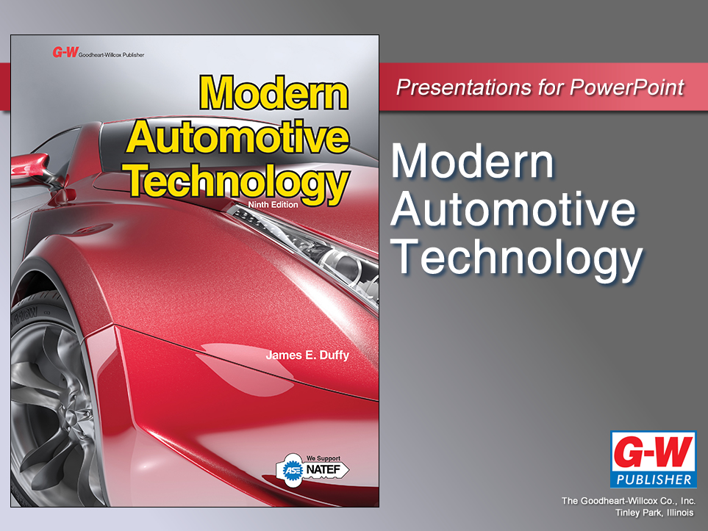

Slide 2
26
Chapter
Hybrid Drive Technology

Slide 3
Objectives
After studying this chapter, you will be able to:
Identify the major parts common to hybrid gas/electric or all-electric vehicles.
Compare hybrid design and construction variations.
Explain the operation of a motor-generator, HV battery, and HV power control module.
Correctly answer ASE certification test questions on hybrid drive systems.

Slide 4
Hybrid Vehicles
Hybrid electric vehicle (HEV)
  Uses two power sources for propulsion
  Small gas or diesel engine used with high-voltage battery and motor-generator
To electricians, HV means “high voltage”
  All hybrid vehicles operate on high voltage
  HV refers to high voltage circuits and components

Slide 5
Hybrid Vehicle History
1898
  Ferdinand Porsche
    Small internal combustion engine to spin direct current (dc) electric generator
1966
  U.S. Congress passed bill recommending developing electric vehicles to reduce air pollution and dependence on foreign oil

Slide 6
Hybrid Vehicle History (Cont.)
1990s
  Automakers started perfecting hybrid drive systems
Currently
  All major automakers build hybrid electric vehicles capable of operating on electricity only
Full electric vehicles practical for short trips or city driving

Slide 7
Hybrid Drive Construction
Internal combustion engine (ICE) and electric drive system
  Under computer control to propel vehicle and operate accessory systems
Hybrid vehicle comes to a stop
  Both internal combustion engine and high-voltage charging system shut off

Slide 8
Hybrid Drive Construction (Cont.)
Hybrid electric drive system
Almost silently cranks engine over for starting
Steps-down HV battery dc voltage to
12–15 volts dc
  Power lights, instrumentation, and on-board computer circuits

Slide 9
Hybrid Drive Construction (Cont.)
Shut off internal combustion engine when battery charging is not needed
Hybrid drive regenerative braking system prevents wear of conventional friction brake pads and brake rotors

Slide 10
Hybrid Drive Construction (Cont.)
Six major assemblies in hybrid drive system
HV battery
Motor-generator
HV power control module (HV PCM)
Hybrid control module
HV power cables
Internal combustion engine

Slide 11
Full Hybrids
Uses motor-generator to initially accelerate and propel vehicle
Internal combustion engine runs only when battery pack discharges, or during heavy acceleration
Full hybrids accelerate normally without consuming fuel or emitting exhaust emissions

Slide 12
Mild Hybrids
Mild hybrid or assist hybrid
  Propelled by internal combustion engine only
This hybrid shuts down internal combustion engine when vehicle coasts, brakes, or stops
Uses HV starter-alternator to restart engine when brake pedal is released

Slide 13
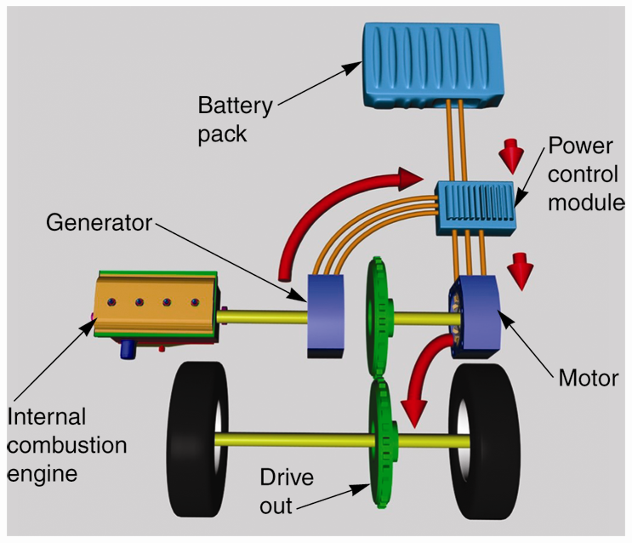
Series Hybrid
Electric motor
  Only method used to apply torque to vehicle’s drive train
Internal combustion engine
  No mechanical connection to drive train

Slide 14
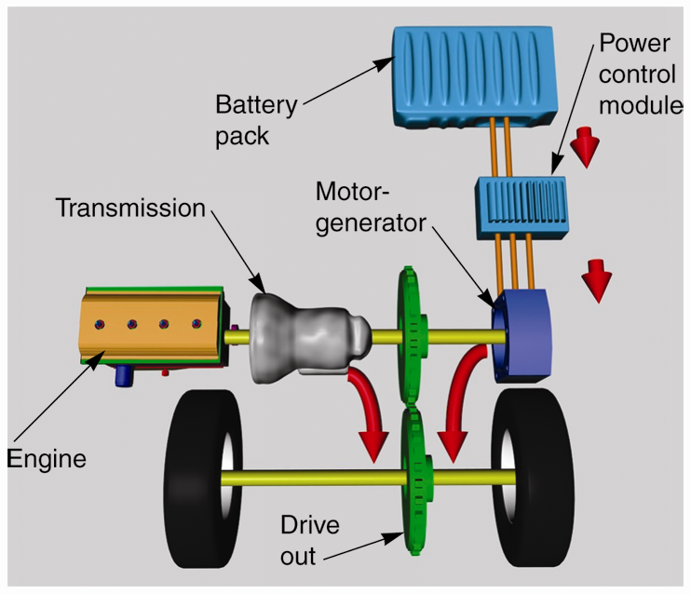
Parallel Hybrid
Uses both internal engine and motor-generator to apply mechanical torque to drive train
Engine and motor-generator operate in parallel

Slide 15
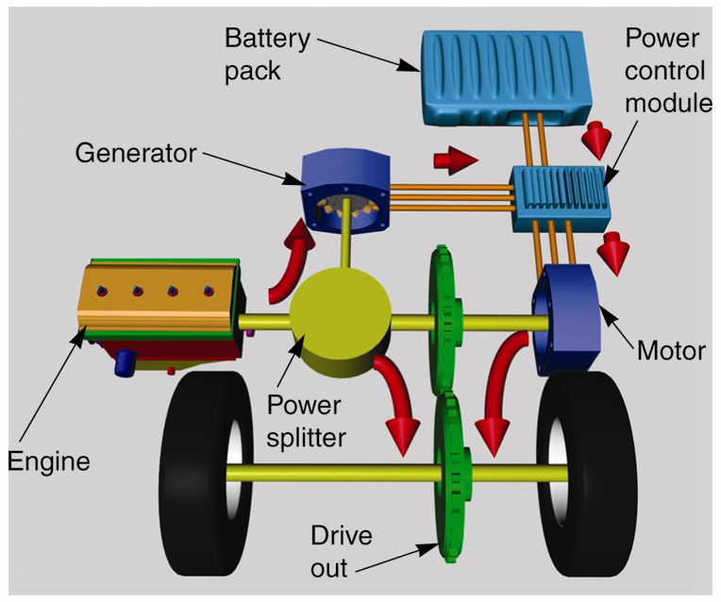
Series-Parallel Hybrid
Combines advantages of parallel hybrid and series hybrids
Can recharge battery while electric motor in use
ICE can drive wheels or disconnect so only electric drive motor propels vehicle

Slide 16
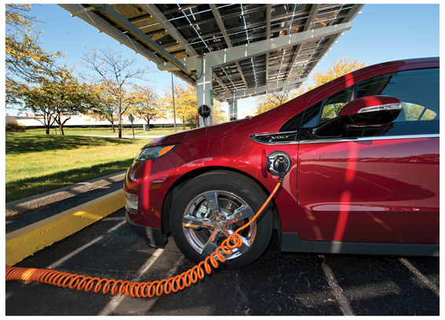
Plug-In Hybrid Electric Vehicles (PHEVs)
Designed so battery can be fully recharged when vehicle is not in use
New PHEVs can travel 30–40 miles before gas or diesel engine operates
(General Motors Corp.)

Slide 17
Full-Electric Vehicles
Only have electric propulsion system
No method of recharging HV battery when driving
Practical for city driving
  Driving range limited to less than 100 miles

Slide 18
Flywheel Generator Hybrids
HV flywheel or kinetic energy generator
  Uses large, heavy flywheel rotor spinning series of electromagnets to store electrical energy
Equipped in hybrid race cars
  Successful on international road race courses
  Corner exit boost

Slide 19
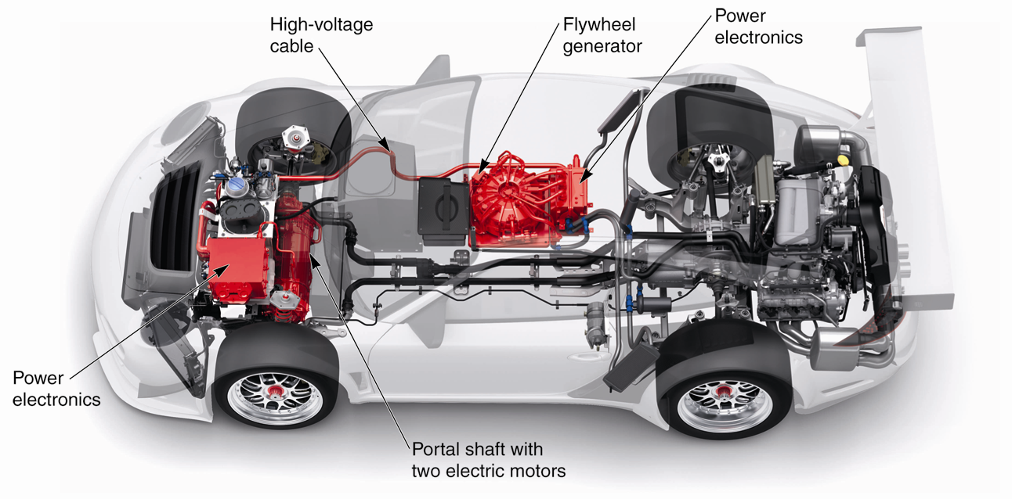
Flywheel Generator Hybrids (Cont.)
(Porsche)

Slide 20
Hybrid Vehicle Operation
Six basic modes of operation
All-electric drive mode
Motor-assist mode
Idle stop mode
Regenerative braking mode
Engine starting mode
HV battery recharging mode

Slide 21
All-Electric Drive Mode
Vehicle operates just like all-electric car
Battery pack provides all energy needed for driving

Slide 22
Motor-Assist Mode
Both motor generator and internal combustion engine apply torque to drive train

Slide 23
Idle Stop Mode
System automatically shuts off ICE when vehicle stops
Restarts engine when vehicle reaches predetermined speed or HV battery is partially discharged

Slide 24
Regenerative Braking Mode
Motor-generator serves as electrical generator
  Sends high voltage and current through HV power cables, to HV PCM, and into HV battery

Slide 25
Engine Starting Mode
Motor generator spins engine crankshaft to start internal combustion engine
Hybrid ECU energizes transmission solenoids that apply and release clutches
Also signals engine ECU to provide “spark and fuel” to engine

Slide 26
Battery Charging Mode
Hybrid control module detects lower voltage
  About 70% discharge
Internal combustion engine starts to propel vehicle and recharge HV battery

Slide 27
Hybrid Drive Assemblies
HV battery
  Sends high-voltage dc into HV PCM through HV power cables
HV PCM
  Converts this dc to ac, and usually steps voltage up or down as needed by system circuits
HV battery dc
  Converted into three-phase ac to operate motor-generator

Slide 28
HV Battery
HV battery and motor generator easily propel vehicle or start internal combustion engine
Contains several high-efficiency lithium-ion battery modules stacked in sealed enclosure
  Wired in series to produce very high-voltage power source

Slide 29
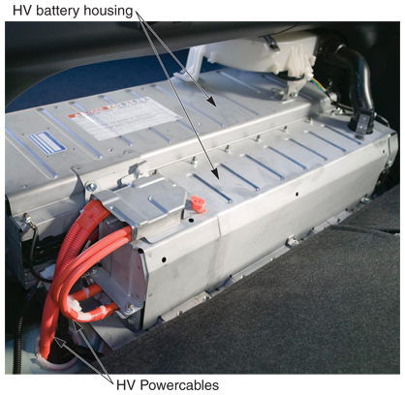
HV Battery (Cont.)
HV battery cover
Encloses modules and protects from damage
Normally mounted in rear of chassis
Behind or under rear seat or in trunk area
(Toyota)

Slide 30
Motor-Generator
Functions as traction motor and as alternator in powertrain
Several specific functions
  Helps power drive train and propel vehicle
  Recharges HV battery
  Cranks internal combustion engine
  Helps slow and stop vehicle

Slide 31
Motor-Generator (Cont.)
Basic parts
Armature
  Set of permanent magnets mounted inside segmented steel or carbon fiber disc
Stator
  Set of stationary coil windings wrapped around iron cores and arranged around armature
Housing
  Holds stator assembly and sometimes armature in place

Slide 32
Motor-Generator as an HV Motor
Propel vehicle, three-phase voltage is applied to stator windings by HV PCM
To efficiently control motor-generator, HV PCM can vary ac frequency, voltage, and resulting current
  Increase or decrease motor torque and speed

Slide 33
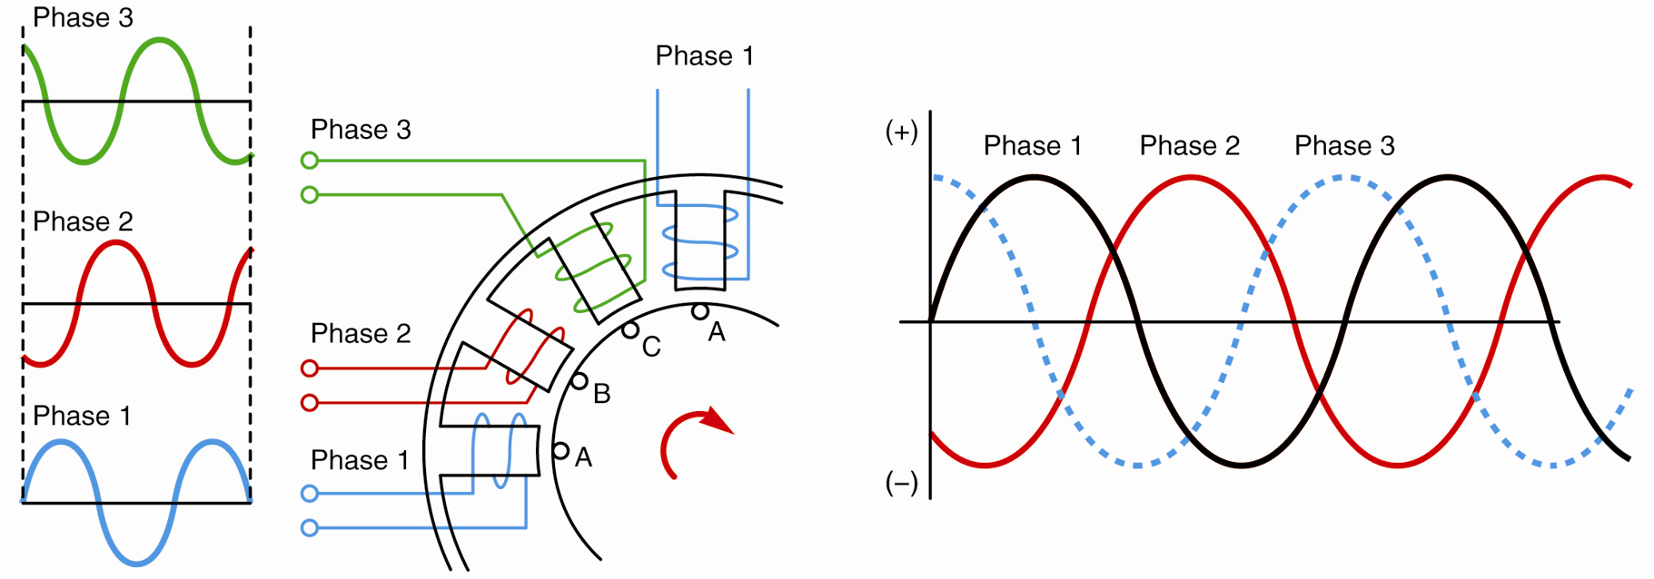
Three-Phase AC Power
Three single phase alternating voltage waves
Flowing through three conductors at different intervals in time
Spin armature
(Toyota)

Slide 34
Motor-Generator as an HV Generator
Motor-generator acts as ac generator
  During regenerative braking
  When driven by internal combustion engine or transmission

Slide 35
Dual Motor-Generator Hybrids
Two separate motor-generators used to provide assist
  Usually located inside transmission or transaxle
During regenerative braking, both act as generators to recharge battery and help drag drive train to a stop
Both motor-generators act as motors to help propel vehicle

Slide 36
Triple Motor-Generator Hybrids
Two motor-generators located in transmission or transaxle
One motor-generator located in rear drive axle assembly
Triple or quad motor-generator arrangements
  Used in large four-wheel drive vehicles to help electrically drive all four wheels

Slide 37
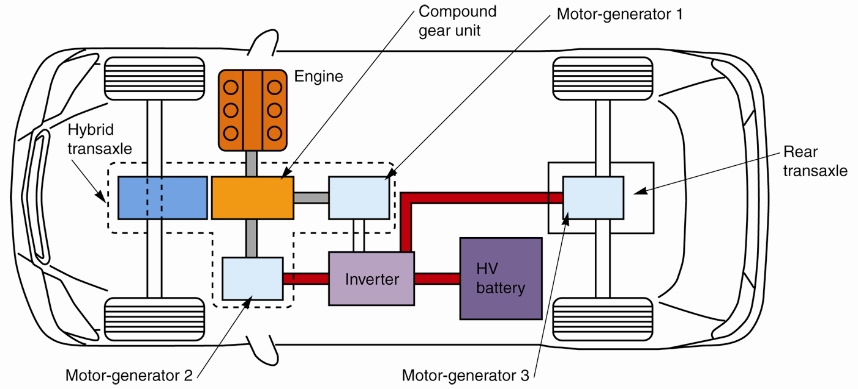
Triple Motor-Generator Hybrids (Cont.)

Slide 38
Power Splitter
Hybrid power splitter
  Planetary gearset used to control transfer of power through hybrid drive train
With transaxle, under computer control

Slide 39
HV Power Control Module
Feeds voltage between HV battery and motor-generator
Controls amount of ac or dc (0 to 200 amps) flowing through high-voltage power cables
Controls speed and torque of motor-generator by varying ac frequency and ac phase shift

Slide 40
HV Power Control Module (Cont.)
Located next to HV battery, on transaxle, or on top of engine
Contains
  Converter circuit
    Can step dc voltage up or down
  Inverter circuit
    Changes dc to ac and ac to dc

Slide 41
Hybrid Control Module
Controls inverter and converter circuits to efficiently operate motor-generator(s)
Responds to control signals from other control modules
Controls HV PCM to keep HV battery operating at optimum temperature and state of charge
Increases battery service life and fuel economy

Slide 42
Hybrid Rotor Sensor
Measures armature speed and position to control ac phase shift
  Controls motor torque and speed

Slide 43
HV Power Cables
Transfer extremely high voltage and current levels to components of electric drive system
Heavily insulated to prevent voltages from shorting to ground
Two large HV power cables connect battery pack to HV PCM
Three more large power cables connect HV PCM to motor-generator

Slide 44
Hybrid Ground Fault Interrupter
Constantly monitors system for high-voltage leakage into the vehicle’s metal chassis
If high voltage from HV battery or motor-generator is shorting to ground
  HV PCM
    Illuminates warning light
    De-energizes main power relays (contactors)
    Disconnects HV battery from its drive circuit

Slide 45
Impact Sensors
Impact sensors or inertia switches open during severe impact
  Open high-voltage circuits
  Disable electric fuel pumps for internal combustion engine
  Deploy air bags

Slide 46
Hybrid Dash Display
Combination meter
  Displays variables pertinent to performance and condition of internal combustion engine and electric drive system
Hybrid drive ready light
  Blinks at startup, stays on when electric drive engaged

Slide 47
Hybrid Dash Display (Cont.)
Hybrid master warning light
  In combination meter
  Warns for problems in any part of drive train
Battery pack warning light
  In instrument cluster
  Illuminates to signal driver about battery pack problems

Slide 48
Hybrid Dash Display (Cont.)
Malfunction indicator light (MIL)
  Turns on when any control module detects vehicle malfunction
Hybrid power display
  Informs driver of hybrid drive operating conditions

Slide 49
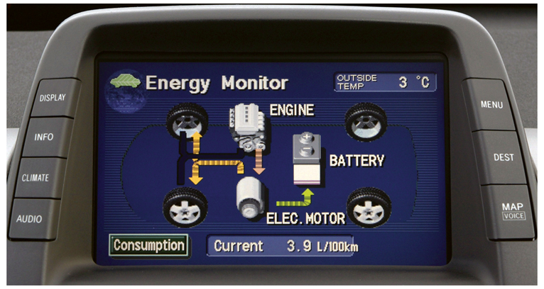
Hybrid Power Display
(Toyota)

