Slide 1
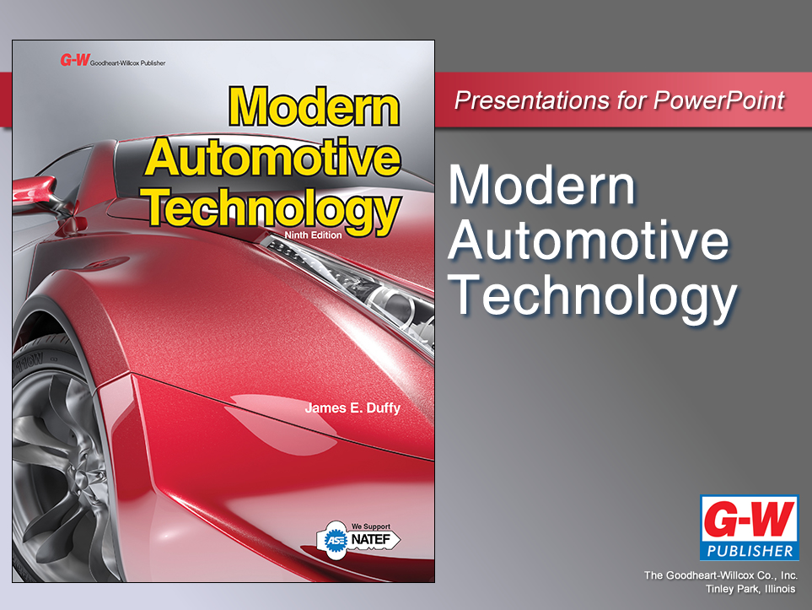

Slide 2
28
Chapter
12-Volt and HV Battery Technology

Slide 3
Objectives
After studying this chapter, you will be able to:
Describe the operation of a basic battery cell.
Summarize the functions of all types of automotive batteries.
Explain the construction of a 12-volt battery and how it operates in a car engine.
Compare battery terminals and connection types.

Slide 4
Objectives
Summarize typical 12-volt and HV battery types and ratings.
Explain how temperature affects battery performance.
Summarize the operation of both a fuel cell and a flywheel generator.
Describe the role of capacitor banks in battery operation.

Slide 5
Objectives
Correctly answer ASE certification test questions that require a basic knowledge of chemical/ electrical and mechanical/electrical storage devices.

Slide 6
12-Volt and HV Battery Technology
Introduction
Conventional vehicles use 12-volt lead-acid battery
Hybrid vehicles use high-voltage nickel metal hydride or lithium-ion battery producing 100–300 V
HV battery has 50 kilowatts of potentially deadly energy
Good technicians fully understand both 12-volt and HV batteries

Slide 7
Battery Principles
12-volt battery
Electrochemical device that produces and stores electricity
All batteries produce direct current (dc)
It changes chemical energy into electrical energy
  Current and electrons flowing out of cells

Slide 8
Battery Principles (Cont.)
During charging, battery converts electrical energy back into chemical energy
  Current flowing back into cells from charging system
  Energy is stored for extended periods

Slide 9
Battery Principles (Cont.)
Battery cycling
  Time between discharging and charging battery cells
Deep cycling
  Going from very low charge to full charge
  Can shorten service life of 12-volt battery
Load
  Current-using device
  Connected to simple battery cell, current will flow through load

Slide 10
Basic Battery Cell
Metal-acid battery cell consists of
  Negative plate
  Positive plate
  Container
  Electrolyte (liquid sulfuric acid)
Electrolyte usually acidic lithium paste or gel in HV battery cells

Slide 11
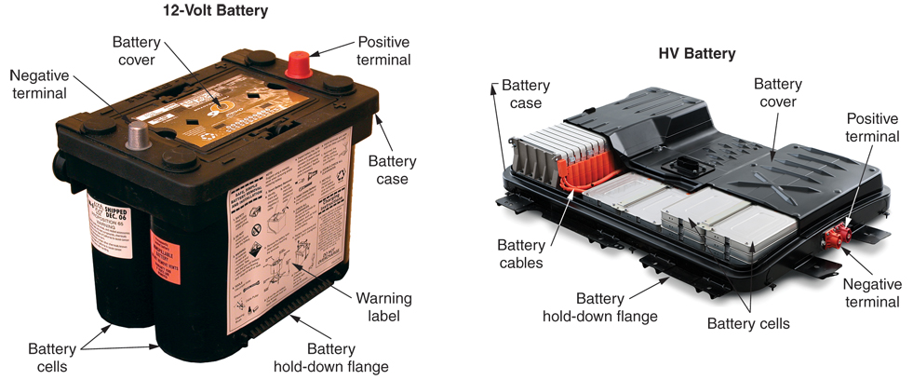
Basic Battery Cell (Cont.)
(Nissan)

Slide 12
Basic Battery Cell (Cont.)
Current equalizes difference in voltage potential on two cell plates
  Excess electrons move from negative to positive plate
    To cancel out difference in potential
  With enough current flow, electrolyte changes into water
  Complete discharge of plates results in dead battery

Slide 13
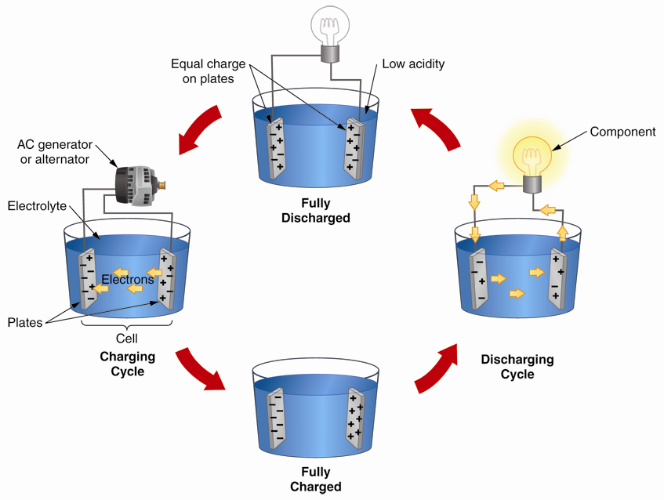
Basic Battery Cycling

Slide 14
Battery Functions
Operate starting motor, ignition system, electronic fuel injection system, and other electrical devices during engine cranking and starting
Supply all electrical power, even propulsion, when engine is not running
Store electrical energy for extended periods

Slide 15
Battery Functions (Cont.)
Provides electricity to instrumentation and circuits with vehicle stopped and internal combustion engine not running
Act as capacitor or filter that produces smoother dc than alternator or motor-generator
Sends filtered dc throughout electrical system

Slide 16
12-Volt Batteries
Most vehicles still use conventional 12-volt battery and main electrical system
12-volt battery
  Six cells
  Open circuit voltage of 12.6 volts
Some large diesel pickup trucks use two 12-volt batteries connected in parallel
  Output voltage stays the same
  Current output doubles

Slide 17
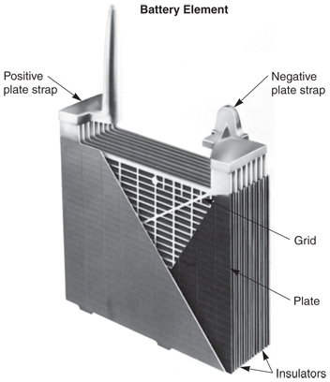
12-Volt Battery Construction
Battery Cell
Positive plates
Negative plates
Battery straps or connectors
Separators
Battery case
Electrolyte
  Battery acid
(Gould)

Slide 18
Battery Cell
Battery plates
  Made of grid coated with porous lead
  Calcium or antimony is normally added to lead to increase performance and decrease gassing
Gassing
  Conversion of water in electrolyte into hydrogen and oxygen
  Gases escape from top of battery resulting in loss of water

Slide 19
Battery Cell (Cont.)
Battery straps, or connectors
  Run along upper part of battery case to connect plates
Separators
  Fit between plates to keep them from touching and shorting

Slide 20
Battery Case, Cover, and Caps
Battery case
  Made of high quality plastic
  Holds elements and electrolyte
Battery cover
  Bonded to top of battery case and seals case’s top
Battery caps
  Snap into holes in battery cover
  Keep electrolyte from splashing out of battery

Slide 21
Electrolyte
Electrolyte, often called battery acid
  Mixture of sulfuric acid and distilled water
Poured into each cell until plates are covered
Distilled water used in 12-volt batteries because it does not contain impurities

Slide 22
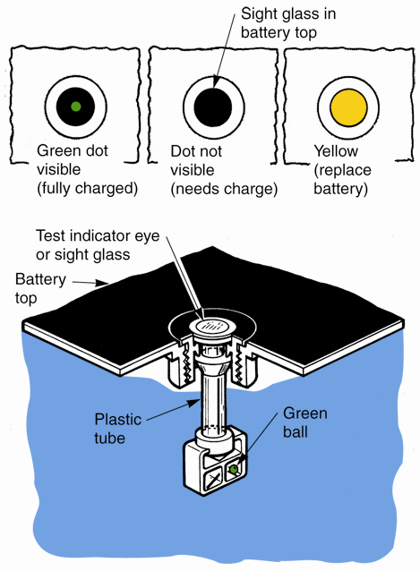
Battery Charge Indicator
Also called battery eye or test indicator
Shows general charge condition of 12-volt battery
(Chrysler)

Slide 23
Battery Terminals
Connect battery plates to electrical system
Battery posts
  Round metal terminals that extend through top of battery cover
Side terminals
  Electrical connections located on battery side

Slide 24
Battery Terminals (Cont.)
Positive post
  Larger than negative post
  May be marked with red paint
  Has positive (+) symbol on or near it
Negative post
  Smaller than positive post
  May be black or green in color
  Normally has negative (–) symbol on or near it

Slide 25
12-Volt Battery Cables
#10 gage to #1 gage copper conductor with plastic insulation and metal terminals
  Post clamping terminal, side bolt terminal, eye terminal
Positive battery cable
  Normally red and fastens to starter solenoid
Negative battery cable
  Usually black and connects to ground on engine block or frame

Slide 26
Battery Tray and Retainer
Hold 12-volt battery securely in place
Keep battery from bouncing around during vehicle movement
Retainer, or battery hold-down
  Consists of special bracket and fasteners that hold battery in its tray

Slide 27
Battery Tray and Retainer (Cont.)
Battery temperature sensor
  Monitors battery temperature
  May be housed in battery tray
Battery heat shields
  Designed to keep excess engine heat from damaging battery

Slide 28
12-Volt Battery Types
Maintenance-free battery
  Does not use removable filler caps
Gel battery
  Does not contain liquid electrolyte
Absorbed glass mat or AGM battery
  Contains fiber matting that absorbs liquid electrolyte and holds it between battery plates

Slide 29
12-Volt Battery Ratings
Cold cranking rating
  Current (A) battery can deliver for 30 seconds at 0°F (–18°C), while maintaining terminal voltage of 7.2 volts (1.2 volts per cell)
Reserve capacity rating
  Time needed to lower 12-volt battery terminal voltage below 10.2 volts (1.7 volts per cell) at discharge rate of 25 A

Slide 30
12-Volt Battery Ratings (Cont.)
Amp-hour rating
  Measurement of how much current battery can produce for 20 hours at 80°F (27°C) with battery voltage staying above 10.5 volts

Slide 31
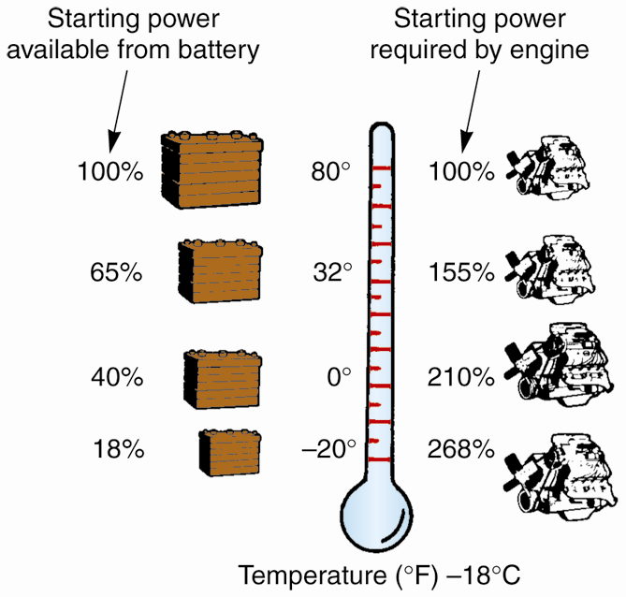
Battery Temperature and Efficiency
As temperature drops, battery power is reduced
Motor oil gets thick
Amount of current and torque needed increases
At 0°F (–18°C), a battery has only 40% of its normal cranking power

Slide 32
HV Batteries
Also called battery stack or battery bank
Store chemical-electrical energy for starting internal combustion engine
For full electric propulsion
In some cases, provide 12–15 volts dc for electrical accessories and conventional electric circuits

Slide 33
HV Batteries (Cont.)
Three major stages of development
  First generation hybrid electric drives
  True high-voltage electric driveline
  Lithium-ion (Li-ion) HV batteries
Dual voltage system
  12 volts for conventional electrical/electronic circuits
  High voltage (HV) for double ought (00) conductors and HV motor-generator

Slide 34
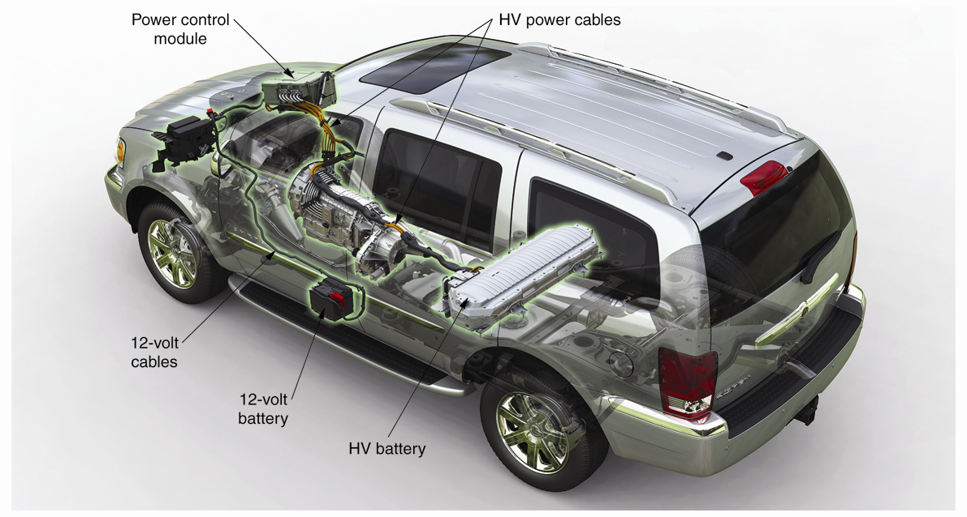
Dual Voltage System
(Dodge)

Slide 35
HV Battery Construction
HV battery
  Normally mounted in chassis rear, often behind or under rear seat or in trunk area
Economy vehicles have only one large HV battery
Larger, full-size vehicles and full-electric-drive vehicles can be equipped with two or three HV batteries

Slide 36
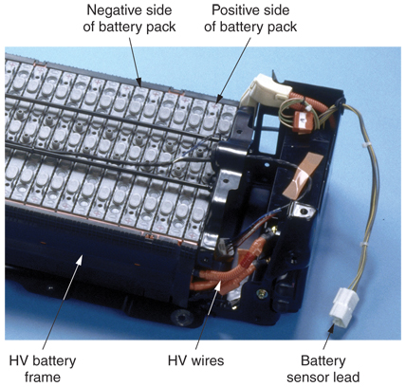
HV Battery Construction (Cont.)
Made of many small battery cells inside several battery packs
Wired in series to produce a high-voltage and current
Hybrid battery cell
  Individual rechargeable battery
(Toyota)

Slide 37
Battery Cells
Each NiMH or lithium-ion cell generates about 1.2–1.6 volts dc
Individually sealed to hold semi-solid electrolyte (acid paste or gel) around positive and negative plates
Soldered or mechanically fastened to adjacent cells in series

Slide 38
Battery Cells (Cont.)
Intercalation
  Electrons or protons migrate from positive plate to negative plate and become embedded in porous electrode materials

Slide 39
HV Battery Pack
Set of low-voltage battery cells wired in series
HV battery has approximately 30–40 individual battery packs
Even more for all-electric vehicles

Slide 40
Battery Packs
Battery pack voltage
  7.2–9.2 volts, depending on number and types of cells
Banks of battery packs wired in series to produce anywhere from 100–300 volts dc
Battery pack fuses
  Protect against shorts and excessive current draw from each group of cells

Slide 41
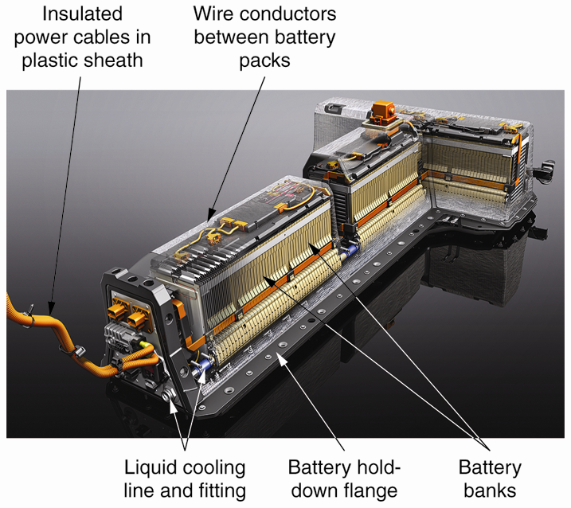
Battery Cover and Frame
HV battery cover
  Usually made of plastic
  Encloses and protects individual battery packs
HV battery frame
  Holds battery packs together
  Flange on frame provides secure mounting
(General Motors)

Slide 42
HV Battery ECM
HV Battery ECM
  Electronic control circuit that reads signals from HV battery temperature and voltage sensors to prevent battery overheating
  Can activate air, water, or refrigerant cooling systems
HV battery temperature sensors
  Protect against battery thermal and overcharging damage

Slide 43
HV Power Cables
Large conductors (00 or 000 AWG) coated with bright-orange plastic insulation
HV battery cables
  Connect dc to HV power control module
HV motor-generator cables
  Connect three-phase ac from power control module to motor-generator

Slide 44
HV Battery Ratings
HV battery nominal operating voltage
Maximum dc voltage available from HV battery
HV battery peak power rating
Rated in kilowatts (thousands of watts)
Determines how much current can be fed to HV motor for short period of time

Slide 45
HV Battery Ratings (Cont.)
HV battery continuous power rating
  Voltage and current safely generated before battery is fully discharged
HV battery amp-hour rating
  Compares power available for one hour of continuous discharge
  Equivalent of cold cranking rating

Slide 46
HV Capacitor Banks
HV capacitor banks
  Storage devices for electrical energy that do not require electrolyte or battery acid
Wired in series to aid electric-drive vehicle acceleration

Slide 47
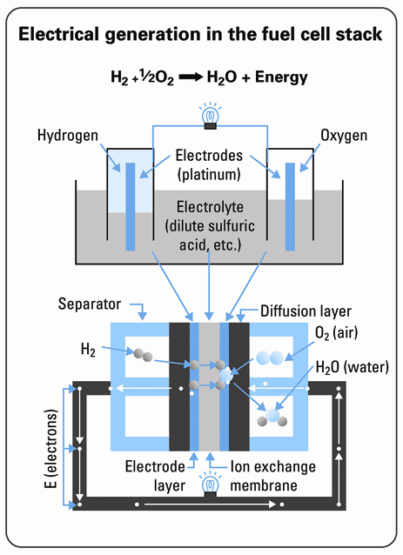
Fuel Cells
Similar to batteries
Require outside fuel source, usually hydrogen, to generate electricity
Fuel cell contains
  Positive plate (anode)
  Negative plate (cathode)
  Electrolyte
(Honda)

Slide 48
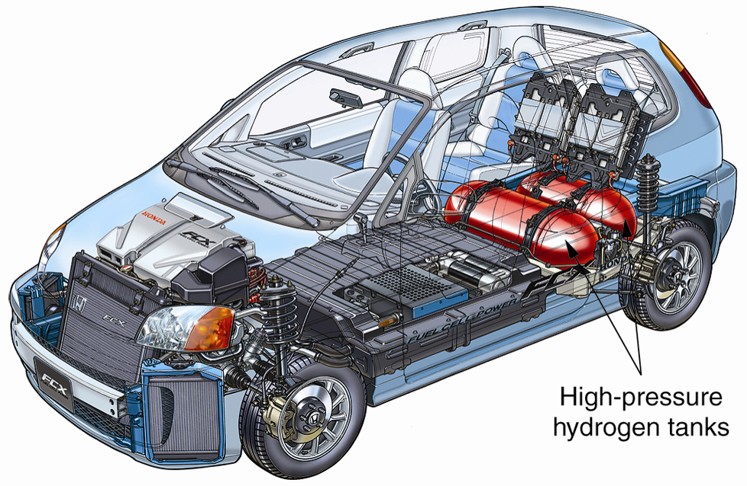
Fuel Cell Hybrid
(Honda)

Slide 49
Flywheel Generator
Also called flywheel battery
Uses kinetic energy of high-speed ac armature (flywheel) to store electrical energy
Motor-generators serve as electric brakes to slow car while producing three-phase ac to feed to flywheel generator stator windings

