Slide 1
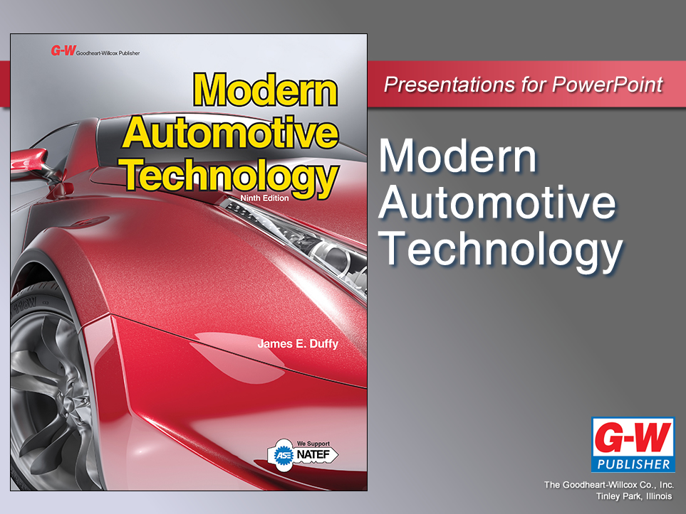

Slide 2
75
Chapter
Suspension System Technology

Slide 3
Objectives
After studying this chapter, you will be able to:
Identify the major parts of a suspension system.
Describe the basic function of each suspension system component.
Compare the various types of suspension systems.

Slide 4
Objectives
Explain the operation of the four common types of springs.
Explain automatic suspension leveling systems.
Correctly answer ASE certification test questions requiring a knowledge of suspension system construction and design.

Slide 5
Suspension System Technology
Introduction
Suspension system
  Allows vehicle’s tires and wheels to move up and down over bumps and holes in road
  Makes vehicle ride more smoothly
Works in unison with tires, unibody or frame, wheels, wheel bearings, brake system, and steering system to provide safe and comfortable means of transportation

Slide 6
Functions of a Suspension System
Supports weight of frame, body, engine, transmission, drive train, and passengers
Provides smooth, comfortable ride by allowing wheels and tires to move up and down with minimum movement of vehicle body
Allows rapid cornering without extreme body roll
Keeps tires in firm contact with road, even after striking bumps or holes in road

Slide 7
Functions of a Suspension System
(Cont.)
Prevents excessive body squat when accelerating or heavily loaded
  Body tilts down in rear
Prevents excessive body dive when braking
  Body tilts down in front
Allows front wheels to turn from side to side for steering
Works with steering system to help keep wheels in correct alignment

Slide 8
Basic Suspension System
Basic parts of suspension system
Control arm
  Movable lever that fastens steering knuckle to vehicle’s body or frame
Steering knuckle
  Provides spindle or bearing support for wheel hub, bearings, and wheel assembly
Ball joint
  Movable connection that allows control arm to move up and down and steering knuckle to swivel from side to side

Slide 9
Basic Suspension System (Cont.)
Suspension spring
  Support vehicle weight and permit control arm and wheel to move up and down
Shock absorber or damper
  Helps keep suspension from continuing to bounce after spring compression and extension
Control arm bushing
  Sleeve that allows control arm to swing up and down on frame

Slide 10
Types of Suspension Systems
Suspension systems grouped into two broad categories
Independent suspension
  Allows one wheel to move up and down with minimal effect on other wheels
Nonindependent suspension
  Has both right and left wheels attached to same solid axle

Slide 11
Understeer and Oversteer
Understeer
  Means that vehicle is slow to respond to steering changes in a turn
Oversteer
  Means that rear tires try to skid around sideways in sharp or hard turn
Perfect suspension system provides neutral steering
  All four wheels have equal traction in turns

Slide 12
Lateral Acceleration
Amount of side force vehicle can handle before tires lose traction and skid in sharp turn
Measured in units of gravity, or “g-force,” usually on skidpad
Skidpad
  Round or circular driving course
Higher the “Gs,” the better

Slide 13
Suspension System Springs
Suspension system springs must jounce and rebound as vehicle travels over bumps and holes in road surface
  Compress and extend
Springs must support weight of vehicle while still allowing suspension travel
  Movement

Slide 14
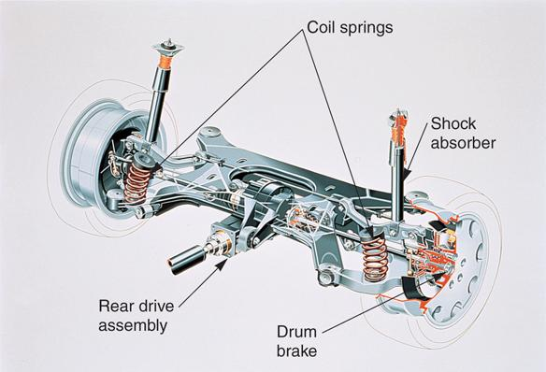
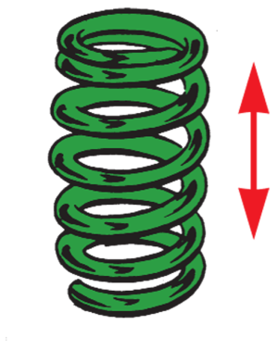
Coil Springs
Length of spring-steel rod wound into spiral
Most common type of spring found in modern suspension systems.
May be used on both front and rear of vehicle
(Audi)

Slide 15
Leaf Springs
Commonly made of flat plates or strips of spring steel bolted together
  A few are made of fiberglass
Although once used on front suspension systems, they are now limited to the rear of some cars

Slide 16
Leaf Springs (Cont.)
Shackle
  Fastens rear leaf spring eye to vehicle’s frame and allows spring to change length when bent
Insulators
  Synthetic rubber bushing and metal inserts that press-fit into leaf spring eyes
Leaf spring windup
  Causes rear leaf springs to flex when driving or braking forces are applied to suspension system

Slide 17
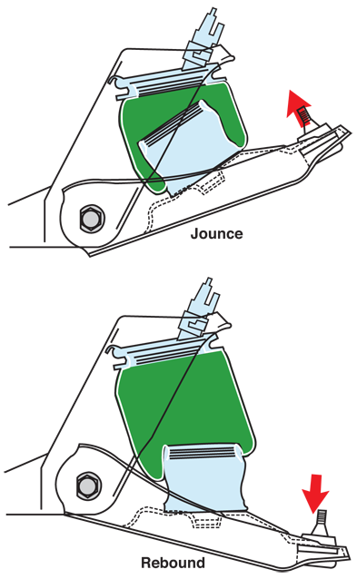
Air Springs
Typically two-ply rubber cylinder filled with air
End caps are formed on air spring for mounting
Air pressure in rubber cylinder gives unit spring action, similar to coil spring
(Ford)

Slide 18
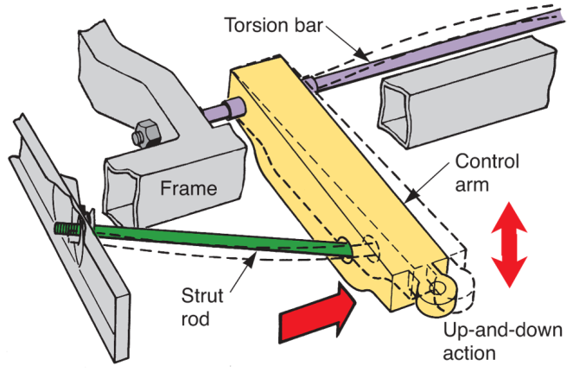
Torsion Bars (Springs)
Made of large spring-steel rod
Up-and-down movement of the suspension system twists torsion bar
Bar then tries to return to its original shape, moving control arm back into place
(Moog)

Slide 19
Suspension Spring Specifications
Spring rate
  Stiffness, or tension, of spring, determined by weight needed to bend and compress it
Sprung weight
  Weight of parts supported by springs and suspension system
Unsprung weight
  Weight of parts not supported by springs

Slide 20
Control Arms
Holds steering knuckle, bearing support, or axle housing in position as wheel moves up and down
Control arm bushings
  Act as bearings, allowing arm to swing up and down on shaft bolted to frame or suspension unit

Slide 21
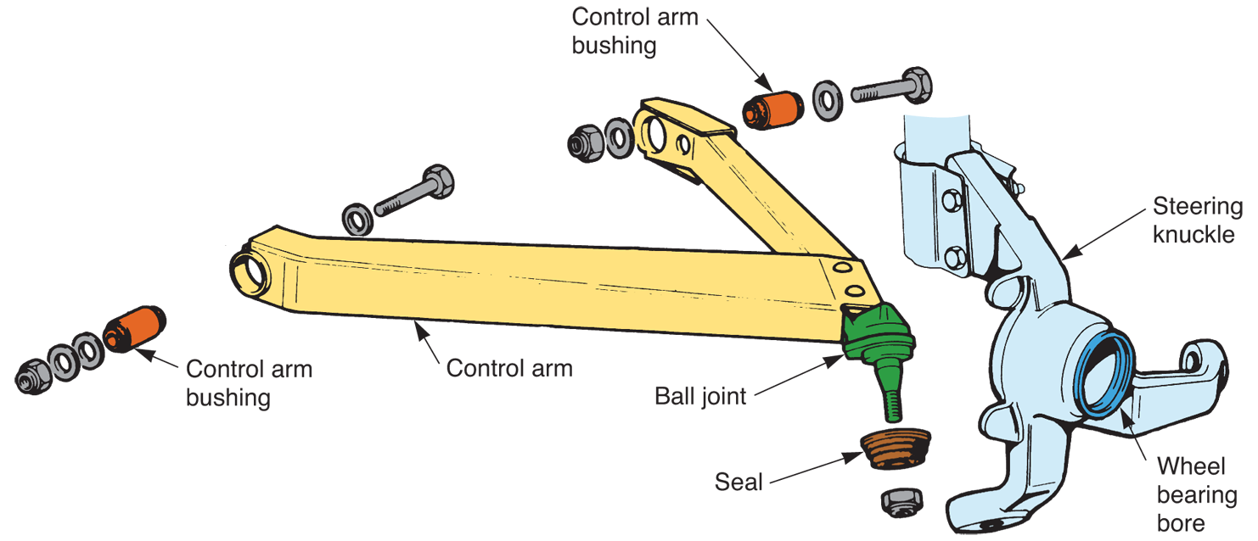
Control Arms (Cont.)
(Fiat)

Slide 22
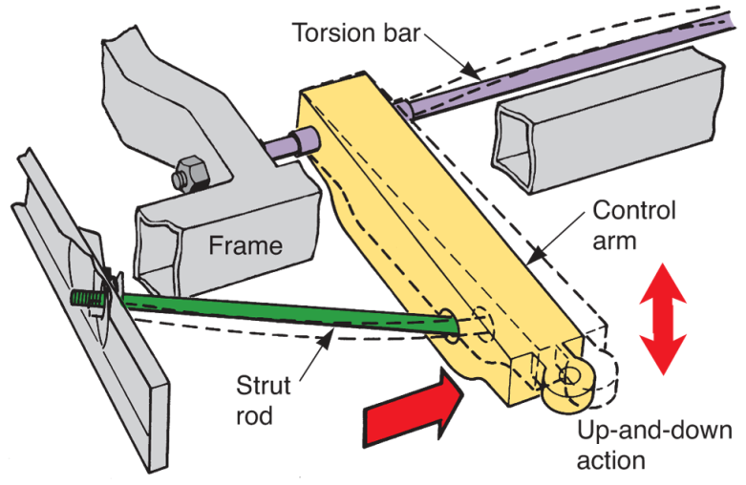
Strut Rod
Fastens to outer end of lower control arm and to unibody or frame
Keeps control arm from swinging toward front or rear of vehicle
(Moog)

Slide 23
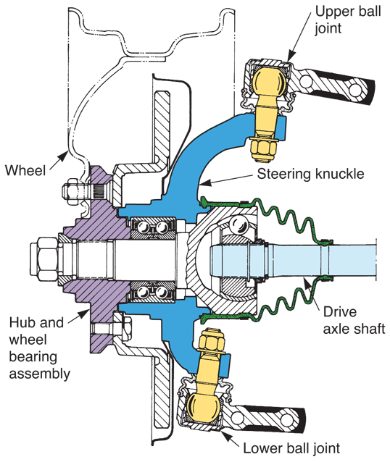
Ball Joints
Short for ball-and-socket joints
Connections that allow limited rotation in every direction
Connect outer ends of control arms to steering knuckle
(Chrysler)

Slide 24
Shock Absorbers
Limit spring oscillations to smooth vehicle’s ride
Oscillations
  Compression-extension movements
Without shock absorbers, vehicle would continue to bounce up and down long after striking dip or hump in road

Slide 25
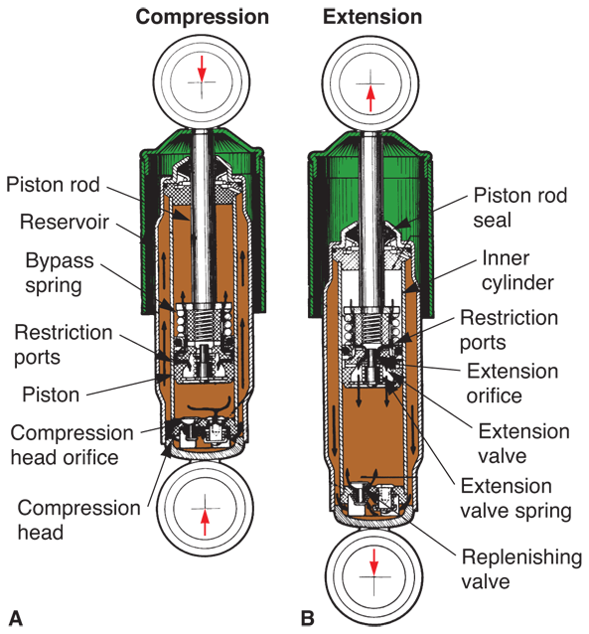
Shock Absorbers (Cont.)
Shock absorber compression
  Occurs when vehicle’s tire forces upward upon hitting a bump
Shock absorber extension
  Outward movement of piston and rod as control arm moves down
(Gabriel)

Slide 26
Shock Absorbers (Cont.)
Gas-charged shock absorbers
  Use low-pressure gas to help keep oil in shock from foaming
  Usually nitrogen gas
Self-leveling shock absorber
  Special design that causes hydraulic lock action to help maintain normal vehicle curb height

Slide 27
Shock Absorbers (Cont.)
Adjustable shock absorbers
  Provide means of changing shock stiffness
  By turning shock outer body or adjustment knob, you can set shock soft for smooth ride or stiff for better handling
  Some electronic suspension systems automatically change shock dampening stiffness with road and driving conditions

Slide 28
Strut Assembly
Consists of shock absorber, coil spring, and upper damper unit
Basic parts of typical strut assembly
Strut shock absorber
  Piston operating in oil-filled (or oil and gas) cylinder to prevent coil spring oscillations
Dust shield
  Metal shroud or rubber boot that keeps road dirt off shock absorber rod

Slide 29
Strut Assembly (Cont.)
Lower spring seat
  Lower mount formed around shock body for coil spring
Coil spring
  Supports weight of vehicle and allows suspension action
Upper spring seat
  Holds upper end of coil spring and contacts strut bearing

Slide 30
Strut Assembly (Cont.)
Strut bearing
  Ball bearing that allows shock-and-spring assembly to rotate for steering action
  Only used on front of vehicle
Rubber bumpers
  Jounce and rebound bumpers that prevent metal-to-metal contact during extreme suspension compression and extension

Slide 31
Strut Assembly (Cont.)
Rubber isolators
  Prevent noise from transmitting into body structure of vehicle
Upper strut retainer
  Secures upper end of strut assembly to frame or unibody
Strut rod nut
  Hex nut that holds shock absorber rod in upper strut retainer

Slide 32
Strut Assembly (Cont.)
Damper unit
  Shock that fits inside coil spring to prevent excessive jounce and rebound
Strut shock absorber
  Similar to conventional shock absorber
  Longer
  Provisions for mounting and holding steering knuckle or bearing support and spring

Slide 33
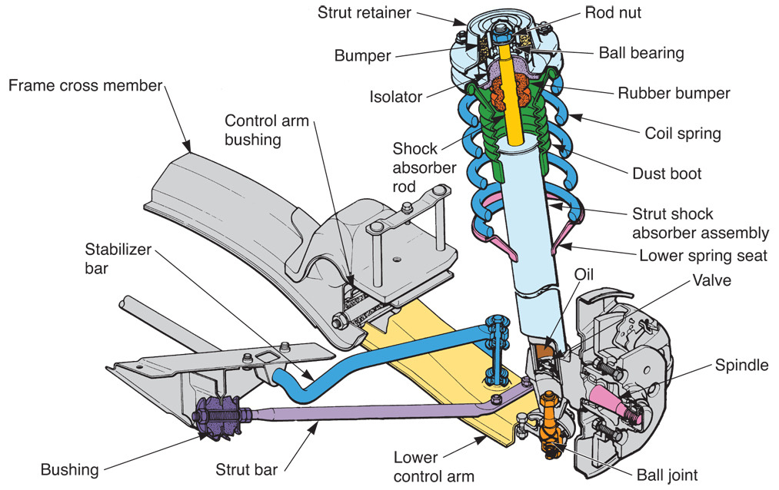
Strut Assembly (Cont.)
(Chrysler)

Slide 34
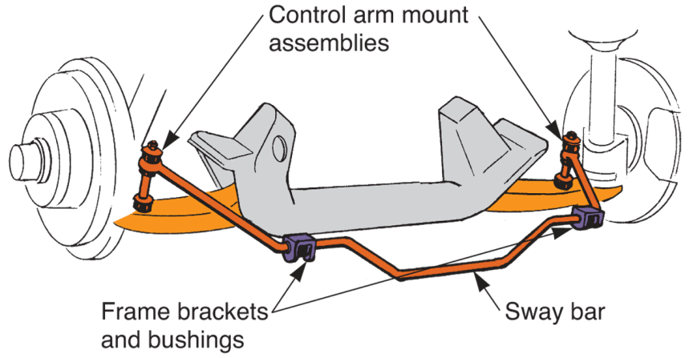
Sway Bar (Stabilizer Bar)
Keeps body from leaning excessively in sharp turns
Fastens to both lower control arms and to frame
Sway bar links connect sway bar to control arms
(Moog)

Slide 35
Track Rod (Lateral Control Rod)
Track rod or lateral control rod
  Sometimes used on rear suspension systems to prevent side-to-side axle movement during cornering
Track rod is almost parallel to rear axle
One end of rod is fastened to axle
Other end of rod is fastened to frame or body structure on opposite side of vehicle

Slide 36
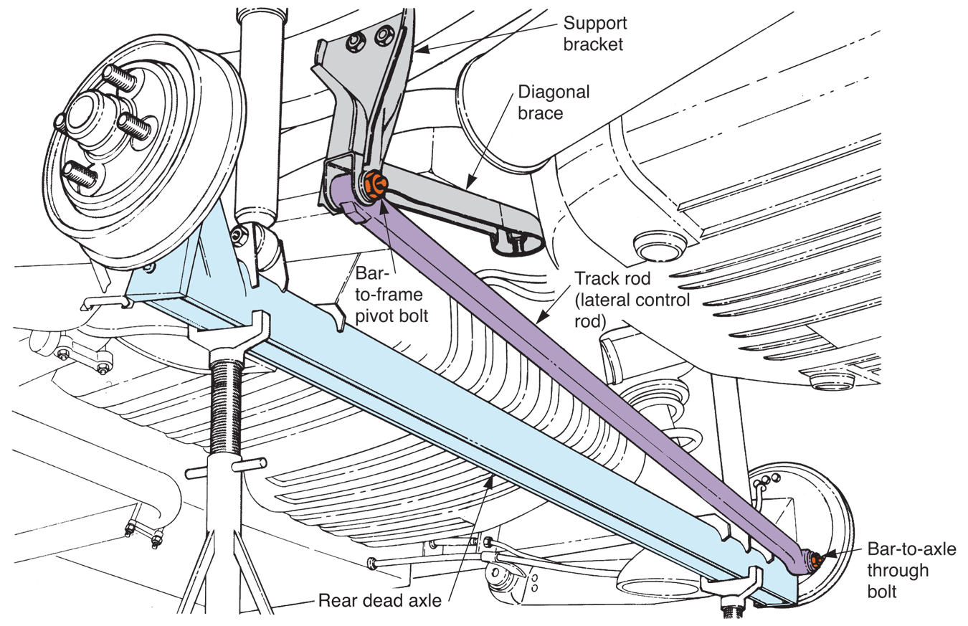
Track Rod (Lateral Control Rod)
(Cont.)
(Chrysler)

Slide 37
Jounce Bumpers
Blocks of hard rubber that keep suspension system parts from hitting the frame or body when car hits large bumps or holes
If you drive over a large hump in road too quickly, you will hear a loud thud or bang
Suspension arms hit the jounce bumpers
Warns driver that tires are leaving road surface

Slide 38
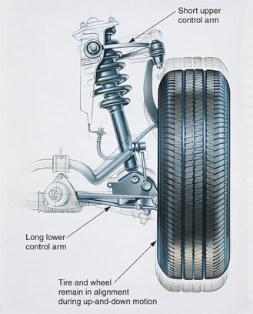
Long-Short Arm Suspension
Uses control arms of different lengths to keep tires from tilting with suspension action
Upper control arms are shorter than lower control arms
(Lexus)

Slide 39
Torsion Bar Suspension
Suspension system that contains torsion bar springs instead of coil springs
Most torsion bar suspensions allow easy adjustment of curb height
  Distance from road to specific point on car
By turning adjustment bolt, you can increase or decrease tension on torsion bar
  This either raises or lowers frame and/or body of vehicle

Slide 40
MacPherson Strut Suspension
Uses only one control arm and strut assembly to support each wheel assembly
Modified strut suspension has coil spring mounted on top of lower control arm, not around strut
Most common type of suspension found on late-model cars

Slide 41
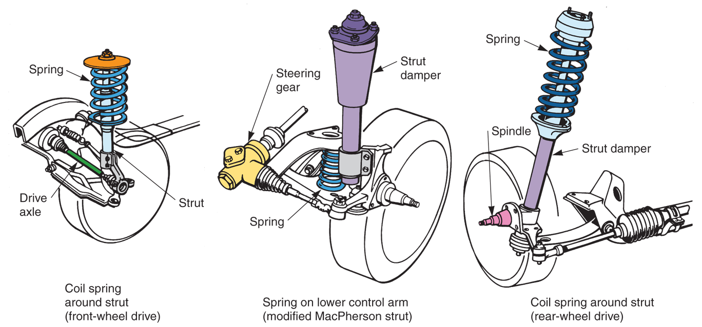
MacPherson Strut Suspension (Cont.)

Slide 42
Pickup Truck Suspension Systems
Pickup trucks use numerous suspension system designs
  Long-short control arm
  MacPherson strut
  Solid axle
  Twin axle suspension
    Or twin I-beam
Control arm and strut types are basically the same as those used on passenger cars but heavier and stronger

Slide 43
Rear Suspension Systems
Similar to front suspension systems, but normally, do not provide for steering
With rear-wheel drive vehicle, rear axle housing may be solid, resulting in nonindependent suspension
Rear swing axles and independent suspension can be used

Slide 44
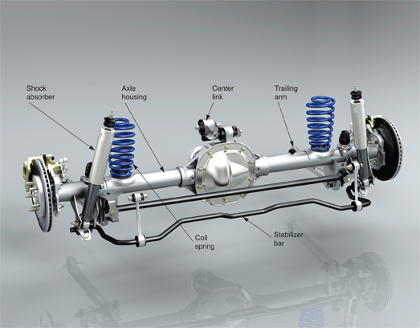
Rear Suspension Systems
(Cont.)
(Ford)

Slide 45
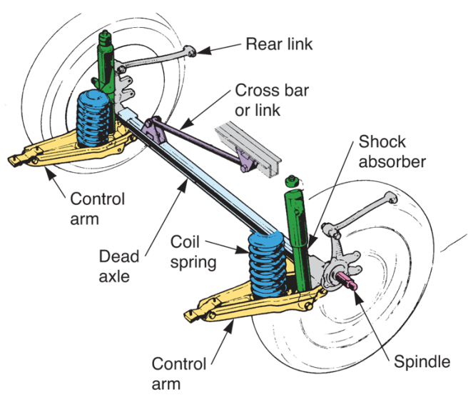
Dead Axle
Solid rear axle on front-wheel drive vehicle
Front wheels transfer driving power to road
Rear axle is simply straight, or solid, axle
(Saab)

Slide 46
Semi-Independent Suspension
Right and left wheels are partially independent of each other
This type of suspension uses flexible axle
Since axle can flex or twist, effect on other tire is minimized

Slide 47
Independent Rear Suspension
Independent suspension
  Increases ride smoothness and cornering capabilities
Variations of this design can be used with either front- or rear-wheel drive vehicle

Slide 48
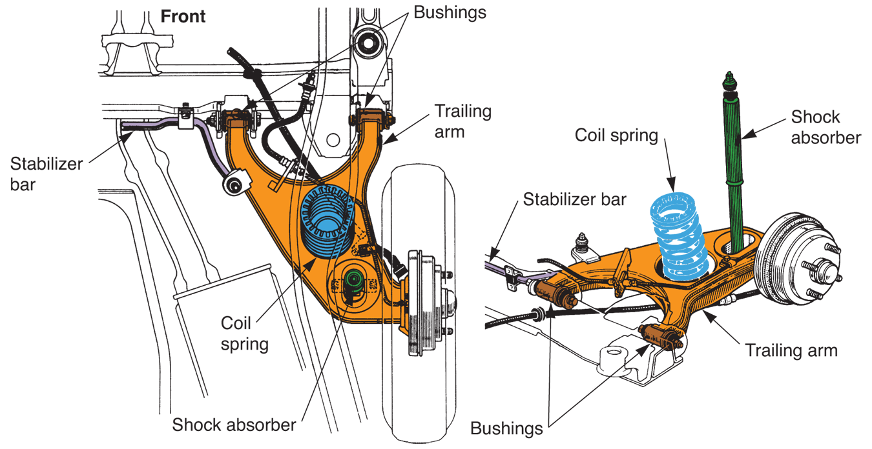
Trailing-Arm Independent Rear Suspension
(Toyota)

Slide 49
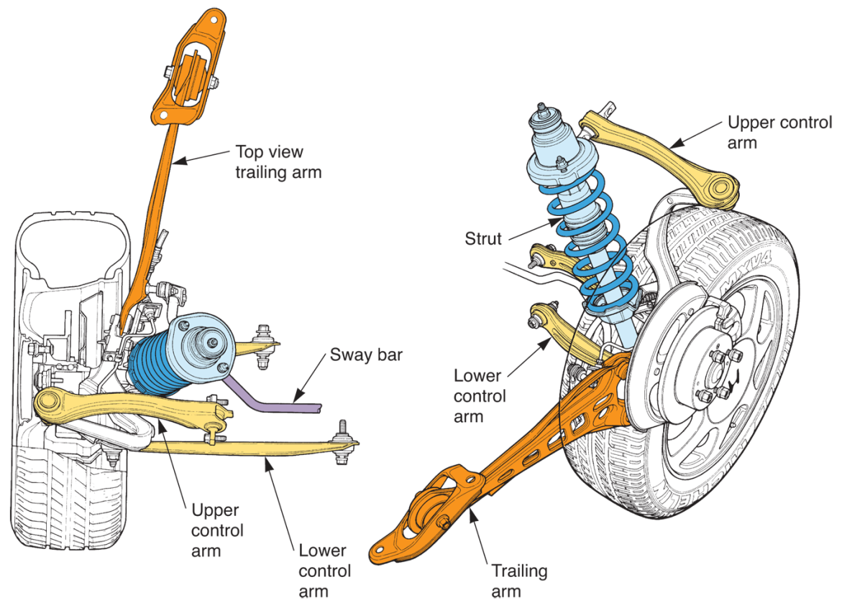
Double Wishbone Suspension
(Honda)

Slide 50
Suspension Leveling Systems
Maintains ride height and vehicle attitude
Attitude
  Height ratio between front and rear of body
Manual suspension leveling system
  Air shocks and electric compressor counteract changes in passenger and luggage weight

Slide 51
Suspension Leveling Systems
(Cont.)
Automatic suspension leveling systems
  Air shocks or air springs, height sensors, and compressor to maintain curb height
Electronic height control system
  Height sensors and electronic control module control operation of small electric air compressor, which maintains correct ride height

Slide 52
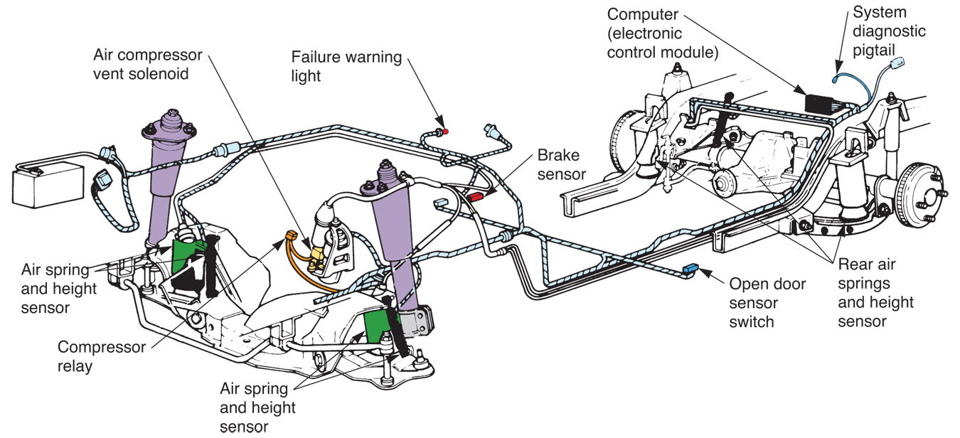
Suspension Leveling Systems
(Cont.)
(Ford)

Slide 53
Electronic Height Control System
Main parts include
Height sensor
  Lever operated switch that reacts to changes in body height and suspension movement
Compressor assembly
  Motor-powered air pump that produces pressure for system

Slide 54
Electronic Height Control System
(Cont.)
Pressure lines
  Air hoses that connect compressor to air shock absorbers
Air shocks
  Air-filled shock absorbers act on suspension system to alter ride height
Sensor link
  Linkage rod that connects height sensor to suspension

Slide 55
Electronic Height Control System
(Cont.)
Solenoid valve
  Solenoid-operated air valve that can release air pressure from system
Suspension control module
  An ECM or small computer that operates solenoid valve by responding to signals from height sensor

Slide 56
Electronic Suspension System
Various sensors, computer, and shock absorber actuators control ride stiffness
Major components include
Steering sensor
  Detects steering wheel rotational direction and speed, and feeds data about vehicle direction to computer

Slide 57
Electronic Suspension System
(Cont.)
Brake sensor
  Uses brake light switch to report when brakes are applied
Acceleration sensor
  Throttle position sensor and accelerator pedal sensor are used to detect when car is accelerating rapidly

Slide 58
Electronic Suspension System
(Cont.)
Mode switch
  Dash-mounted switch that allows driver to choose desired shock action or stiffness, and sometimes ride height
Electronic control module
  Small computer that uses sensor inputs to control shock actuators
Shock actuators
  Solenoid-operated valves that control fluid flow inside shock absorbers

Slide 59
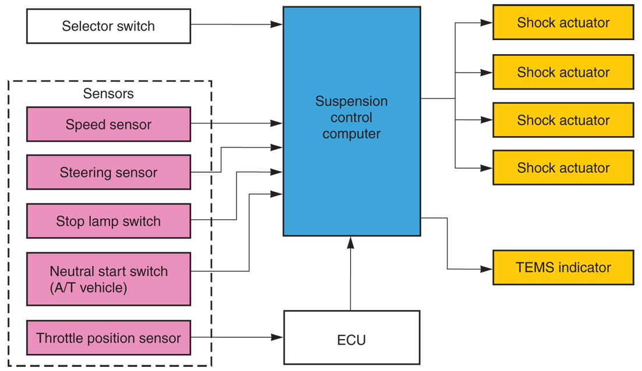
Electronic Suspension System
(Cont.)
(Toyota)

Slide 60
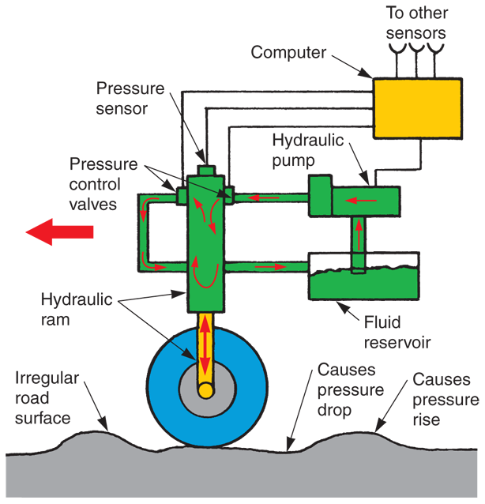
Active Suspension System
Computer-controlled hydraulic rams control ride characteristics
Fully active suspension is called “intelligent suspension” because hydraulic system is computer-controlled

