Slide 1
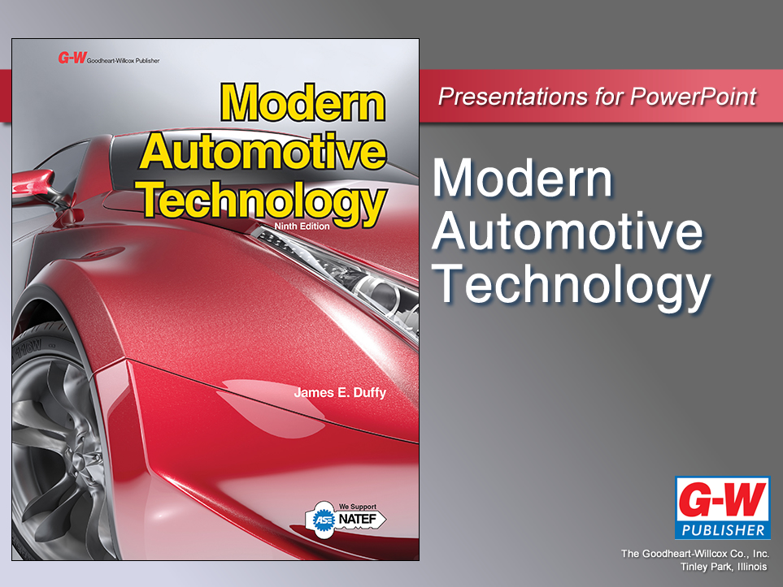

Slide 2
77
Chapter
Steering System Technology

Slide 3
Objectives
After studying this chapter, you will be able to:
Explain the operating principles of steering systems.
Identify the major parts of a steering system.
Compare the differences between a linkage steering and a rack-and-pinion steering system.

Slide 4
Objectives
Describe the operation of hydraulic and electric-assist power steering systems.
Explain the operation of four-wheel steering systems.
Correctly answer ASE certification test questions requiring a knowledge of modern steering system designs.

Slide 5
Functions of a Steering System
Provides precise control of front-wheel direction and, sometimes, rear-wheel direction
Maintains correct amount of effort needed to turn wheels
Transmits road feel to driver’s hands
  Slight steering wheel pull caused by road surface irregularities

Slide 6
Functions of a Steering System
(Cont.)
Absorbs most of shock going to steering wheel as tires hit bumps and potholes in road
Allows for suspension action with minimal effect on direction and alignment of vehicle’s front wheels

Slide 7
Basic Steering Systems
Two basic kinds of steering systems
Linkage steering systems
  Found on large, full-size pickup trucks and full-size vans, both two- and four-wheel drive
Rack-and-pinion steering systems
  Lighter and better for passenger cars and small trucks
Each type may be operated manually or with power assist

Slide 8
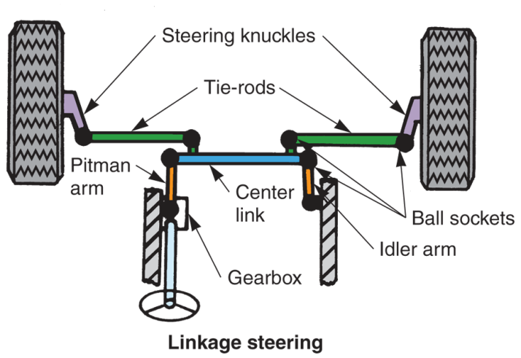
Basic Steering Systems
(Cont.)

Slide 9
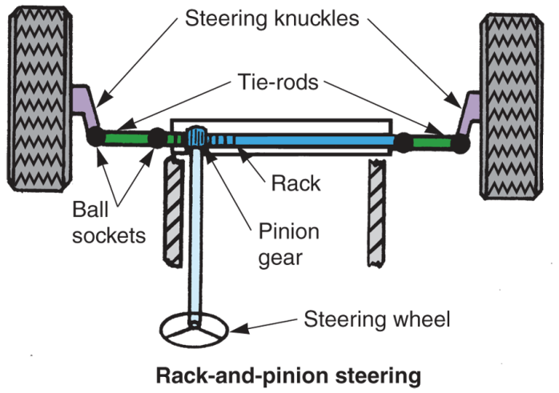
Basic Steering Systems
(Cont.)

Slide 10
Basic Linkage Steering
Parts that make up linkage steering system
Steering wheel
  Used by driver to rotate steering shaft that passes through steering column and firewall
Steering shaft
  Long steel shaft that transfers turning motion from steering wheel to steering gearbox

Slide 11
Basic Linkage Steering
(Cont.)
Steering column
  Hollow tube that supports steering wheel and steering shaft
Steering gearbox
  Changes turning motion into straight-line motion for moving steering knuckles

Slide 12
Basic Linkage Steering
(Cont.)
Steering linkage
  Connects steering gearbox to steering knuckles and wheels
Ball sockets
  Grease-filled swivel joints that allow linkage arms to swivel up and down and from left to right

Slide 13
Basic Rack-and-Pinion Steering
Also uses steering wheel, steering column, and steering shaft
Other major components
Steering pinion gear
  Small gear is rotated by steering wheel and steering shaft
  Its teeth mesh with teeth on the rack

Slide 14
Basic Rack-and-Pinion Steering
(Cont.)
Rack
  Long steel bar with teeth along one section
  Slides sideways as pinion gear turns
Gear housing
  Holds pinion gear and rack
Tie-rods
  Steel rods with swivel sockets on each end that connect rack with two front steering knuckles

Slide 15
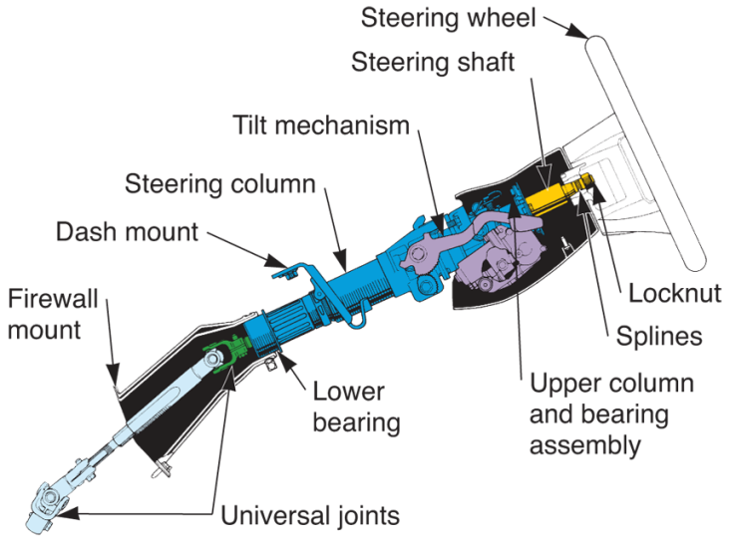
Steering Column Assembly
Steering wheel
Steering shaft
Column (outer housing)
Sometimes
Ignition key mechanism
Flexible coupling
Universal joint
(Lexus)

Slide 16
Ignition Lock and Switch
Ignition lock and switch mechanism are mounted on steering column in most vehicles
Ignition lock mechanism
  Normally on top, right-hand side of column
Ignition switch
  Usually bolted inside steering column

Slide 17
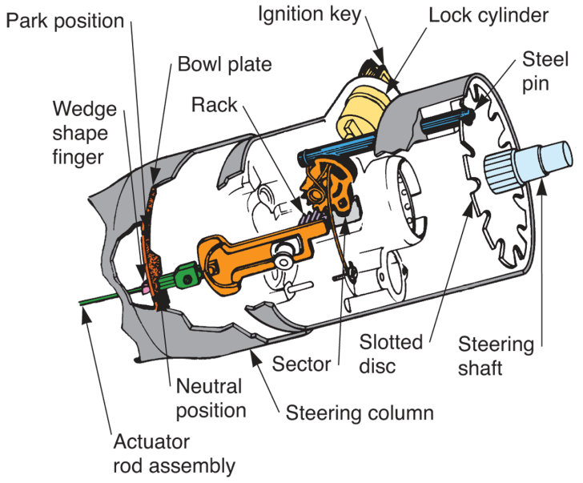
Locking Steering Wheel
To help prevent theft, late-model vehicles have locking steering wheel
When ignition key is off, steering wheel cannot be turned

Slide 18
Collapsible Steering Column
Several types of collapsible steering columns
  Steel mesh columns
    Crushing
  Tube-and-ball columns
    Sliding
  Shear capsule columns
    Break and slide
In all types, column is made up of two pieces

Slide 19
Tilt Steering Columns
Tilt steering column or tilt steering wheel
  Has flex joint, or U-joint, that allows top half of column and steering wheel to be positioned at different angles
Manual tilt column
  Uses lever on steering column to unlock flex joint so wheel can move up or down

Slide 20
Tilt Steering Columns (Cont.)
Power tilt column
  Uses small electric motor, control switch, and gear mechanism to change steering wheel angle or height
Memory tilt wheels
  Use tilt control module to “remember” more than one steering wheel position

Slide 21
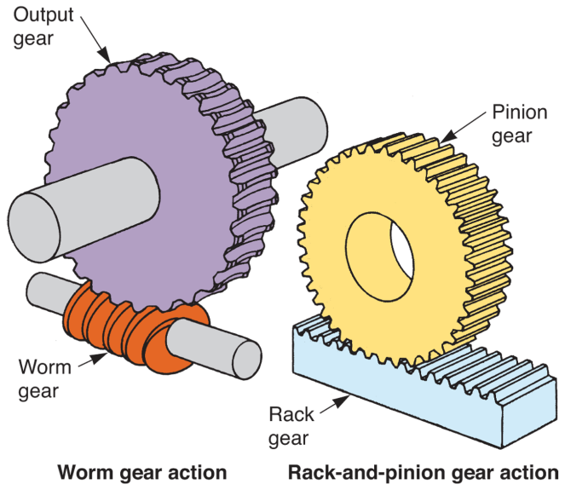
Steering Gear Principles
Large pickup trucks sometimes use worm-type steering gear assembly
Modern passenger cars normally use lighter, less complex rack-and-pinion system
(Deere & Co.)

Slide 22
Recirculating-Ball Gearbox
Used with linkage steering system
Has small steel balls that circulate between gear members
Worm shaft
  Input gear connected to steering column shaft
  Balls fit and ride in grooves in worm gear

Slide 23
Recirculating-Ball Gearbox (Cont.)
Sector shaft
  Output gear from steering gearbox
  Transfers motion to steering linkage
Ball nut
  Rides on ball bearings and worm gear
Ball guides
  Route extra ball bearings in and out from between worm and ball nut

Slide 24
Recirculating-Ball Gearbox (Cont.)
Adjusting nut
  Provided to set worm shaft bearing preload
Adjusting screw
  Sets sector shaft clearance
Gearbox housing
  Provides enclosure for other components
End cover
  Bolts on housing to cover end of sector gear

Slide 25
Gearbox Ratio (Steering Gear Reduction)
Gearbox ratio, steering ratio, or steering gear reduction
  Comparison between steering wheel rotation and sector shaft rotation
  Steering gearbox ratios range from 15:1 to 24:1
Manual gearbox will have high gearbox ratio to reduce turning effort
Power steering gearboxes have lower gearbox ratio for faster steering response

Slide 26
Variable- and Constant-Ratio Gearboxes
Variable-ratio gearbox
  Changes internal gear ratio as front wheels are turned from center position
  Most modern recirculating-ball gearboxes are variable-ratio designs
Constant-ratio gearbox
  Has same gear reduction from full left to full right

Slide 27
Worm-and-Roller Steering Gearbox
Contains roller mounted on pinion shaft that meshes with worm gear
Roller replaces ball bearings and ball nut used in recirculating-ball gearbox
Worm-and-roller design helps reduce internal friction

Slide 28
Steering Linkage
(Worm-type Gearbox)
Series of arms, rods, and ball sockets that connect worm-type steering gearbox to steering knuckles
Parallelogram steering linkage
  Linkage used with worm-type gear box

Slide 29
Steering Linkage
(Worm-type Gearbox) (Cont.)
Pitman arm
  Transfers gearbox motion to the steering linkage
  Splines to gearbox sector shaft
  Large nut and lock washer secure arm to its shaft
  Outer end of pitman arm is normally connected to linkage through ball socket

Slide 30
Steering Linkage
(Worm-type Gearbox) (Cont.)
Center link or relay rod
  Steel bar that connects right and left sides of steering linkage
Idler arm
  Supports end of center link on passenger side of vehicle
Steering damper
  Oil-filled shock absorber found in some parallelogram linkage arrangements

Slide 31
Tie-Rod Assemblies
Fasten center link to steering knuckles
Typically consists of two tie-rods and toe adjustment sleeve
Toe adjustment sleeve
  Provided for changing length of tie-rod assembly during wheel alignment

Slide 32
Tie-Rod Assemblies
Fasten center link to steering knuckles
Typically consists of two tie-rods and toe adjustment sleeve
Toe adjustment sleeve
  Provided for changing length of tie-rod assembly during wheel alignment

Slide 33
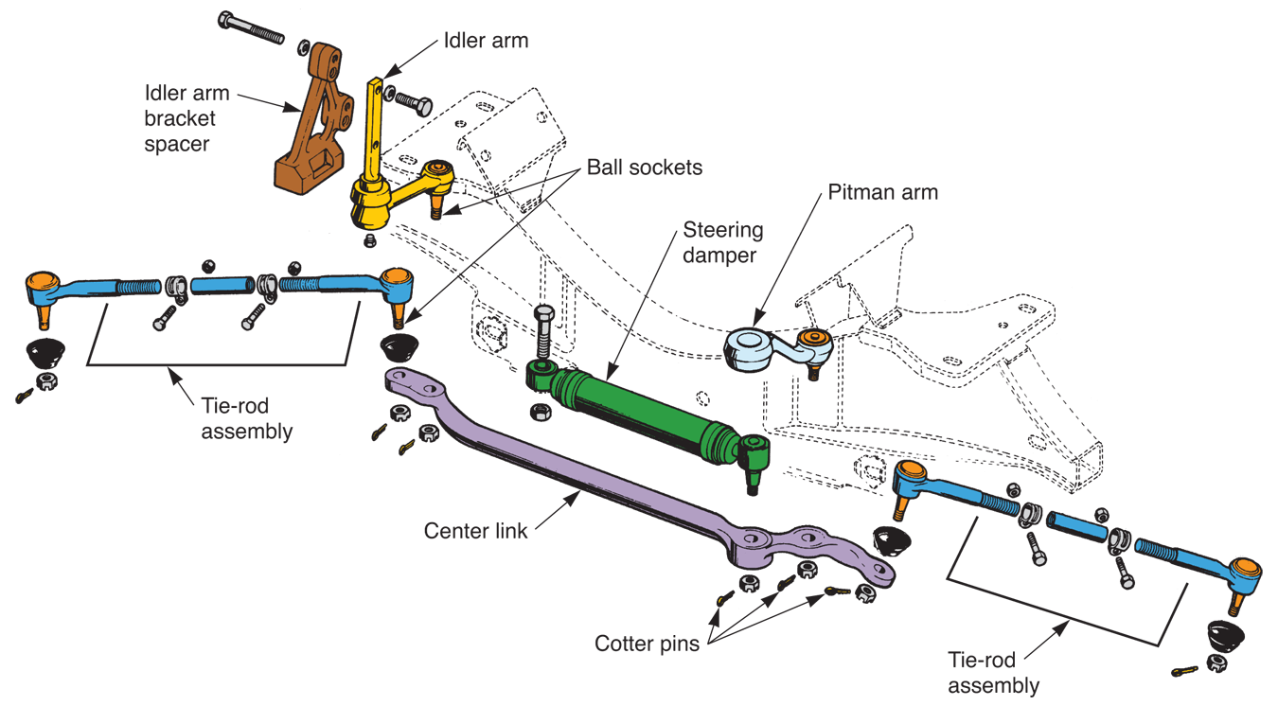
Linkage Type Steering System
(Chrysler)

Slide 34
Manual Rack-and-Pinion Steering
Many steering systems have flexible coupling and/or universal joint in steering shaft
Flexible coupling
  Helps keep road shock from being transmitted to steering wheel
Universal joint
  Allows for change in angle between steering column and steering shaft

Slide 35
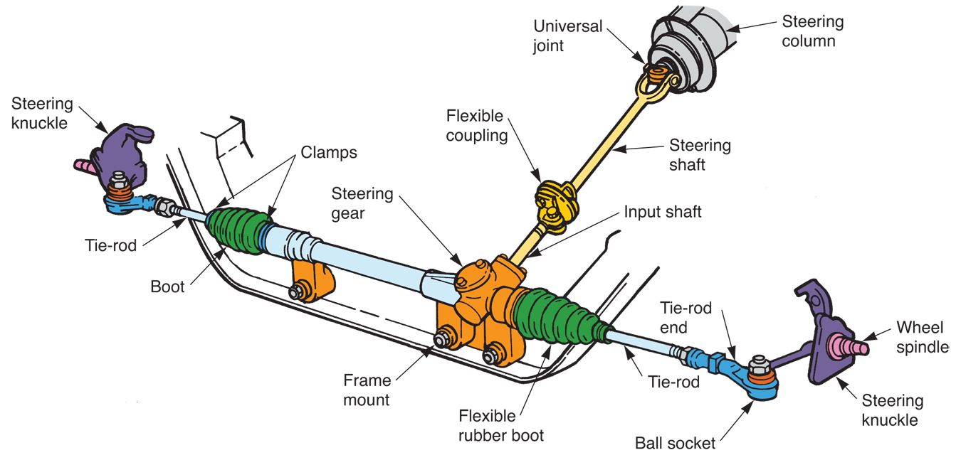
Manual Rack-and-Pinion Steering System
(Ford)

Slide 36
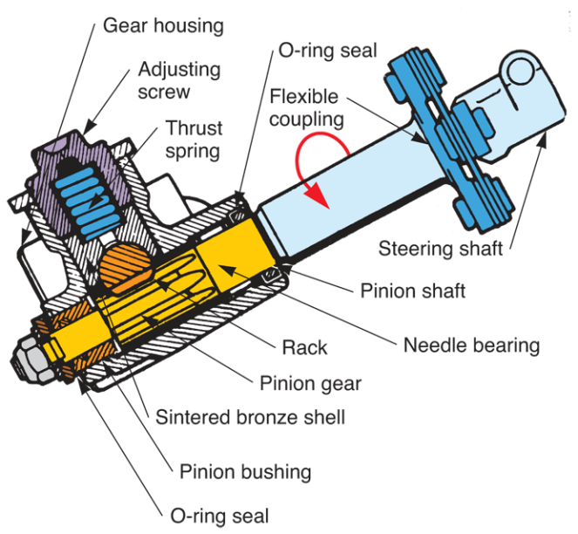
Rack-and-Pinion Steering Gear
Pinion shaft
Rack
Thrust spring
Bearings
Seals
Gear housing
  Thrust spring preloads rack-and-pinion gear teeth to prevent excessive gear backlash
(Ford)

Slide 37
Rack-and-Pinion Tie-Rod Assemblies
Tie-rod assemblies for rack-and-pinion steering systems connect ends of rack with steering knuckles
Rubber dust boots
  Fit over inner ball sockets to keep out road dirt and water, as well as to hold in lubricating grease

Slide 38
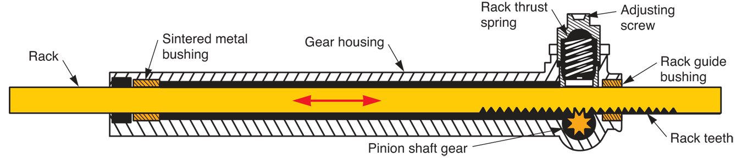
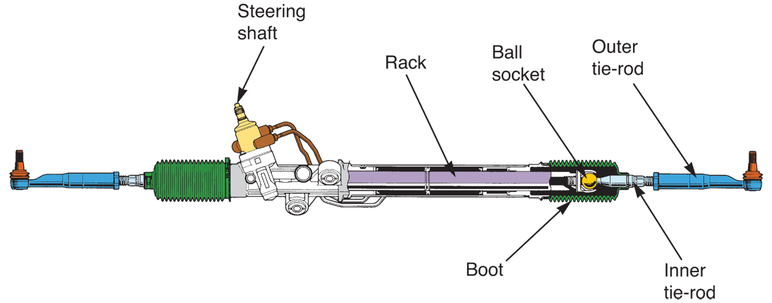
Rack-and-Pinion Steering System
(Toyota)

Slide 39
Power Steering Systems
Use engine driven pump and hydraulic system to assist steering action
Three major types of power steering systems used on modern automobiles
  Integral piston linkage systems
  External cylinder power steering systems
  Rack-and-pinion systems

Slide 40
Power Steering Pumps
Engine driven, produces hydraulic pressure for steering system operation
In most cases, belt running from engine crankshaft pulley powers pump

Slide 41
Power Steering Pumps
(Cont.)
Four basic types of power steering pumps
  Roller
  Vane
  Slipper
  Gear
Power steering fluid reservoir
  Holds extra supply of power steering oil or fluid
  Can be form as part of pump body or be separate container

Slide 42
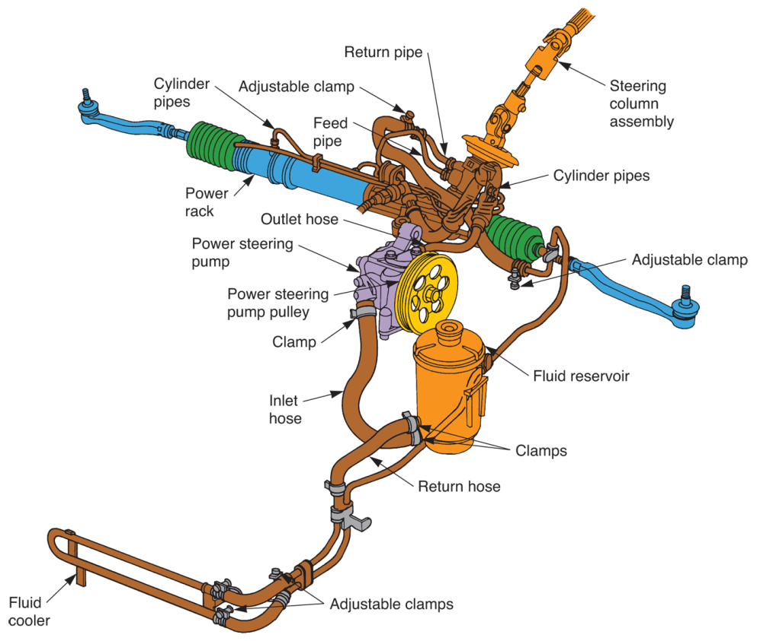
Power Steering Pumps
(Cont.)
(Honda)

Slide 43
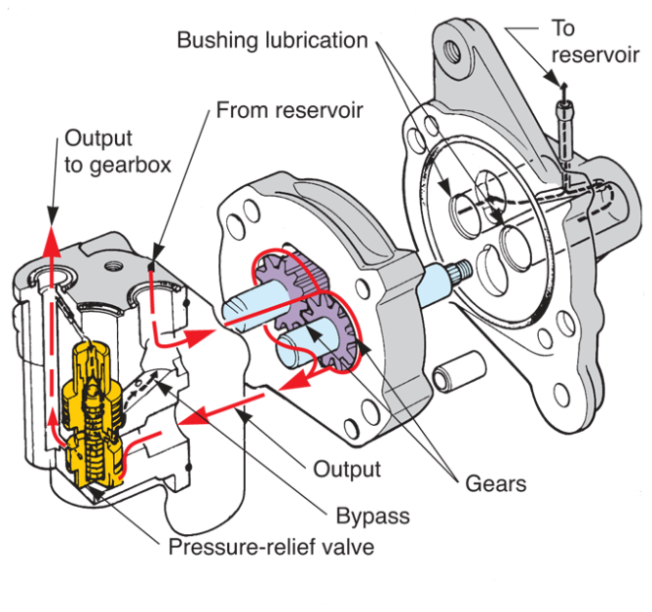
Pressure-Relief Valve
Used in power steering system to control maximum oil pressure
Prevents system damage by limiting pressure when needed

Slide 44
Power Steering Hoses
High-pressure, hydraulic, rubber hoses that connect power steering pump and integral gearbox or power cylinder
One line serves as pressure feed line
Other acts as return line to reservoir
Metal lines carry fluid between parts where vibration or part movement is not a problem

Slide 45
Linkage-Type Power Steering
Systems
Heavy duty, linkage-type power steering system is still used on full-size trucks
Integral-piston power steering system
  Has hydraulic piston mounted inside steering gearbox housing
Integral power steering gearbox
  Contains conventional worm-and-sector gear, hydraulic piston, and flow-direction valve

Slide 46
Linkage-Type Power Steering
Systems (Cont.)
One type of integral power steering gearbox uses spool valve, another uses a rotary valve
Spool valve
  Controls pressure entering power chambers
Rotary valve
  Directs hydraulic pressure to correct side of power piston

Slide 47
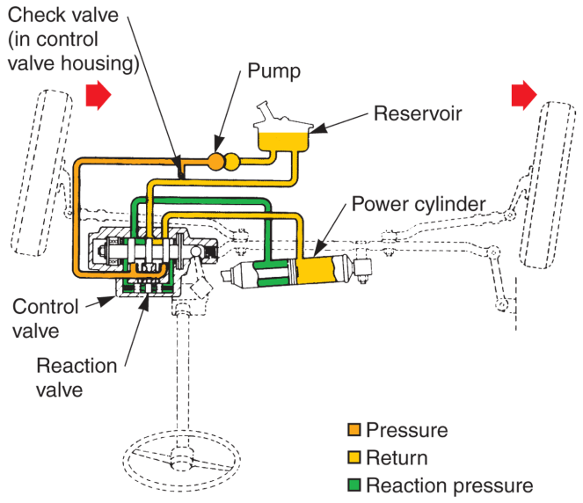
Linkage-Type Power Steering
Systems (Cont.)
In external cylinder power steering system, power cylinder is commonly bolted to frame and center link
Found on older passenger cars and large industrial equipment
(Ford)

Slide 48
Power Rack-and-Pinion Steering
Hydraulic pump pressure assists driver in moving rack and front wheels
Power rack-and-pinion assembly
Power cylinder
  Hydraulic cylinder machined inside the rack or gear housing

Slide 49
Power Rack-and-Pinion Steering (Cont.)
Power piston
  Hydraulic, double-acting piston formed on rack shaft
Hydraulic lines
  Steel tubing connecting the control valve and power cylinder
Control valve
  Either rotary valve or spool valve that regulates pressure entry into each end of power cylinder

Slide 50
Power Cylinder and Piston
Precisely machined tube designed to accept power piston
Provisions are made for hydraulic lines
Cylinder housing bolts to vehicle frame member, just like manual unit
Power piston formed by attaching hydraulic piston to center of rack

Slide 51
Power Rack-and-Pinion Control Valves
Two types of control valve mechanisms used
Rotary control valve
  Operated by torsion shaft connected to pinion gear
Spool control valve
  Thrust action of pinion shaft shifts valve to route oil to power cylinder

Slide 52
Power Rack-and-Pinion Operation
When steering wheel is turned, weight of vehicle causes front tires to resist turning
This twists torsion bar or thrusts pinion shaft slightly
This makes control valve move and align specific oil passages

Slide 53
Power Rack-and-Pinion Operation
(Cont.)
Pump pressure flows through the control valve, through the hydraulic line, and into the power cylinder
Pressure then acts on the power piston
The piston helps push the rack and the front wheels for turning
A power steering oil cooler is used to remove excess heat from the oil

Slide 54
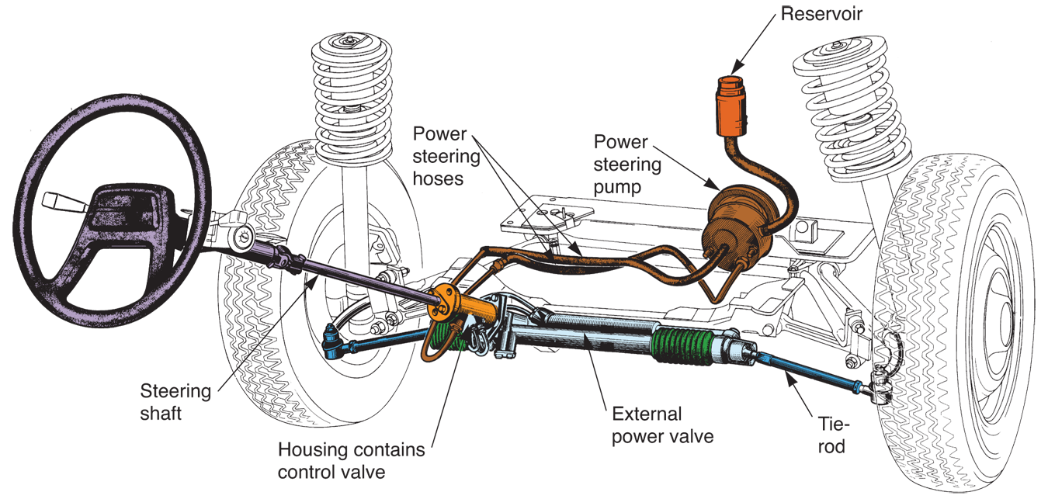
Power Rack-and-Pinion Operation
(Cont.)
(Peugeot)

Slide 55
Electronic Steering Assist
Small electric motor helps move rack-and-pinion gearbox
Steering control module reacts to steering pressure and energizes rack motor to help move rack left or right for steering
Steering control module can reverse motor rotation and alter motor speed as needed to help driver steer car

Slide 56
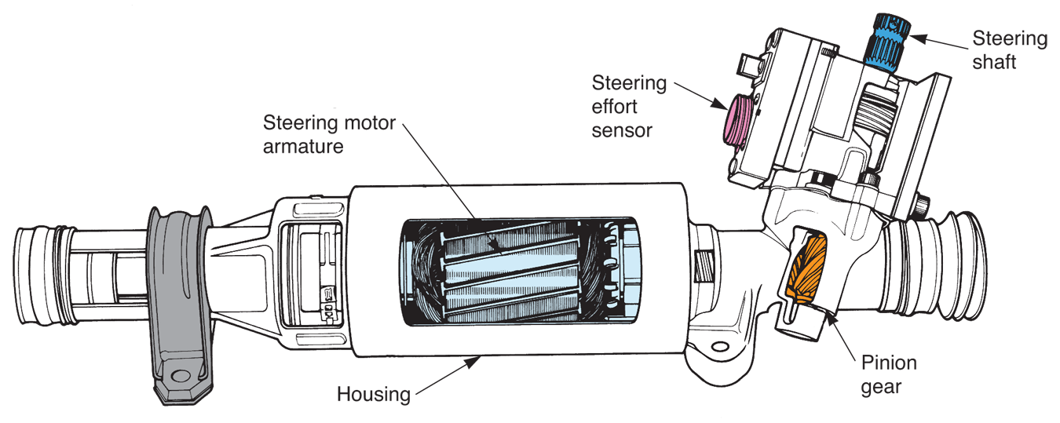
Electronic Steering Assist
(Cont.)
(Moog)

Slide 57
Proportional Rack-and-Pinion
Power Steering
Proportional rack-and-pinion power steering or speed-sensitive power steering
  Senses vehicle speed and steering load to ensure adequate road feel
Increase effort at higher speeds for more road feel
Lower steering effort at low speeds to help driver turn steering wheel when parking

Slide 58
Four-Wheel Steering Systems
Instead of just front two wheels, all four wheels change direction to improve handling, stability, feel, and maneuverability
Three types of four-wheel steering systems
  Mechanical
  Hydraulic
  Electronic

Slide 59
Four-Wheel Steering Systems
(Cont.)
Mechanical four-wheel steering system
  Uses special front rack-and-pinion gearbox with transfer box
  Transfer box operates long shaft that extends back to rear rack
  When front wheels are turned, shaft rotates to turn rear wheels

Slide 60
Four-Wheel Steering Systems
(Cont.)
Hydraulic four-wheel steering system
  Uses conventional power rack-and-pinion steering system up front
  Hydraulic lines extend back to rear power steering pump, which is driven by differential
  Control valve can then operate rear steering system

Slide 61
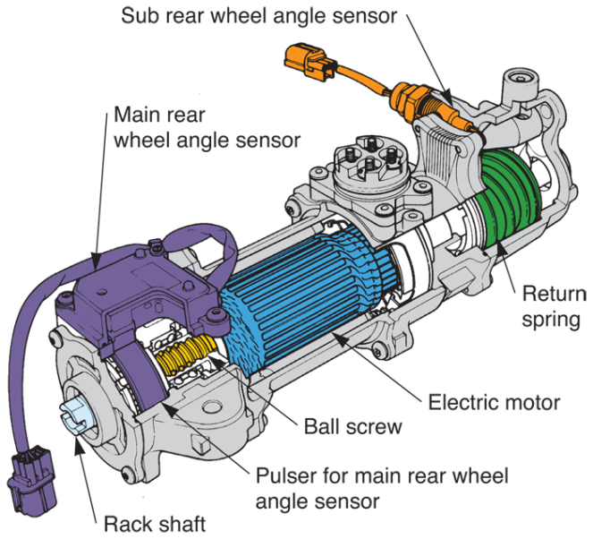
Four-Wheel Steering Systems
(Cont.)
Electronic four-wheel steering systems
Have electric-motor-driven power rack that acts upon rear wheels via its own recirculating-ball drive and mechanical links
Electronic control module controls rear-wheel steering angles
(Honda)

