Slide 1
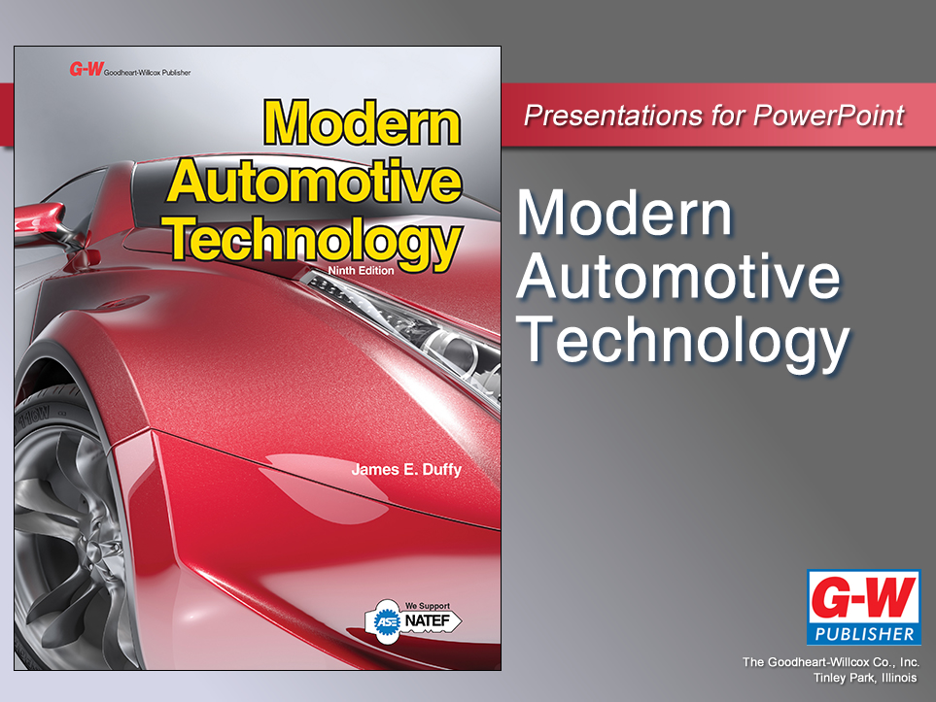

Slide 2
79
Chapter
Wheel Alignment

Slide 3
Objectives
After studying this chapter, you will be able to:
Explain the principles of wheel alignment.
List the purpose of each wheel alignment setting.
Explain toe-out on turns, steering axis inclination, and tracking.
Perform a pre-alignment inspection of tires, steering, and suspension systems.

Slide 4
Objectives
Describe caster, camber, and toe adjustment.
Describe the use of different types of wheel alignment equipment.
Correctly answer ASE certification test questions about wheel alignment angles and procedures.

Slide 5
Wheel Alignment Introduction
Alignment
  To position in straight line
Wheel alignment
  Adjust suspension geometry so all four tires roll in straight line with full tread contact on road surface
  Without scuffing, slipping, or dragging under all operating conditions

Slide 6
Wheel Alignment Principles
Six fundamental angles or specifications needed for proper wheel alignment
Caster
Camber
Toe
Steering axis inclination
Toe-out on turns
  Turning radius
Tracking
  Thrust line

Slide 7
Caster
Forward or rearward tilt of steering knuckle when viewed from side of vehicle
Caster controls tire’s load distribution in relation to imaginary centerline drawn through spindle support

Slide 8
Caster (Cont.)
Basic purposes of caster
Aid directional control of vehicle
Cause wheels to return to straight ahead position
Offset road crown pull
  Steering wheel pull caused by hump in center of road

Slide 9
Caster (Cont.)
Positive caster
  Tilts top of steering knuckle toward rear of vehicle
  Helps keep vehicle’s wheels traveling in straight line
Negative caster
  Tilts top of steering knuckle toward front of vehicle
  Opposite of positive caster

Slide 10
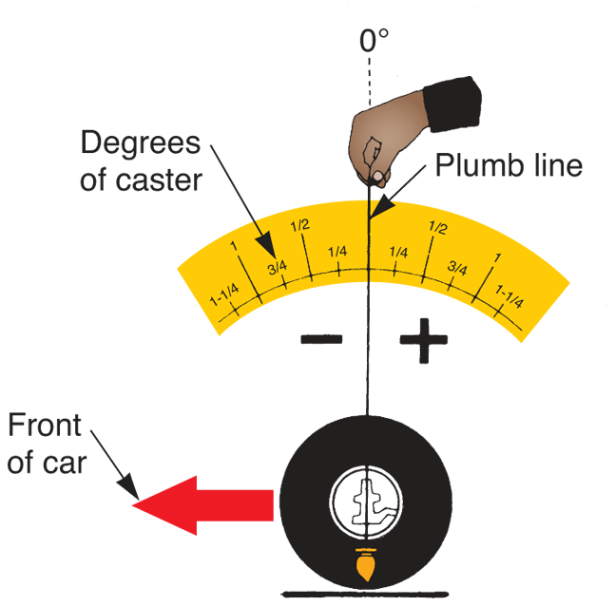
Caster (Cont.)
Caster measured in degrees, starting at true vertical
  Plumb line
Auto manufacturers give specs as specific number of degrees positive or negative
(Bear)

Slide 11
Caster and Road Crown Effect
Caster is directional control angle
  It determines whether vehicle travels straight or pulls to right or left
Road crown
  Normal slope toward outer edge of road surface
Most road surfaces angle downward from center

Slide 12
Caster and Road Crown Effect (Cont.)
If caster of both front wheels were the same, road crown could make vehicle pull or steer toward outside edge of road
Right front wheel may be set with slightly more positive caster than left
This counteracts forces caused by road crown, and vehicle will travel straight ahead

Slide 13
Camber
Inward or outward tilt of wheel and tire assembly when viewed from front of vehicle
Controls whether tire tread touches road surface evenly
Camber is tire-wearing angle and is measured in degrees

Slide 14
Camber (Cont.)
Three reasons for camber
Prevent tire wear on outer or inner tread
Load larger inner wheel bearing
Aid steering by placing vehicle weight on inner end of spindle

Slide 15
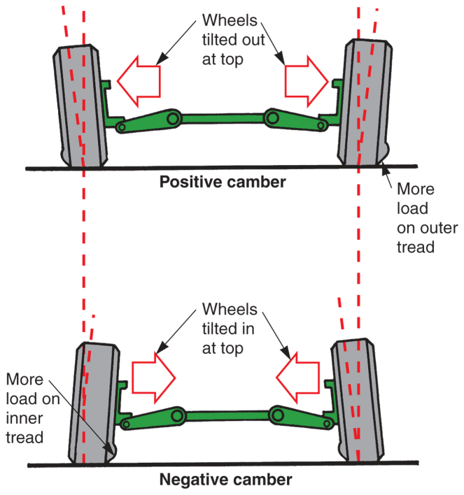
Camber (Cont.)
Positive camber
  Tops of wheels tilt outward when viewed from front of vehicle
Negative camber
  Tops of wheels tilt inward when viewed from front
Measured from true vertical in degrees
  Plumb line

Slide 16
Camber Settings
Most vehicle manufacturers suggest slight positive camber setting
  About 1/4° to 1/2°
Suspension wear and above-normal weight, caused by several passengers or extra luggage, tend to increase negative camber
Positive camber counteracts this tendency

Slide 17
Toe
Determined by difference in distance between front and rear of left- and right-hand wheels
Measured in inches or millimeters
Controls whether wheels roll in direction of travel
Toe is very critical to tire wear

Slide 18
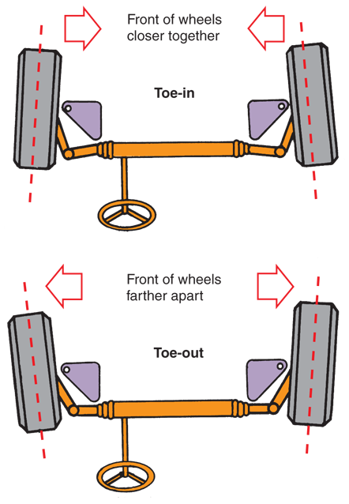
Toe (Cont.)
Toe-in
  Produced when wheels are closer at front than at rear
  Causes wheels to point inward at front
Toe-out
  Results when wheels are farther apart at front than at rear
  Causes front of wheels to point away from each other

Slide 19
Rear-Wheel-Drive Toe Settings
Rear-wheel-drive vehicles usually set to have toe-in at front wheels
  Front wheels tend to toe-out while driving
By adjusting wheels for slight toe-in, wheels and tires roll straight ahead when driving
  Approximately 1/16″–1/4″

Slide 20
Front-Wheel-Drive Toe Settings
Since front wheels propel vehicle, they are pushed forward by engine torque
  This makes wheels point inward
Front-wheel-drive vehicles normally have front wheels adjusted for slight toe-out
  Approximately 1/16″
Theoretically, this gives front end a zero toe setting when vehicle moves down the road

Slide 21
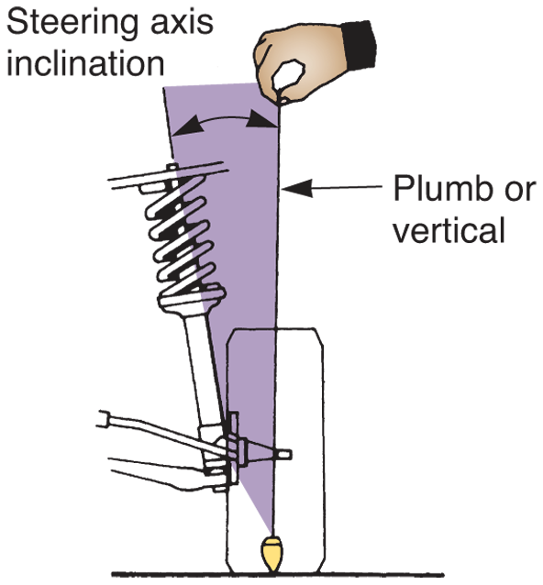
Steering Axis Inclination
Angle, away from vertical, formed by inward tilt of ball joints, king pin, or MacPherson strut tube
Steering axis inclination is always inward tilt, regardless of whether wheel tilts inward or outward
(Bear)

Slide 22
Steering Axis Inclination
(Cont.)
Not a tire wearing angle
Aids directional stability by helping the steering wheel return to the straight-ahead position
Not adjustable
Designed into the suspension system by the vehicle manufacturer
If angle is not correct, replace parts to correct problem

Slide 23
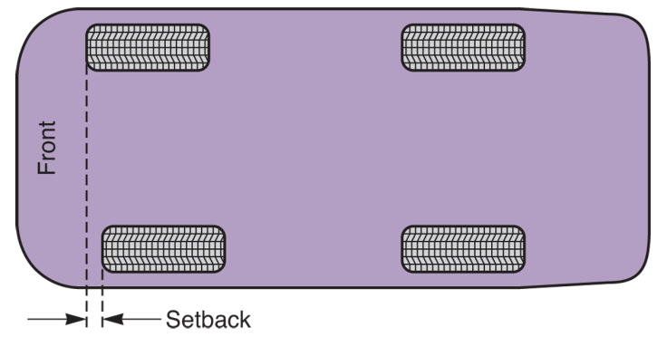
Setback
Condition where one front wheel is set farther back from front than other
Positive setback
  Right wheel is farther back than left wheel
Negative setback
  Left wheel is farther back than right wheel
Excessive setback is indication of damage

Slide 24
Toe-Out on Turns (Turning Radius)
Toe-out on turns or turning radius
  Amount front wheels toe-out when turning corners
As vehicle goes around turn, inside tire must travel in smaller radius circle than outside tire
Steering system designed to turn inside wheel sharper than outside wheel

Slide 25
Tracking
Position or direction of two front wheels in relation to two rear wheels
Dog tracking
  Improper tracking, rear tires do not follow tracks of front tires
  Causes back of vehicle to actually shift sideways compared to front when vehicle is traveling down the road

Slide 26
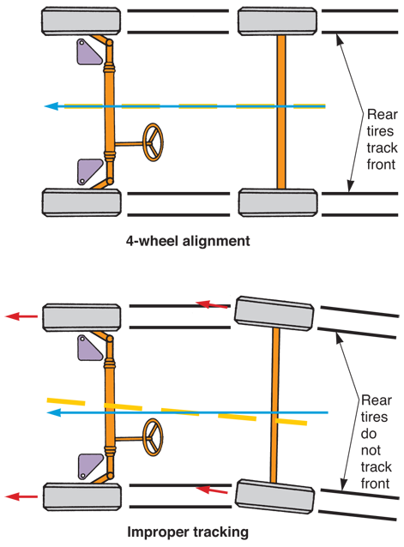
Tracking (Cont.)
With proper tracking, rear tires follow in tracks of front tires, with vehicle moving straight ahead
Poor tracking will increase tire wear, lower fuel economy, degrade handling tremendously

Slide 27
Reading Tire Wear
Reading tires
  Inspecting tire tread wear and diagnosing cause for any abnormal wear
Incorrect camber
  Produces wear on one side of tire tread
  Too much negative camber would wear inside of tire tread
  Too much positive camber would wear outer tread only

Slide 28
Reading Tire Wear (Cont.)
Incorrect toe
  Causes feathered edge to form on tire tread
  Too much toe-in, sharp feathered edge points inward
  Too much toe-out, sharp edge on thread ribs points outward
Feathered edge
  One side of each tread rib is sharp and raised and other side of each rib is rounded or recessed

Slide 29
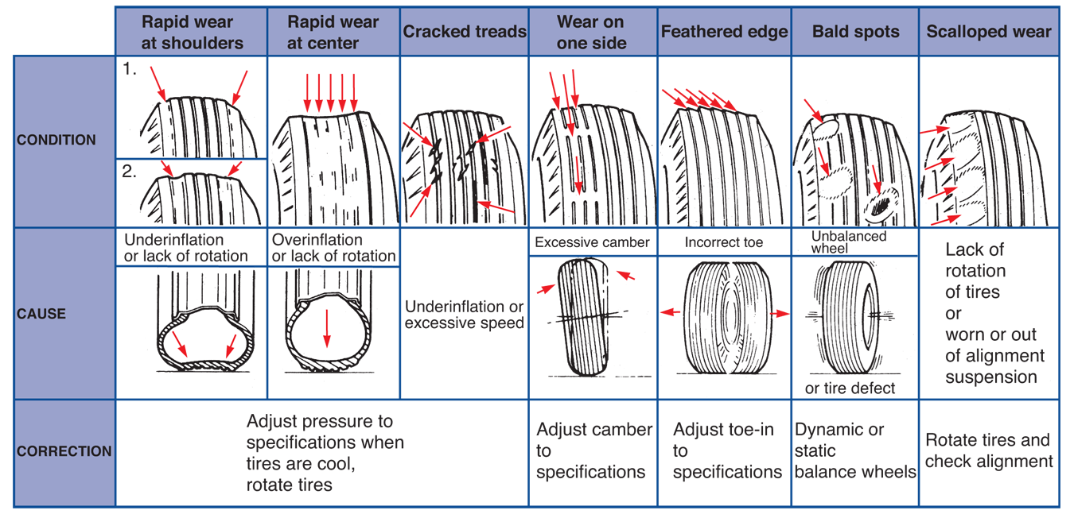
Reading Tire Wear (Cont.)
(DaimlerChrysler)

Slide 30
Checking Setback
Measure distance from rear of one front wheel or tire to inside of corresponding fender opening
Take same measurement at other front wheel or tire and compare two dimensions
Setback should be 1/4″ or less

Slide 31
Cradle Alignment
Vehicle cradle
  Strong metal structure mounted at lower front and sometimes lower rear of unibody structure
Often holds lower control arms, steering rack, and engine in alignment in body
Loosening and moving cradle can alter wheel alignment

Slide 32
Cradle Alignment (Cont.)
Adjusting position of cradle is handy on front-wheel-drive vehicles that do not provide method of adjusting caster and camber
By shifting cradle forward, rearward, or to one side, you can alter these angles

Slide 33
Adjusting Wheel Alignment
Inspect and correct tire, steering, and suspension problems
Adjust caster
Adjust camber and recheck caster
Adjust toe
Check toe-out in turns
  Needed if there is damage
Check caster, camber, and toe on rear wheels
Check tracking

Slide 34
Caster Adjustment Methods
Caster adjusted by moving control arm so that ball joint moves toward front or rear of vehicle
Control arm can be moved by adding or removing shims, adjusting strut rod, turning eccentric bolt, or shifting control arm shaft bolts in slotted holes

Slide 35
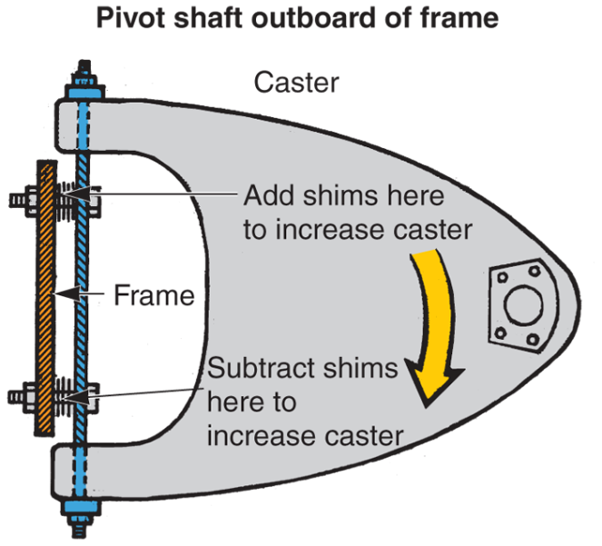
Caster Adjustment Methods
(Cont.)
If upper control arm ball joint is moved forward, negative caster is increased
If upper control arm ball joint is moved rearward, positive caster is increased
Opposite is true for lower control arm

Slide 36
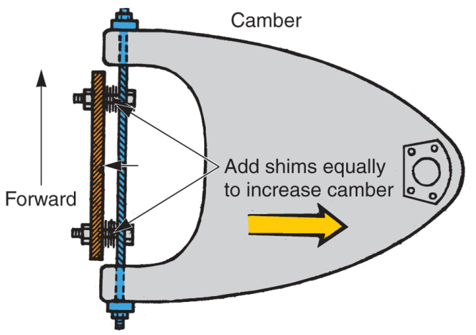
Camber Adjustment Methods
Adjusted after setting caster
Changed by moving control arm in or out without moving ball joint forward or rearward
Shims or slots in control arm mount and eccentric bolts are most common methods for adjustment

Slide 37
Camber Adjustment Methods (Cont.)
Some MacPherson strut suspensions do not have provisions for caster and camber adjustments
Other strut-type suspension systems have camber adjustment at connection between steering knuckle and strut
Upper bolt on steering knuckle may have an eccentric that moves knuckle when turned

Slide 38
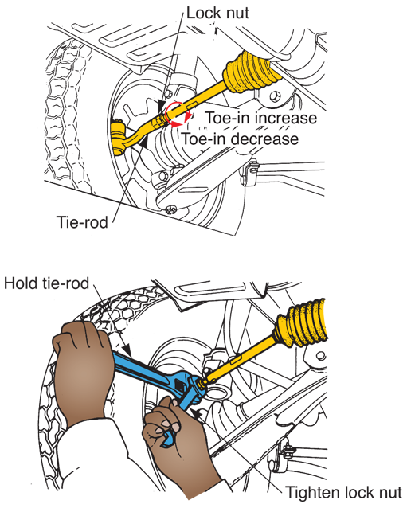
Toe Adjustment
Toe adjusted by lengthening or shortening tie-rods
On most rack-and-pinion steering systems, tie-rod is threaded into outer ball socket
(Subaru)

Slide 39
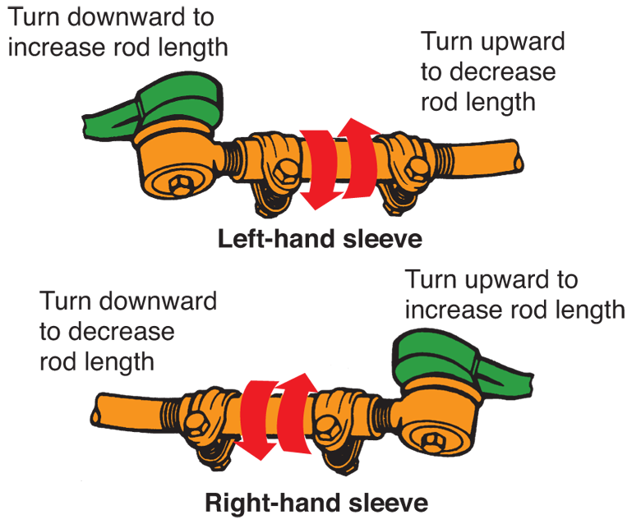
Toe Adjustment (Cont.)
Linkage type steering systems have sleeve threaded on two-piece tie-rod
(Ford)

Slide 40
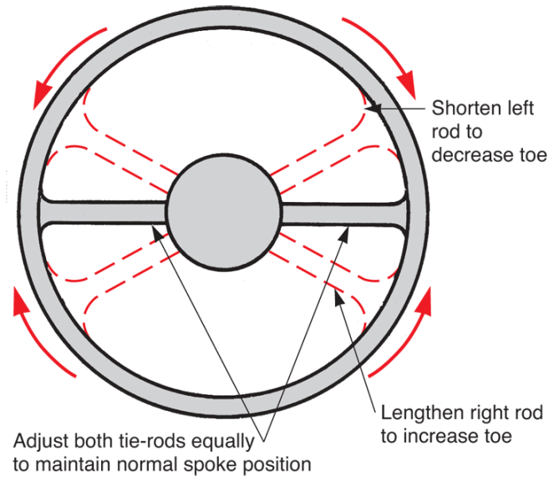
Centering Steering Wheel
To keep steering wheel spokes centered, shorten or lengthen each tie-rod same amount
Changing one tie-rod more than other will rotate steering wheel spokes
(Ford)

Slide 41
Adjusting Rear Wheel Alignment
Vehicle may or may not have provisions for adjusting rear wheel alignment
Vehicle might have been in accident that shifted rear wheels out of place
Follow same principles used for aligning front wheels
Shims can adjust camber and toe to align rear wheels

Slide 42
Wheel Alignment Tools and Equipment
Basic equipment for wheel alignment
  Turning radius gauge
  Caster-camber gauge
  Tram gauge
Combined measuring capabilities of these basic pieces of equipment are built into large alignment racks

Slide 43
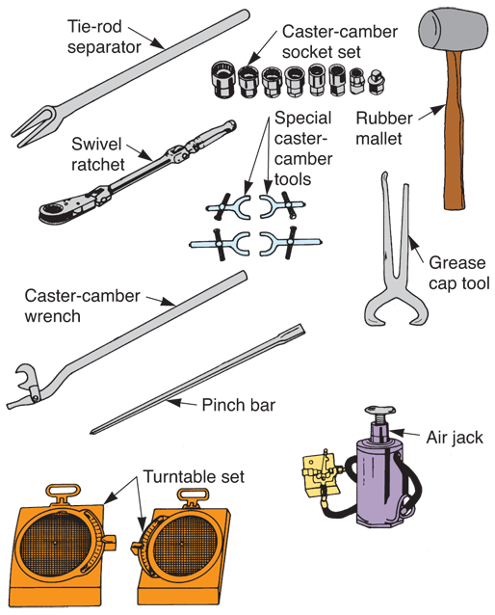
Wheel Alignment Tools and Equipment (Cont.)
(Snap-on Tool Corp.)

Slide 44
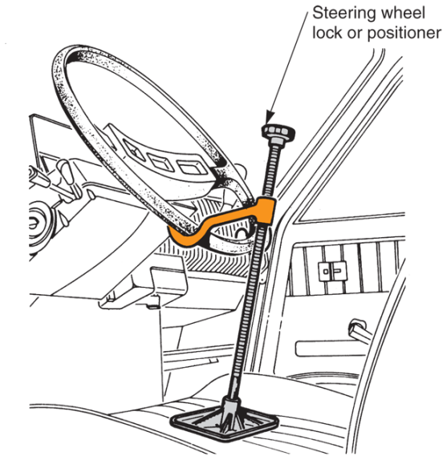
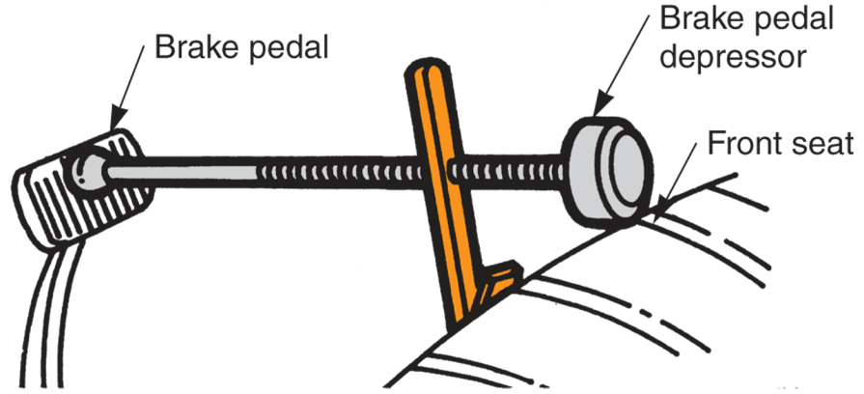
Wheel Alignment Tools and Equipment (Cont.)
(Florida Dept. of Voc. Ed. And Renault)

Slide 45
Turning Radius Gauges
Measure how many degrees front wheels are turned right or left
Commonly used when measuring caster, camber, and toe-out on turns
May be portable units
Commonly mounted and integral part of an alignment rack

Slide 46
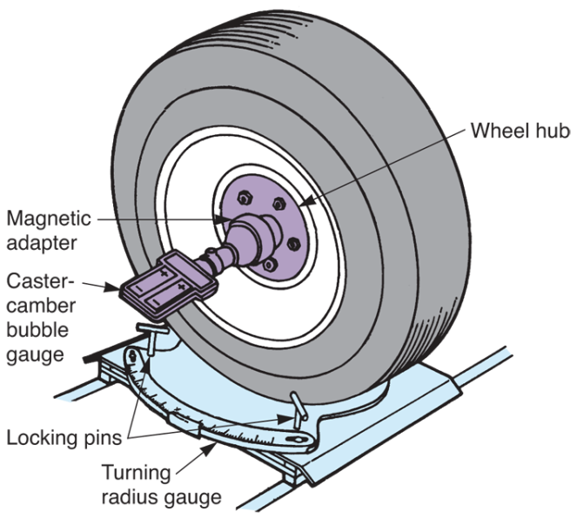
Turning Radius Gauges (Cont.)
Front wheels of vehicle are centered on turning radius gauges
When locking pins are pulled out, gauge and tire turn together
Pointer on gauge will indicate how many degrees wheels have been turned
(Florida Dept. of Voc. Ed.)

Slide 47
Checking Toe-Out on Turns
Center front tires on turning radius gauges
Turn one of front wheels until gauge reads 20°
Read number of degrees showing on other gauge
Check toe-out on turns on both right and left sides

Slide 48
Alignment Machines
Consists of rack, console, and related parts
Rack
  Ramps, turning radius gauges, and one of several types of equipment for measuring alignment angles
Console
  Color monitor, keypad, and computer, all mounted in a roll-around cabinet

Slide 49
Alignment Machines (Cont.)
(Hunter)

Slide 50
Alignment Equipment Software
Contains
  Computer instructions
  Information for using alignment equipment
  Alignment specifications for various makes and models of vehicles
Will help you adjust all alignment angles quickly and easily
Usually stored on CD-ROM (compact disc)

Slide 51
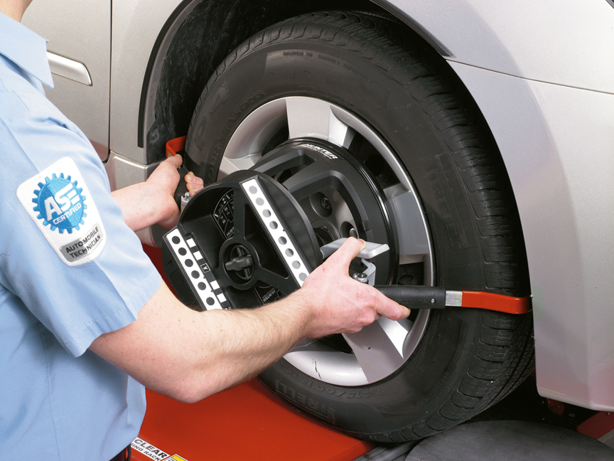
Alignment Heads
Mount on vehicle wheels
Used to check caster, camber, and toe
Often use lasers or proximity sensors to compare alignment of each wheel
(Hunter)

Slide 52
Using Alignment Equipment
With so many types of alignment equipment, always follow operating instructions provided by manufacturer
Alignment principles are the same regardless of equipment used
Apply knowledge of wheel alignment to specific type of equipment

Slide 53
Using Alignment Equipment
(Cont.)
Mount alignment heads on vehicle wheels
For two-wheel alignment, only mount heads on front wheels.
For all-wheel alignment, mount heads on all four wheels
After turning on alignment console, computer might prompt you to enter make, model, year, and other information about car or truck

Slide 54
Using Alignment Equipment
(Cont.)
Monitor will let you select different equipment functions, including
Training on equipment
Inspection of vehicle
Vehicle specifications
Vehicle measurements
Vehicle adjustment locations and procedures
Print out work order or measurements
Using help functions for additional information

Slide 55
Road Test after Alignment
After completing wheel alignment
Road test vehicle on level pavement to check your work
Check for misaligned steering wheel, steering wheel pull, and similar troubles
If you detect problems, alter alignment adjustments to correct any troubles

