Slide 1
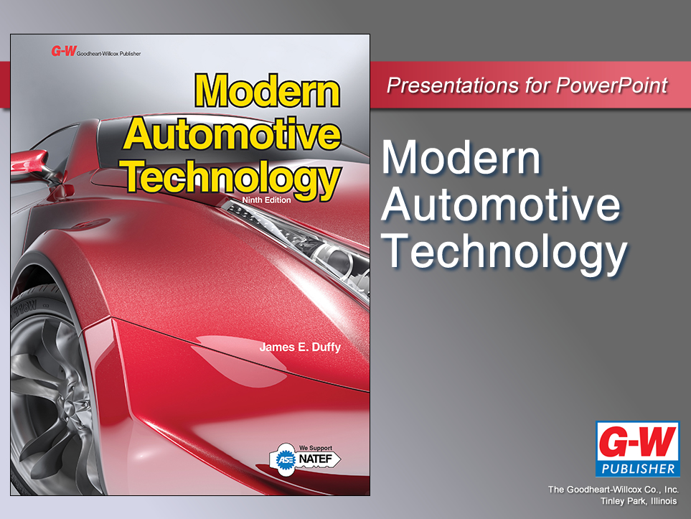

Slide 2
80
Chapter
Brake System Technology

Slide 3
Objectives
After studying this chapter, you will be able to:
Explain the hydraulic and mechanical principles of a brake system.
Identify the major parts of an automotive brake system.
Define the basic functions of the major parts of a brake system.

Slide 4
Objectives
Compare drum and disc brakes.
Explain the operation of power brakes.
Describe the operation of parking brakes.
Correctly answer ASE certification test questions requiring a knowledge of automotive brake systems.

Slide 5
Brake System Technology
Introduction
Automotive brakes
  Provide means of using friction to either slow, stop, or hold wheels of vehicle
Moving car has tremendous amount of stored energy in form of inertia
  Tendency to keep moving
To stop vehicle, brakes convert mechanical energy into heat energy

Slide 6
Brake System Technology
Introduction (Cont.)
Hydraulic brakes
  Confined brake fluid used to transfer power and motion from brake pedal to wheel cylinders and brakes
Hybrid brakes
  Conventional hydraulic brake system combined with electric regenerative braking system provided by hybrid’s driveline

Slide 7
Basic Brake System
Basic parts include
Brake pedal assembly
  Foot lever for operating master cylinder and power booster
Master cylinder
  Hydraulic-piston pump that develops pressure for hydraulic brake system
Brake booster
  Vacuum, electric, or power steering-operated device that assists brake pedal application

Slide 8
Basic Brake System (Cont.)
Brake lines and hoses
  Metal tubing and rubber hose that transmit pressure to wheel brake assemblies
Wheel brake assemblies
  Hydraulic-mechanical mechanisms that use hydraulic pressure to produce friction to slow or stop each wheel
Emergency or parking brakes
  Mechanical or electric systems for applying rear brake assemblies

Slide 9
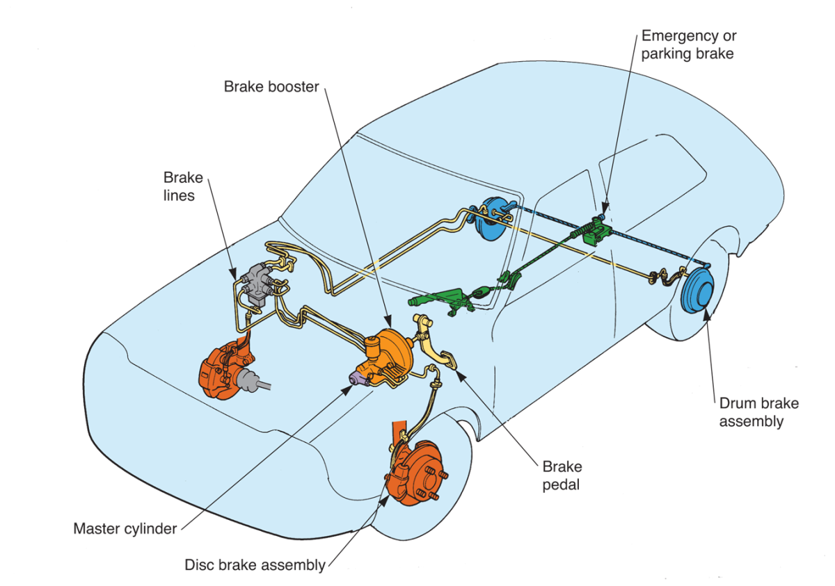
Basic Brake System (Cont.)
(Honda)

Slide 10
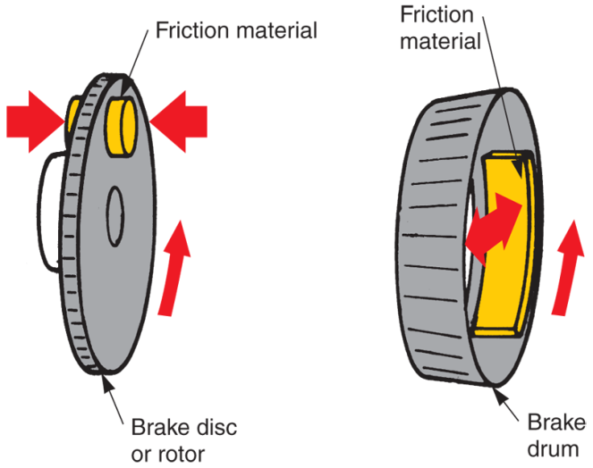
Drum and Disc Brakes
Disc brakes are frequently used on two front wheels of vehicle
Drum brakes are often used on rear wheels
Disc or drum brakes may be used on all four wheels

Slide 11
Drum and Disc Brakes (Cont.)
Components of disc brake assembly
Caliper
  Assembly that holds hydraulic cylinder, piston, seals, and brake pads
Caliper cylinder
  Machined hole in caliper
  Piston fits into this cylinder

Slide 12
Drum and Disc Brakes (Cont.)
Brake pads
  Friction members that push against disc by action of master cylinder, caliper cylinder, and piston
Brake disc
  Large metal rotor that holds wheel and tire and uses friction from brake pads to stop or slow wheel rotation

Slide 13
Drum and Disc Brakes (Cont.)
Components of drum brake assembly
Wheel cylinder assembly
  Houses hydraulic piston that force outward by fluid pressure
Brake shoes
  Friction units that push against rotating brake drum by action of hydraulic wheel cylinder
Brake drum
  Rubs against brake shoes to stop or slow wheel rotation

Slide 14
Braking Ratio
Comparison of front wheel braking effort to rear wheel braking effort
Typically, front wheel brakes handle 60%–70% of the braking power
Rear wheel brakes typically handle 30%–40% of braking
Front-wheel-drive cars can have even higher braking ratio at front wheels

Slide 15
Brake System Hydraulics
Hydraulic system uses liquid to transmit motion or pressure from one point to another
Several principles apply to operation of hydraulic system
  Liquids in confined area will not compress
    Air in confined area will compress
  When pressure is applied to closed system, pressure exerts equally in all directions
  Hydraulic system can increase or decrease force or motion

Slide 16
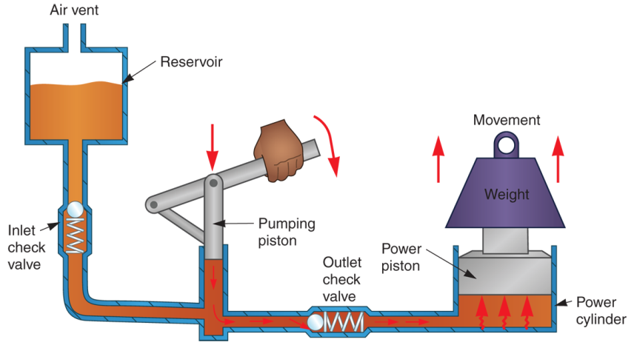
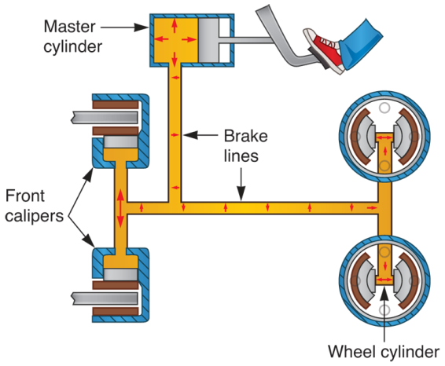
Hydraulic System Action
(OTC)

Slide 17
Brake System Components
Know location and construction of major brake system components
This will better prepare you to troubleshoot and repair these important parts

Slide 18
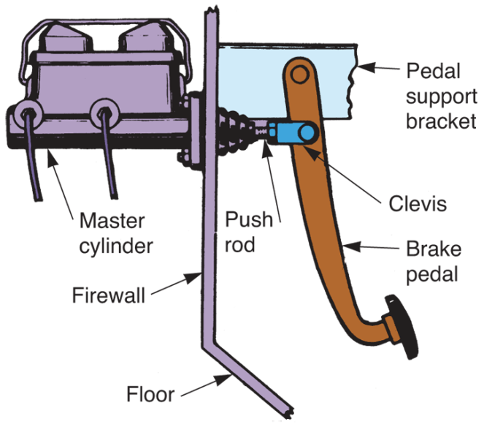
Brake Pedal Assembly
Lever arm increases force applied to master cylinder piston
Manual master cylinder bolts directly to engine’s firewall
Brake pedal assembly bolts under dash
(Bendix)

Slide 19
Master Cylinder
Four basic functions
Develops pressure, causing wheel cylinder pistons to move toward discs or drums
After all shoes or pads produce sufficient friction, it helps equalize pressure required for braking
Keeps system full of fluid as brake linings wear
Maintains slight pressure to keep contaminants from entering system
Air and water

Slide 20
Master Cylinder Construction
Housing
Reservoir
Piston
Rubber cup
Return spring
Rubber boot

Slide 21
Master Cylinder Construction
(Cont.)
Cup and piston
  Pressurize brake system
  When pushed forward, they trap fluid, building pressure
Intake port or vent
  Allows fluid to enter rear of cylinder as piston slides forward

Slide 22
Master Cylinder Construction
(Cont.)
Compensating port
  Releases extra pressure when piston returns to released position
  Fluid can flow back into reservoir through compensating port
Residual pressure valves
  Maintain residual fluid pressure of approximately 10 psi to help keep contaminants out of system

Slide 23
Master Cylinder Construction
(Cont.)
Rubber boot
  Prevents dust, dirt, and moisture from entering back of master cylinder
Master cylinder reservoir
  Stores an extra supply of brake fluid
  Reservoir may be cast as part of housing, or it may be removable plastic part

Slide 24
Dual Master Cylinder
Older vehicles used single-piston, single-reservoir master cylinders
  Dangerous
If brake fluid leak developed, sudden loss of braking ability could occur
Modern vehicles use dual master cylinder for added safety

Slide 25
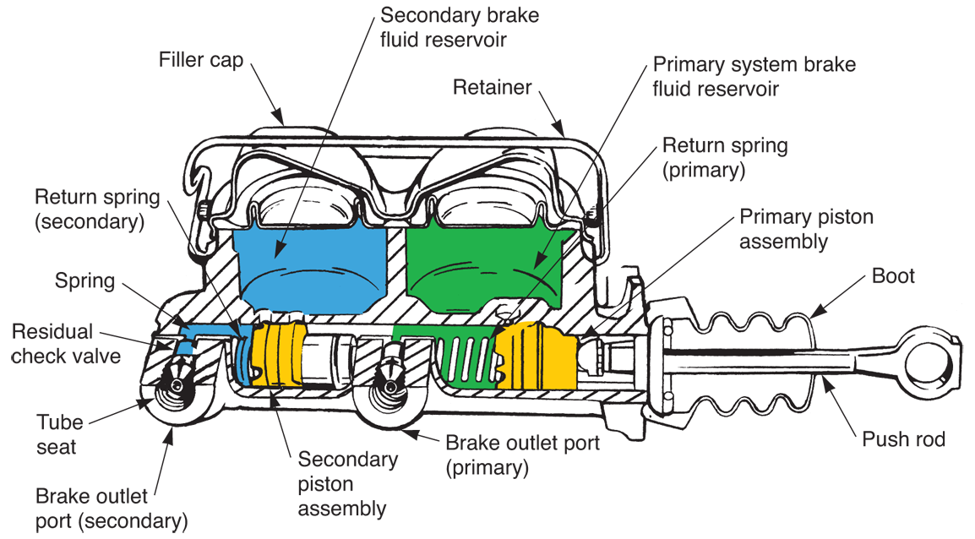
Dual Master Cylinder
(Cont.)
(Bendix)

Slide 26
Dual Master Cylinder
(Cont.)
Dual or tandem master cylinder
  Has two separate hydraulic pistons and two fluid reservoirs
  If there is system leak in one of hydraulic circuits, other circuit can still provide braking action on two wheels
Rear piston assembly is called primary piston
Front piston is secondary piston

Slide 27
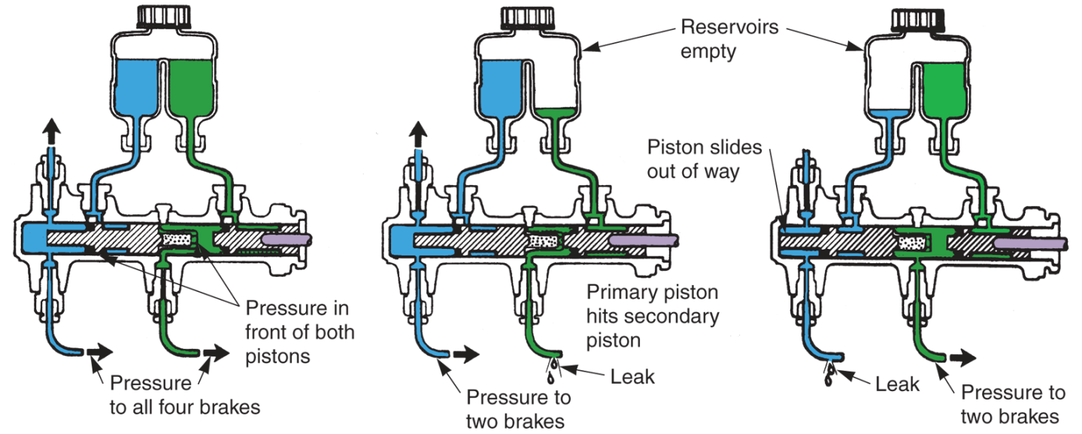
Dual Master Cylinder Operation
(Delco)

Slide 28
Power Brakes
Use booster and either engine vacuum, electric pump, or hydraulic pressure to assist brake pedal application
Booster is located between brake pedal linkage and master cylinder

Slide 29
Power Brake Vacuum Boosters
Vacuum booster
  Uses engine vacuum to apply hydraulic brake system
  Or vacuum created by separate pump on diesel engines
When vacuum is applied to one side of booster, piston or diaphragm moves toward low-pressure area
This movement helps force piston into master cylinder

Slide 30
Vacuum Booster Types
Two types of vacuum brake boosters
Atmospheric suspended brake booster
  Has atmospheric pressure on both sides of diaphragm or piston when brake pedal is released
Vacuum suspended brake booster
  Has vacuum on both sides of piston or diaphragm when brake pedal is released

Slide 31
Power Brake Hydraulic Boosters
Hydraulic booster, hydro-boost or hydra-booster
  Uses power steering pump pressure to help driver apply brake pedal
Fluid pressure, instead of vacuum, helps force piston forward
Commonly used on vehicles equipped with diesel engines

Slide 32
Brake Fluid
Specially blended hydraulic fluid that transfers pressure to wheel brake assemblies
Automakers recommend brake fluid that meets or exceeds SAE and DOT specifications
  Society of Automotive Engineers
  Department of Transportation
Only use brake fluid that satisfies their requirements

Slide 33
Brake Fluid (Cont.)
Brake fluid must have these characteristics
Maintain correct viscosity
  Free flowing at all temperatures
High boiling point
  Remains liquid at highest system operating temperature
Noncorrosive
  Does not attack metal or rubber brake system parts

Slide 34
Brake Fluid (Cont.)
Water tolerant
  Absorbs moisture collecting in system
Lubricates
  Reduces wear of pistons and cups
Low freezing point
  Does not freeze in cold weather

Slide 35
Brake Lines and Hoses
Transfer fluid pressure from master cylinder to wheel brake assemblies
Brake lines are made of double-wall steel tubing and usually have double-lap flares on their ends to prevent high pressure leakage

Slide 36
Brake Lines and Hoses (Cont.)
Brake hoses are reinforced braided rubber hydraulic hoses with threaded metal end fittings
Junction block is used where single brake line must feed two wheel cylinders
  Hollow fitting with one inlet and two or more outlets

Slide 37
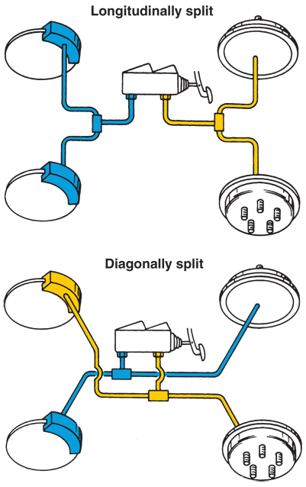
Brake Lines and Hoses (Cont.)
Longitudinally split brake system
  Pistons operate front and rear
Diagonally split brake system
  Pistons operate opposite corners
(Delco)

Slide 38
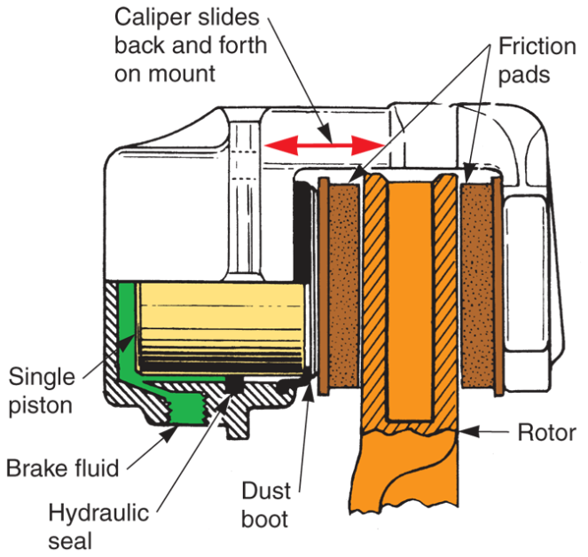
Disc Brake Assemblies
Friction elements are squeezed inward to clamp against rotating disc, or wheel
Disc brake assembly consists of caliper, brake pads, disc, and related hardware

Slide 39
Brake Caliper
Brake caliper assembly includes caliper housing, piston, piston seal, dust boot, brake pads, special hardware, and bleeder screw
When brake pedal is applied, brake fluid flows into caliper cylinder
Piston is then pushed outward by fluid pressure, forcing the brake pads into disc

Slide 40
Brake Caliper (Cont.)
Piston seal
  Prevents pressure leakage between piston and cylinder
Piston boot
  Keeps road dirt and water off caliper piston and wall of cylinder
Bleeder screw
  Allows air to be removed from hydraulic brake system

Slide 41
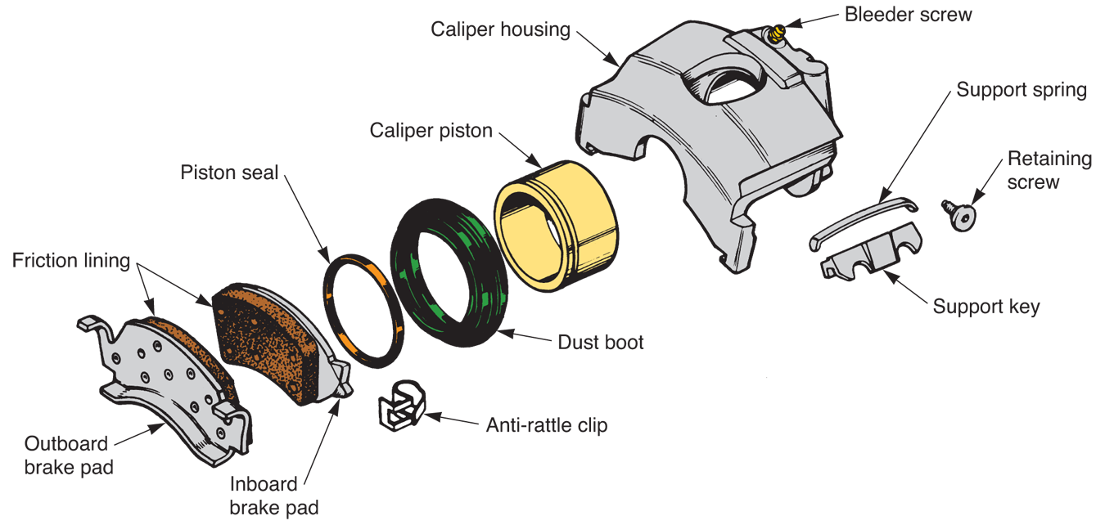
Brake Caliper (Cont.)
(Chrysler)

Slide 42
Disc Brake Pads
Steel plates to which linings are riveted or bonded
Each caliper has inner and outer brake pad that fits inside hydraulic brake caliper
Brake pad linings
  Made of heat-resistant organic or semimetallic friction material

Slide 43
Disc Brake Pads (Cont.)
Anti-rattle clips
  Keep brake pads from vibrating and rattling
  Snap onto brake pad to produce force fit in caliper
Pad-wear sensor
  Metal tab on brake pad that informs driver of worn brake pad linings

Slide 44
Brake Disc
Brake disc or brake rotor
  Uses friction from brake pads to slow or stop wheel rotation
Normally made of cast iron
May be integral part of wheel hub
  In many front-wheel-drive vehicles, disc and hub are separate units
May be solid or ventilated

Slide 45
Disc Brake Types
Floating caliper disc brake
  Mounted on two bolts supported by rubber bushings
  This one-piston caliper is free to shift, or float, in rubber bushings
Sliding caliper disc brake
  One-piston caliper that is mounted in slots machined in caliper adapter
  Caliper is free to slide sideways in slots or grooves as linings wear

Slide 46
Disc Brake Types
Fixed caliper disc brake
  Uses more than one piston and caliper cylinder
  The caliper is bolted directly to the steering knuckle
    It is not free to move in relation to the disc
  Severe vibrations can occur with a slight runout of the disc

Slide 47
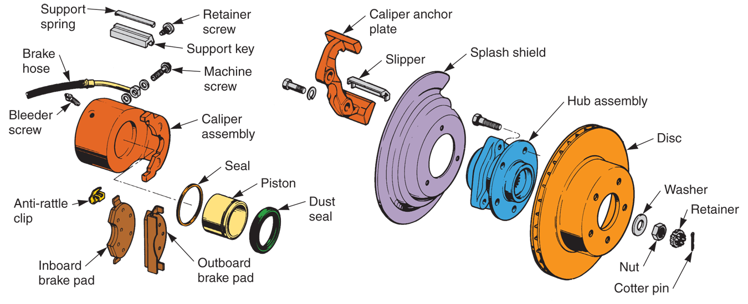
Disc Brake Assembly
(Chrysler and Toyota)

Slide 48
Drum Brake Assemblies
Drum brakes
  Have large drum that surrounds brake shoes and hydraulic wheel cylinder
Drum brake assembly consists of backing plate, wheel cylinder, brake shoes and linings, retracting springs, hold-down springs, brake drum, and automatic adjusting mechanism

Slide 49
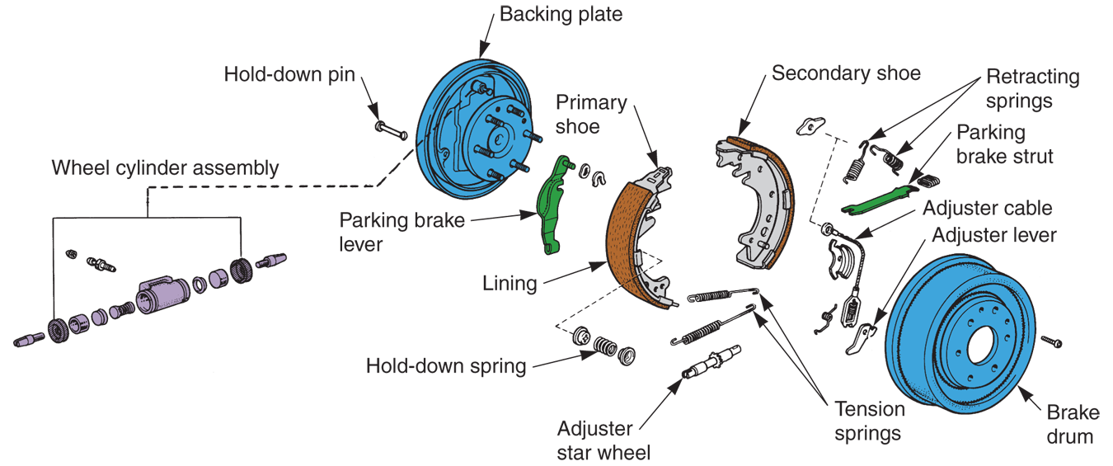
Drum Brake Assembly
(Chrysler and Toyota)

Slide 50
Backing Plate
Brake backing plate
  Holds shoes, springs, wheel cylinder, and other parts inside brake drum
Helps keep road dirt and water off brakes
Backing plate bolts to axle housing or spindle support

Slide 51
Wheel Cylinder Assembly
Wheel cylinder
  Consists of cylinder or housing, expander spring, rubber cups, pistons, dust boots, and bleeder screw
Wheel cylinder housing
  Forms enclosure for other parts of assembly
Wheel cylinder boots
  Keeps road dirt and water out of cylinder

Slide 52
Wheel Cylinder Assembly (Cont.)
Wheel cylinder pistons
  Metal or plastic plungers transfer force out of wheel cylinder assembly
Wheel cylinder cups
  Rubber seals that keep fluid from leaking past pistons
Wheel cylinder spring
  Helps hold rubber cups against pistons when wheel cylinder assembly is not pressurized

Slide 53
Wheel Cylinder Assembly (Cont.)
Cup expanders
  Press outer edges of cups against wall of wheel cylinder
Bleeder screw
  Provides means of removing air from brake system
  Threads into hole in back of wheel cylinder

Slide 54
Drum Brake Shoes
Drum brake shoe assemblies or brake shoes
  Rub against revolving brake drum to produce braking action
Primary brake shoe
  Front shoe, it has slightly shorter lining than secondary shoe
Secondary brake shoe
  Rear shoe, it has largest lining surface area

Slide 55
Retracting Springs and Hold-Down Springs
Retracting springs
  Pull brake shoes away from brake drums when brake pedal is released
Hold-down springs
  Hold brake shoes against backing plate when brakes are in released position

Slide 56
Brake Shoe Adjusters
Brake shoe adjusters
  Maintain correct drum-to-lining clearance as brake linings wear
Many vehicles use star wheel-type brake shoe adjusting mechanism
  Adjusting screw assembly
Other vehicles use latch-type adjusters
Automatic brake shoe adjusters function when brakes are applied with vehicle moving in reverse

Slide 57
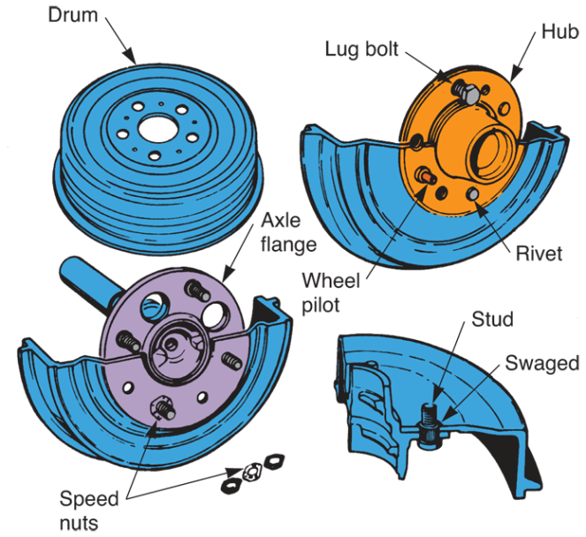
Brake Drums
Provide rubbing surface for brake shoe linings
Fits over wheel lug studs
Large hole in middle of drum centers drum on front hub or rear axle flange
Wheel and drum turn as unit
(Ford)

Slide 58
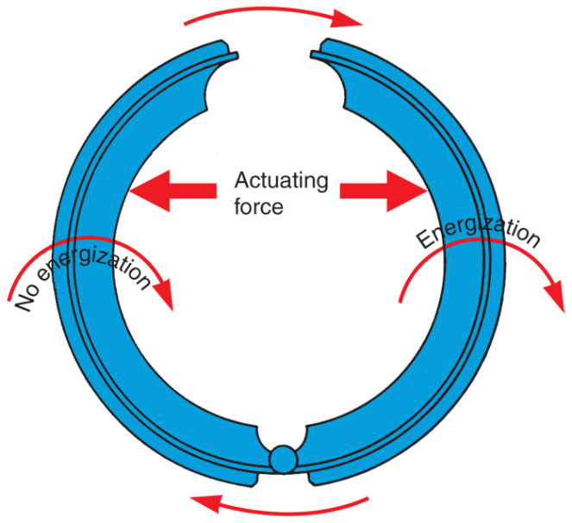
Brake Shoe Energization
When brake shoes are forced against rotating drum, they are pulled away from their pivot point by friction
This self-energizing action draws shoes tighter against drum
(EIS)

Slide 59
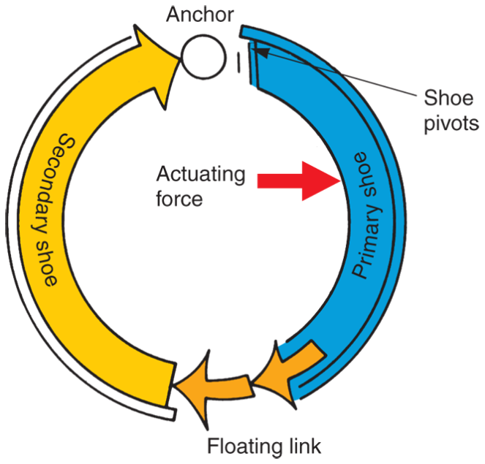
Brake Shoe Energization (Cont.)
With most drum brake designs, shoe energization is supplemented by servo action
Servo action results when primary (front) shoe helps apply secondary (rear) shoe
(EIS)

Slide 60
Brake System Switches
Three types of switches
Stoplight switch
Brake warning light switch
Low-fluid warning light switch

Slide 61
Brake System Switches (Cont.)
Stoplight switch
  Spring-loaded electrical switch that operates rear brake lights of vehicle
Brake warning light switch or pressure differential valve
  Warns driver of pressure loss on one side of dual brake system
Low-fluid warning light switch
  Turns on dash light if brake fluid in master cylinder becomes low

Slide 62
Brake System Control Valves
Metering valve
  Designed to equalize braking action at each wheel during light brake applications
Proportioning valve
  Used to equalize braking action in systems with front disc brakes and rear drum brakes
Combination valve
  Single unit that functions as brake warning light switch, metering valve, and/or proportioning valve

Slide 63
Parking Brakes
Parking brakes or emergency brakes
  Provide mechanical means of applying brakes
    Cable and levers
Electric parking brake
  Uses brake system control module to operate electric servo motor that mechanically engages rear brakes

Slide 64
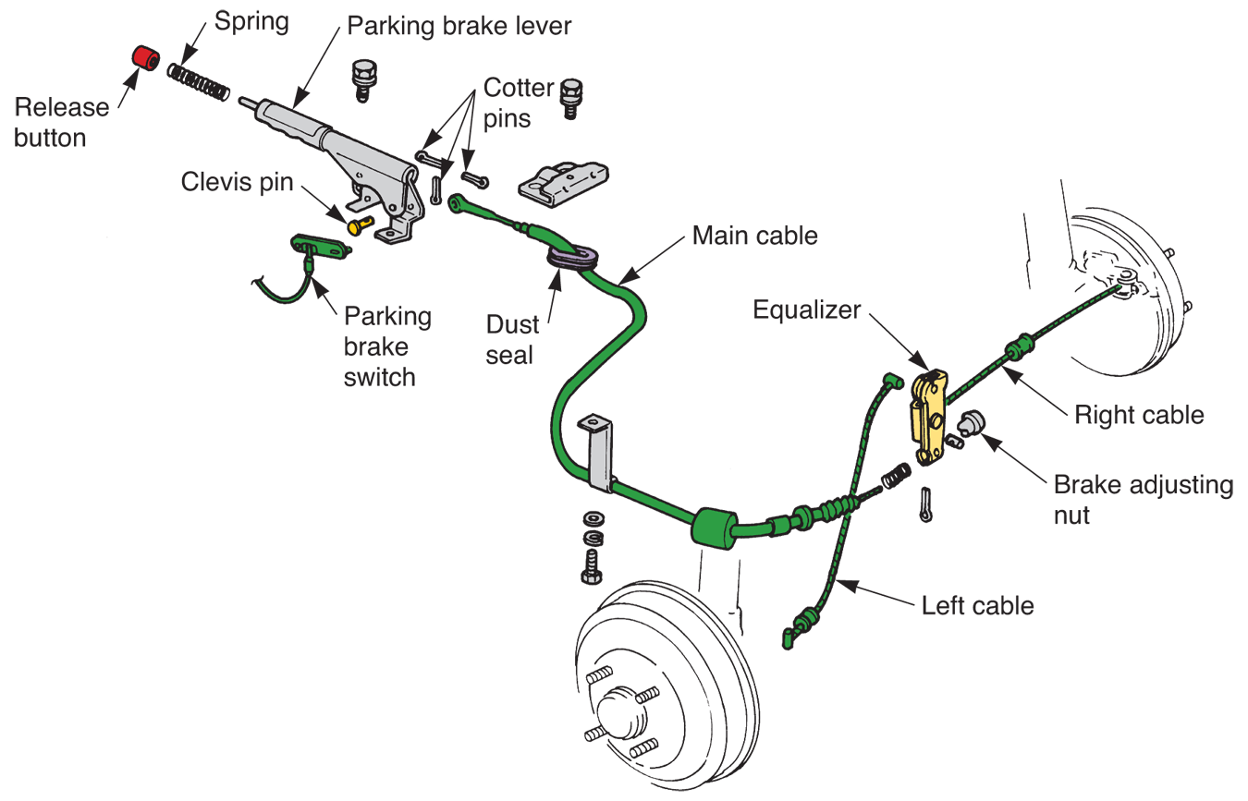
Parking Brakes (Cont.)
(Toyota)

Slide 65
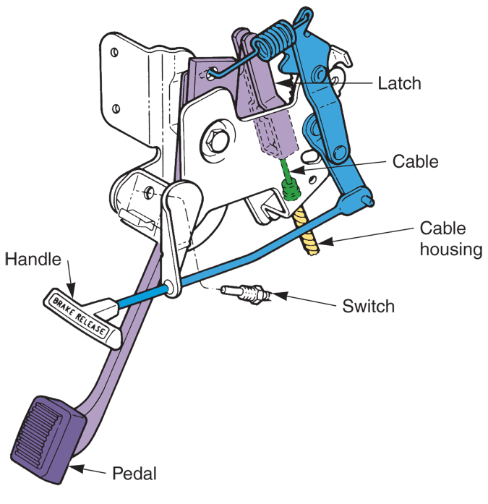
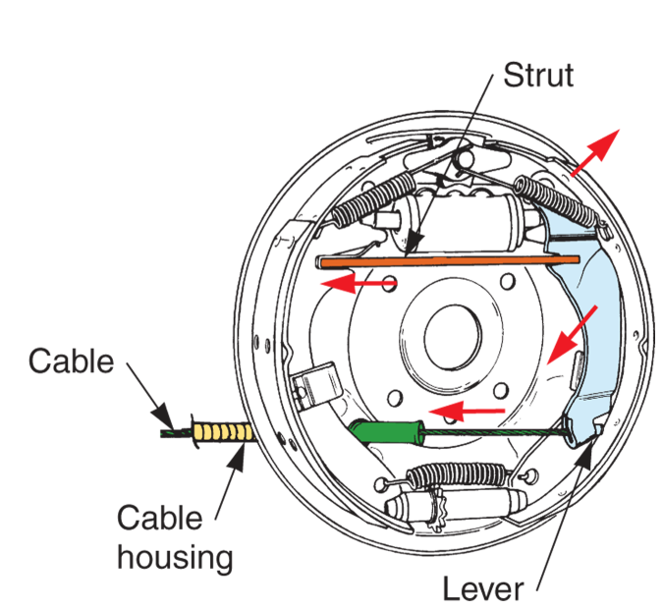
Parking Brakes (Cont.)
(Chrysler and Ford)

Slide 66
Hybrid Brakes
Today’s hybrid vehicles are equipped with regenerative braking systems
Electric braking systems
Work with conventional hydraulic brakes to slow vehicle and generate electricity to recharge vehicle’s HV battery at the same time

