Slide 1
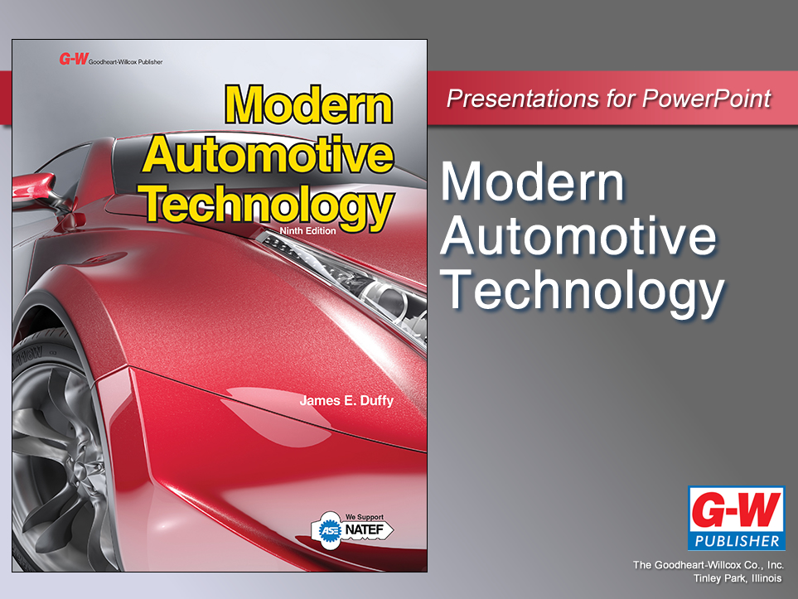

Slide 2
81
Chapter
Brake System Diagnosis, Service, and Repair

Slide 3
Objectives
After studying this chapter, you will be able to:
Diagnose common brake system problems.
Inspect and maintain a brake system.
Explain how to service a disc brake assembly.
Explain how to service a drum brake assembly.
Describe basic procedures for servicing a master cylinder and a brake booster.

Slide 4
Objectives
Describe the procedures for manual, pressure, and vacuum bleeding of a brake system.
Cite the safety rules that should be followed when servicing brake systems.
Correctly answer ASE certification test questions about the diagnosis and repair of brake systems.

Slide 5
Brake System Problem Diagnosis
Diagnostic categories
Brake pedal vibration
Grabbing brakes
Excessive brake pedal effort
Pulling brakes
Spongy brake pedal
Dropping brake pedal
Low brake pedal
Dragging brakes
No brake pedal
Illuminated brake warning light
Braking noise

Slide 6
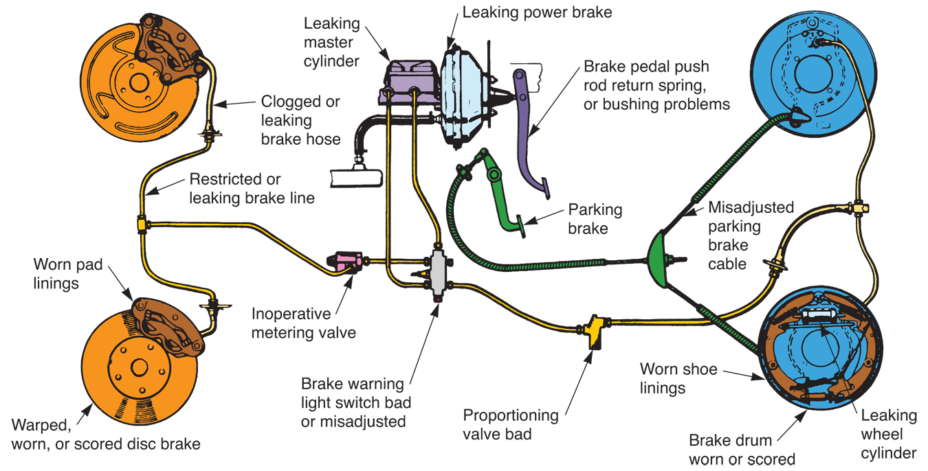
Common Brake System Problems
(Bendix)

Slide 7
Brake System Diagnostics
Modern brake systems, primarily those with antilock brake systems, have self-diagnostic capabilities
If brake control module detects abnormal operating condition in circuit, it will store one or more trouble codes and illuminate malfunction indicator light in dash

Slide 8
Brake Vibration
Chatter, pulsation, or shake problem when brake pedal is pressed
Sources
  Warped brake disc
  Out-of-round brake drum
  Hard spots on disc or drum

Slide 9
Grabbing Brakes
Apply too quickly, even with light brake pedal application
Sources
  Malfunctioning brake booster
  Brake fluid or grease on the linings
  Worn brake linings
  Faulty metering valve
  Mechanical problem in the wheel brake assembly

Slide 10
Excessive Brake Pedal Effort
Noticeable increase in amount of foot pressure needed to apply brakes
Sources
  Frozen wheel cylinder or caliper piston
  Clogged brake hose or line
  Faulty master cylinder
  Contaminated linings
  Disconnected brake booster vacuum line
  Defective brake booster

Slide 11
Pulling Brakes
Cause vehicle to veer to right or left when brakes are applied
Sources
  Frozen caliper or wheel cylinder piston
  Grease- or fluid-coated lining
  Leaking cylinder
  Faulty automatic adjuster
  Buildup of brake lining dust
  Incorrect front end alignment

Slide 12
Spongy Brake Pedal
Feels like it is connected to spring or rubber band
Brakes will apply, but pedal does not feel solid
Sources
  Air in brake system
  Faulty residual pressure check valves in master cylinder
  Maladjusted brake shoes

Slide 13
Dropping Brake Pedal
Slowly moves all the way to floor when steady pressure is applied to it
Caused by internal leak in master cylinder
Fluid leak anywhere else in system can cause same symptom

Slide 14
Low Brake Pedal
Travels too far toward floor before braking
Pedal is not spongy, and braking is normal once pedal applies brakes
Sources
  Inoperative brake adjusters
  Maladjusted master cylinder push rod
  Mechanical problem in wheel brake assemblies

Slide 15
Dragging Brakes
Remain partially applied when brake pedal is released
Sources
  Frozen wheel cylinder pistons
  Overadjusted parking brake
  Weak return springs
  Overadjusted master cylinder push rod
  Brake fluid contamination
  Master cylinder problem

Slide 16
No Brake Pedal
Dangerous condition in which brake pedal moves to floor with no braking action
System leak may have emptied master cylinder reservoir
With today’s dual master cylinders, complete loss of braking is unlikely
  It can occur from driver neglect

Slide 17
Brake Warning Light On
Indicates leak in hydraulic system
Internal leak
  Master cylinder
External leak
  Brake line, hose, wheel cylinder
Unequal pressure in dual master cylinder system caused warning light switch

Slide 18
Braking Noise
Can be grinding sounds, squeaks, rattles, and other abnormal noises
Metal-on-metal grinding sound may be due to worn brake linings
Source of rattle
  Missing anti-rattle clip
  Disconnected spring on brake caliper assembly

Slide 19
Braking Noise (Cont.)
Causes of squeaking may be caused by:
  Glazed brake linings
  Unlubricated brake drum backing plate
  Foreign material embedded in the linings
  Wear indicator rubbing on a rotor

Slide 20
Brake System Inspection
Check fluid level in master cylinder
  Low brake fluid indicates excessive pad and/ or brake disc wear or fluid leaking from system
Check brake pedal action while parked and while driving
Check for abnormal sounds when braking
Inspect brake lines, hoses, and wheel brake assemblies

Slide 21
Checking Brake Pedal Action
Brake pedal check
  Done by applying brake pedal and comparing movement to specifications
Brake pedal height
  Distance from pedal to floor with pedal fully released
  Incorrect pedal height usually caused by problems in pedal mechanism

Slide 22
Checking Brake Pedal Action
(Cont.)
Brake pedal free play
  Amount of pedal movement before beginning of brake application
  Check master cylinder push rod adjustment
Brake pedal reserve distance
  Measured from vehicle’s floor to brake pedal when brakes are applied
  Check push rod adjustment, air in system, or inoperative brake adjusters

Slide 23
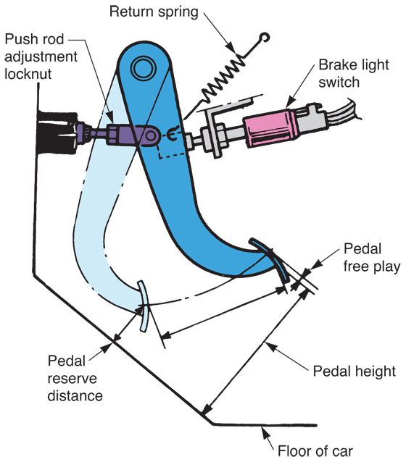
Checking Brake Pedal Action
(Cont.)
(Honda)

Slide 24
Checking Brake Fluid
Remove master cylinder cover
Pry off spring clips
Lift off lid or cover
Be careful not to drip brake fluid on car’s paint
Brake fluid level
  Should be 1/4″ from top of master cylinder reservoir

Slide 25
Checking for Brake System Leaks
Check all brake lines, hoses, and wheel cylinders for wetness and the smell of brake fluid
Brake fluid leakage will show up as darkened, damp area around brake hoses and line fittings, master cylinder, metering valves, wheel, or calipers

Slide 26
Checking the Parking Brake
Apply parking brake
Pedal or lever should not move more than 2/3 of full travel
Should keep vehicle from moving with engine idling and transmission in drive
Inspect parking brake cables and linkage
  Should be tight, undamaged, and well lubricated

Slide 27
Checking Wheel Brake Assemblies
Remove one front wheel and one rear wheel
  Lets you inspect condition of brake linings and assembly components
When inspecting disc brakes
Check thickness of brake pad linings
  Replace pads when thinnest part of lining is no thicker than metal shoe
Check caliper piston for fluid leakage and inspect brake disc for damage

Slide 28
Checking Wheel Brake Assemblies
(Cont.)
Disc should not be scored, cracked, or heat checked
  Small hardened and cracked areas caused by overheating
Inspecting drum brakes
Remove brake drum
  This exposes brake shoes, wheel cylinder, braking surface of drum, adjuster mechanism, and other parts

Slide 29
Checking Wheel Brake Assemblies
(Cont.)
Brake shoe linings must never be allowed to wear thinner than approximately 1/16″
Shoes should not be glazed or coated with brake fluid, grease, or differential fluid
Pull back wheel cylinder boots and check for leakage
Check automatic adjuster, return springs, and brake drum

Slide 30
Vacuum Booster Service
Check condition of vacuum hose
  Should not be hardened, cracked, or swollen
To test vacuum booster
Pump brake pedal several times to remove any vacuum from booster
Press down lightly on brake pedal as you start engine
If vacuum booster is functioning, brake pedal will move downward slightly as soon as engine starts

Slide 31
Hydraulic Booster Service
Check all hydraulic lines for signs of leakage
Tighten connections or replace any line that leaks
If booster is inoperative, check fluid level in power steering pump
  Low fluid level can prevent hydro-boost operation

Slide 32
Master Cylinder Service
Faulty master cylinder usually leaks fluid past rear piston or leaks internally
If fluid is leaking past rear piston, you should find brake fluid in rear boot or on firewall
If leak is internal, brake pedal will slowly sink to floor as pressure is applied

Slide 33
Master Cylinder Removal
Disconnect brake lines from master cylinder with tubing wrench
Unbolt master cylinder from brake booster or firewall
Sometimes, push rod must be disconnected from brake pedal assembly

Slide 34
Master Cylinder Rebuild
Many shops simply replace faulty master cylinder with new or factory rebuilt unit
To rebuild
Drain fluid from reservoir
Completely disassemble unit
Hone cylinder and replace piston cups and valves
Clean parts in brake fluid before reassembly

Slide 35
Master Cylinder Rebuild
(Cont.)
After cleaning, measure piston-to-cylinder clearance
Cylinder must not be tapered or worn beyond specifications
Make sure cylinder is not corroded, pitted, or scored
Replace master cylinder if cylinder is not in perfect condition after honing

Slide 36
Bench Bleeding a Master Cylinder
Bench bleeding
  Removes air from inside master cylinder
Mount master cylinder in vise
Install short sections of brake line and bend them into each reservoir
Fill reservoirs with approved brake fluid
Pump piston in and out by hand until air bubbles no longer form in fluid

Slide 37
Installing a Master Cylinder
Replace reservoir cover after bench bleeding
Bolt master cylinder to firewall or booster
Check adjustment of push rod
Lightly screw brake lines into master cylinder
Bleed system
Tighten brake line fittings
Top off reservoir and check brake pedal feel

Slide 38
Brake System Bleeding
Brake system must be free of air to function properly
Air in system will compress, causing spongy brake pedal
Brake system bleeding
  Involves use of fluid pressure to force air out of brake line connections or wheel cylinder bleeder screws

Slide 39
Manual Bleeding
Attach one end of a hose to bleeder screw
Place other end of hose in jar partially filled with clean brake fluid
Make sure end of hose is submersed in fluid
Have another technician gently depress brake pedal

Slide 40
Manual Bleeding (Cont.)
Open bleeder screw or fitting on caliper or wheel cylinder while watching for air bubbles at hose
Close bleeder screw or fitting and tell helper to release brake pedal
Repeat steps 3–5 until no air bubbles come out of hose
Perform this operation on other wheel brake assemblies or at brake line connections
  If needed

Slide 41
Pressure Bleeding
Done using pressure bleeder tank, which contains brake fluid under pressure
Special adapter is installed over master cylinder reservoir
Pressure hose connects master cylinder and pressure tank
Valve in hose controls flow

Slide 42
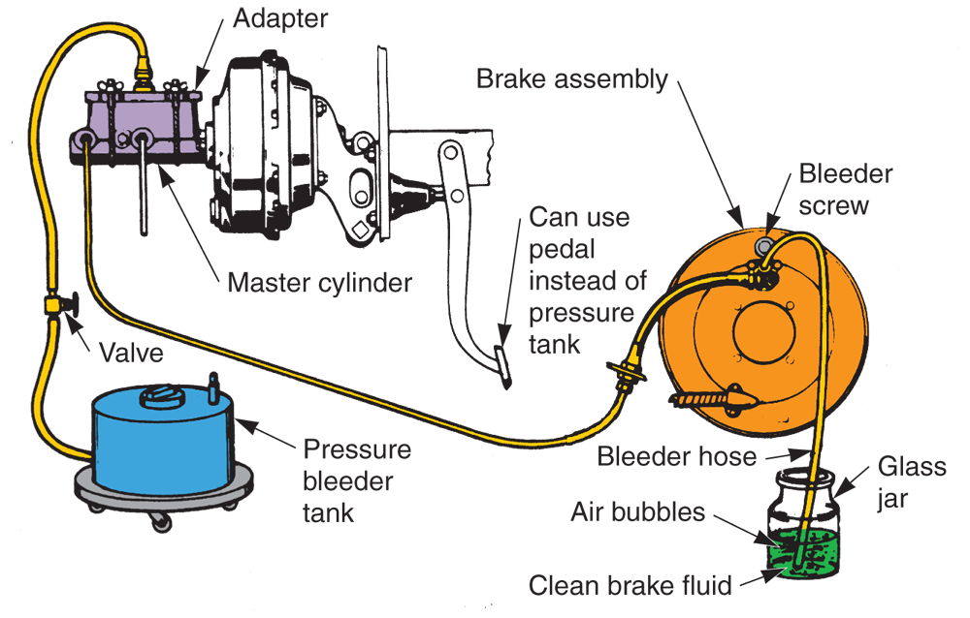
Pressure Bleeding (Cont.)
(Bendix and Chrysler)

Slide 43
Flushing a Brake System
Brake system flushing
  Done by pressure bleeding all old fluid out of system
Needed when brake fluid is contaminated
  Filled with dirt, rust, corrosion, oil, or water
Bleed each wheel cylinder until clean fluid flows from bleeder screw or fitting

Slide 44
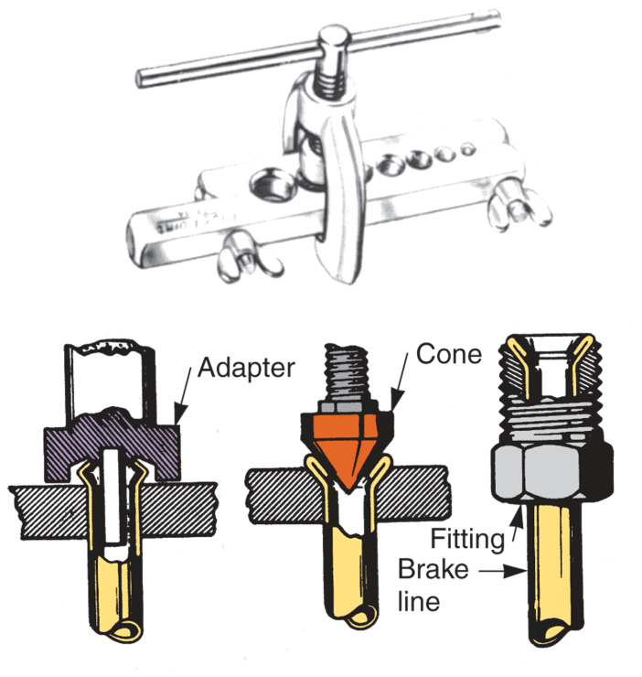
Brake Line and Hose Service
Brake lines and hoses can become damaged or deteriorated after prolonged service
When replacing brake line, use approved double-wall steel tubing
Brake lines normally use double-lap flares
(Bendix and Snap-on Tool Corp.)

Slide 45
Disc Brake Service
Typically involves four major operations
Replacing worn brake pads
Rebuilding caliper assembly
Turning (machining) brake discs
Bleeding system

Slide 46
Replacing Brake Pads
To replace worn brake pads in floating caliper
Loosen wheel lug nuts
Place vehicle on jack stands or secure it on lift
Use impact wrench and socket to remove tire-and-wheel assemblies
Use large C-clamp or caliper tool to push each piston back into its cylinder

Slide 47
Replacing Brake Pads
(Cont.)
Unbolt calipers and slide them off brake discs
Hang calipers with piece of wire if not being removed
Remove old brake pads from calipers
Install anti-rattle clips on new pads
Fit new pads into calipers
  Install any retainer clips on brake pads during installation

Slide 48
Replacing Brake Pads
(Cont.)
With their pistons fully retracted, slide caliper assemblies down over brake discs
Assemble caliper mounting hardware in reverse order of disassembly
Use torque wrench to make sure all bolts are torqued properly
Install wheels and torque lug nuts or bolts to specifications
Test-drive car to verify repairs

Slide 49
Rebuilding a Caliper Assembly
When caliper piston is frozen, leaking, or has extremely high mileage, rebuild or replace it
To remove piston from caliper, apply just enough air pressure in hose fitting hole to push piston out of its cylinder
After piston removal, pry old dust boot and seal out of caliper

Slide 50
Rebuilding a Caliper Assembly (Cont.)
Check caliper cylinder wall for wear, scoring, or pitting
  Clean up light surface imperfections with cylinder hone
Check piston for wear or damage
  Replace if damaged
Clean all caliper parts with approved cleaner
Wipe parts clean and coat them with brake fluid

Slide 51
Rebuilding a Caliper Assembly (Cont.)
Assemble caliper in reverse order of disassembly
Work new seal into cylinder bore groove with your fingers
Install new boot in its groove
Coat piston with more brake fluid
Spread boot with your fingers and slide piston into cylinder

Slide 52
Brake Disc (Rotor) Service
Automakers provide specifications for maximum disc runout and minimum disc thickness
Brake disc must not be scored, cracked, or heat checked

Slide 53
Brake Disc Measurements
Brake disc runout
  Amount of side-to-side movement measured near outer edge of disc’s friction surface
  Dial indicator used to measure brake disc runout
Brake disc thickness
  Measured across two friction surfaces in several locations
  Measure disc thickness with outside micrometer

Slide 54
Resurfacing a Brake Disc
Brake disc resurfacing
  Refers to machining disc’s friction surfaces on brake lathe
Disc resurfacing needed to correct runout, thickness variation, or scoring
Only machine disc when absolutely necessary

Slide 55
Resurfacing a Brake Disc
(Cont.)
To resurface
Mount brake disc on brake lathe
Use appropriate spacers and cones to position disc true on machine’s arbor
Follow directions provided with brake lathe
Tighten large shaft nut on machine so brake disc is held firmly on arbor

Slide 56
Resurfacing a Brake Disc
(Cont.)
Wrap vibration damper around disc to prevent high-frequency vibration and squeal
While wearing eye protection, start machine and adjust cutting tools until they just contact friction surfaces on disc
Engage auto feed mechanism to machine both smooth surfaces on disc
  Remove only enough metal to true disc

Slide 57
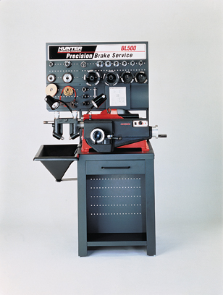
Resurfacing a Brake Disc
(Cont.)
Without touching machined surfaces with your fingers, remove disc from lathe
Double-check disc thickness and install disc on vehicle.
(Hunter)

Slide 58
On-Car Brake Lathes
Some European and Asian front-wheel-drive vehicles have brake discs that are difficult to remove
With these vehicles, on-car disc lathe is time-saver because you do not have to remove disc to machine it
(Hunter Engineering)

Slide 59
Disc Brake Reassembly
After installing brake disc, fit caliper assembly into place
Make sure new pads are properly installed
  In some cases, high-temperature silicone is used on backs of pads to help prevent brake rattle and squeal
Apply small amount of grease to caliper mounting bolt threads if recommended
Torque all caliper fasteners to specifications

Slide 60
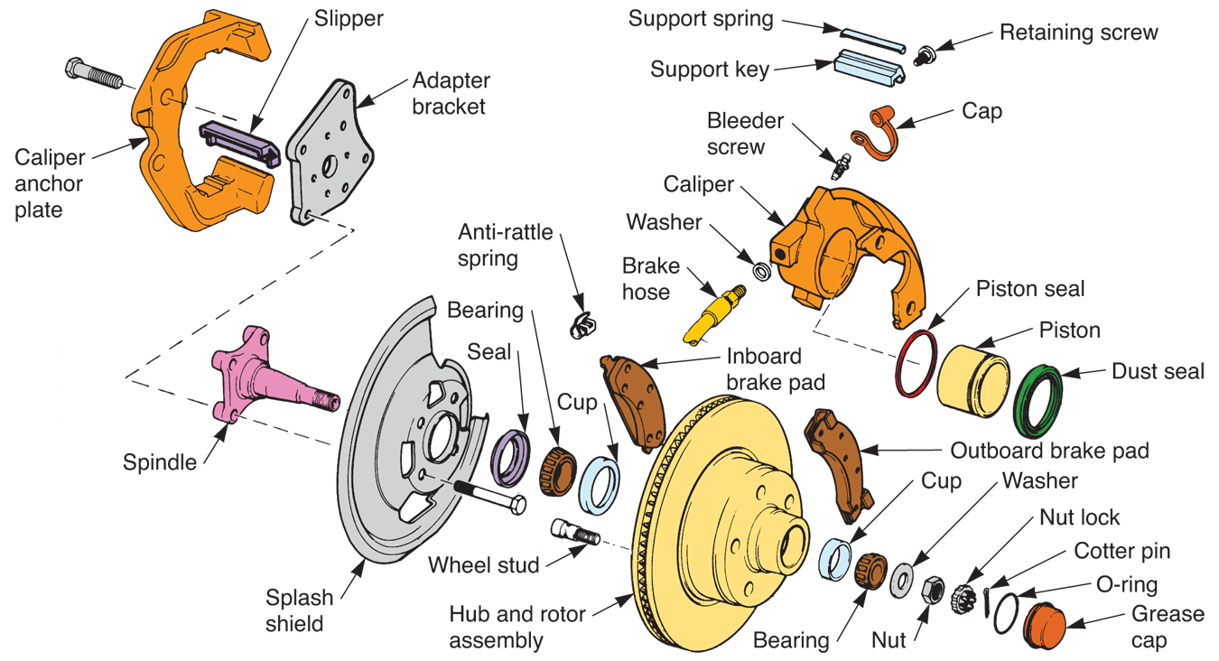
Disc Brake Reassembly
(Cont.)
(Chrysler)

Slide 61
Drum Brake Service
Complete drum brake service typically involves
Removing parts from backing plate
Cleaning and inspecting parts
Replacing brake shoes
Replacing or rebuilding wheel cylinders
Turning brake drums
Lubricating and reassembling brake parts
Preadjusting, bleeding, and testing brakes

Slide 62
Drum Brake Disassembly
Remove tire-and-wheel assemblies and brake drums
If drum is rusted to axle flange, light taps with a hammer may be needed
Back off adjuster if drum is worn

Slide 63
Drum Brake Disassembly
(Cont.)
Use brake spring tool to remove upper shoe return springs
  Organize springs so that they can be installed in same location
Use hold-down spring tool to remove hold-down springs
Lift brake shoes off backing plate
Remove automatic adjuster mechanism
Before disassembling wheel cylinder, clean backing plate

Slide 64
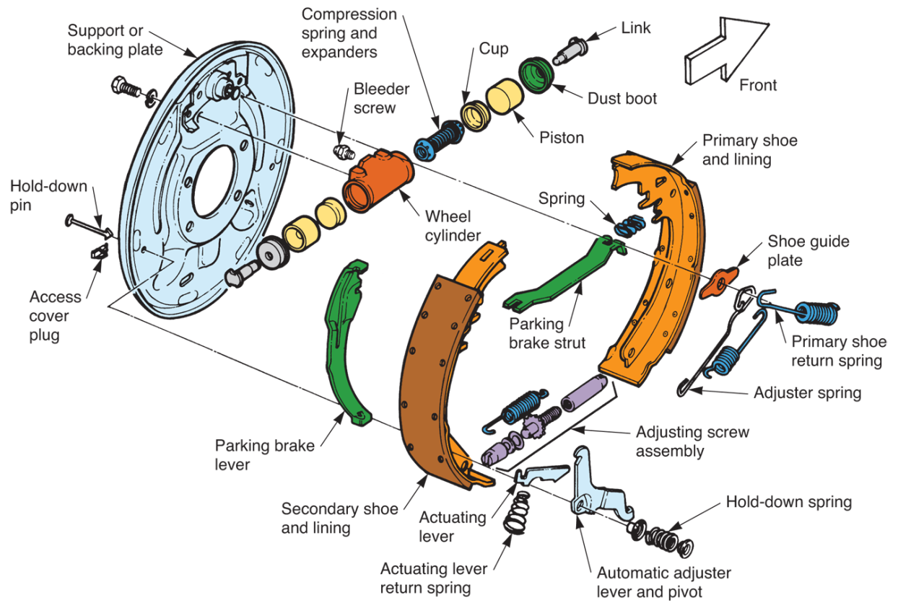
Drum Brake Disassembly
(Cont.)
(Chrysler)

Slide 65
Servicing Wheel Cylinders
Remove boots, pistons, cups, and spring
Usually, wheel cylinder can be serviced while bolted to backing plate
Sometimes, wheel cylinder must be removed before disassembly

Slide 66
Servicing Wheel Cylinders
(Cont.)
Wheel cylinder rebuild
Involves honing cylinder and replacing rubber cups and boots
Inside of cylinder must be in good condition
Replace deeply scratched, scored, or pitted cylinders

Slide 67
Brake Drum Resurfacing
Involves machining friction surface of drum on brake lathe
Resurfacing is needed when drum is scored, out-of-round, or worn unevenly
Some shops machine drum anytime brake linings are replaced
Other shops only resurface when needed

Slide 68
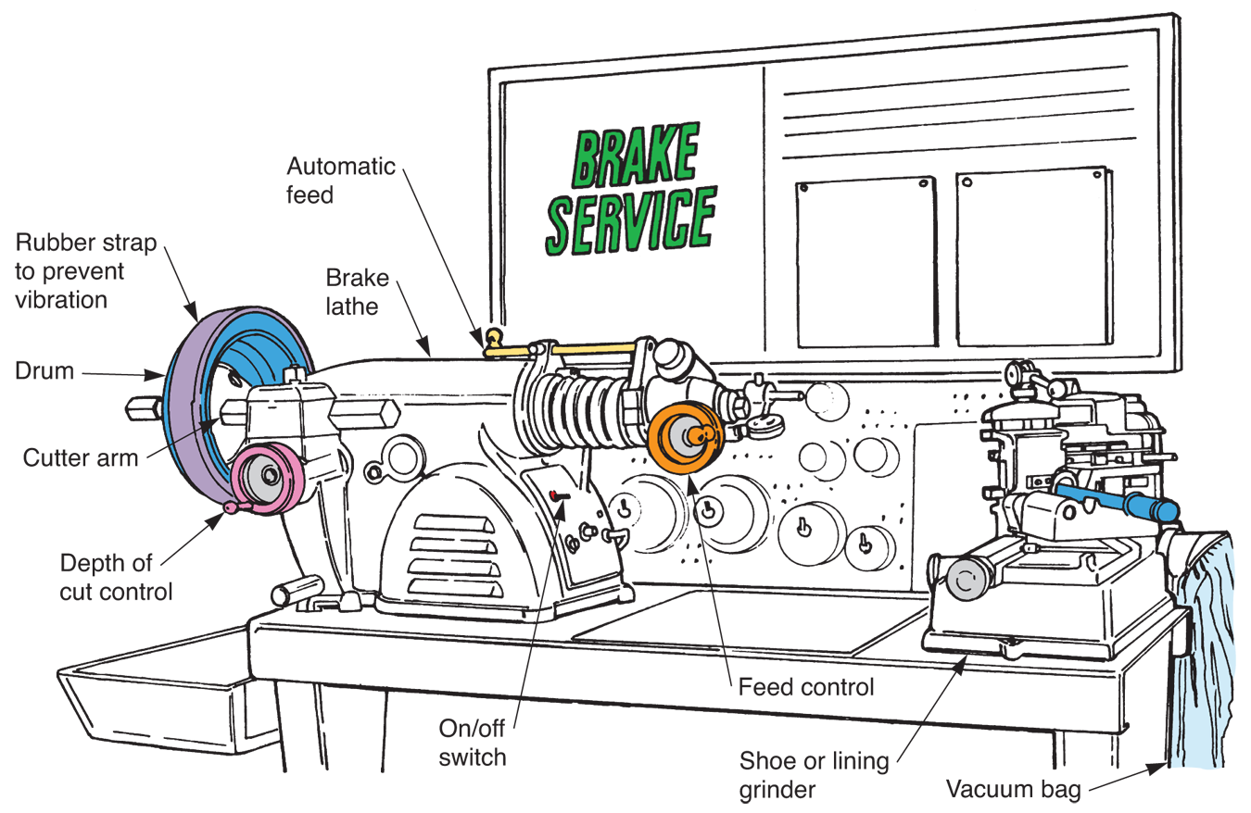
Brake Drum Resurfacing
(Cont.)
(EIS)

Slide 69
Measuring Brake Drum Diameter
Typically, brake drum should not be more than 0.060˝ oversize
To measure brake drum diameter, use special brake drum micrometer
  It will measure drum diameter quickly and accurately

Slide 70
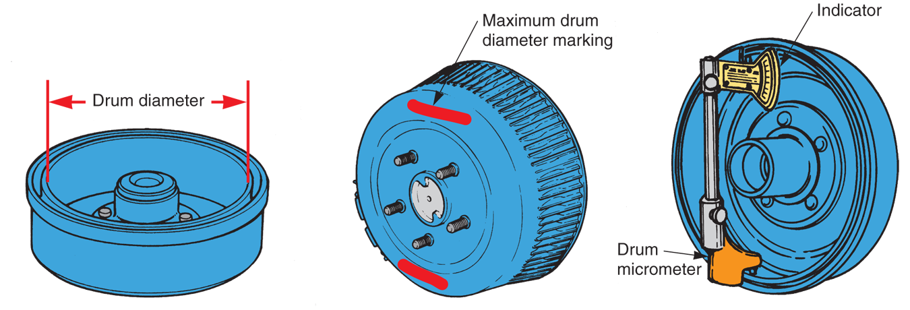
Measuring Brake Drum Diameter
(Cont.)
(Toyota, Chrysler, FMC)

Slide 71
Drum Brake Reassembly
Before reassembling drum brakes, clean wheel bearings and inspect them for wear or damage
Pack bearings with grease and install new grease seals
Lubricate small pads or bumps on backing plate

Slide 72
Drum Brake Reassembly
(Cont.)
Before installing new shoes, check their fit inside brake drum
  There should be small clearance between ends of lining and drums
If centers of linings are not touching drum, linings should be arced
  Ground

Slide 73
Drum Brake Reassembly
(Cont.)
Grind linings so that they are 0.35″ smaller in diameter than drum
  Without this clearance, linings could chatter and vibrate
Install new shoes and adjuster mechanism on backing plate
Make sure all parts are positioned correctly

Slide 74
Drum Brake Reassembly
(Cont.)
Ask yourself theses brake service questions
Are the wheel cylinders in perfect condition and assembled properly?
Did I lubricate the backing plate and the star wheel?
Is the primary lining facing the front of the vehicle and the secondary lining facing the rear of the vehicle?

Slide 75
Drum Brake Reassembly
(Cont.)
Are the shoes centered on the backing plate?
Are the shoes contacting the anchor correctly?
Are all the springs installed properly?
Does the automatic adjuster work?
Are the lining surfaces perfectly clean?
Do I need to bleed the brakes?

Slide 76
Preadjusting Drum Brakes
Fit brake adjusting gauge into brake drum
Set gauge for inside diameter of drum
Tighten lock on gauge
Fit gauge over brake shoes
Turn star wheel or move adjuster arm until linings touch gauge

Slide 77
Preadjusting Drum Brakes (Cont.)
Another way to preadjust drum brakes involves using brake spoon to turn star wheel
Turn wheel until brake drums drag lightly when rotated by hand

Slide 78
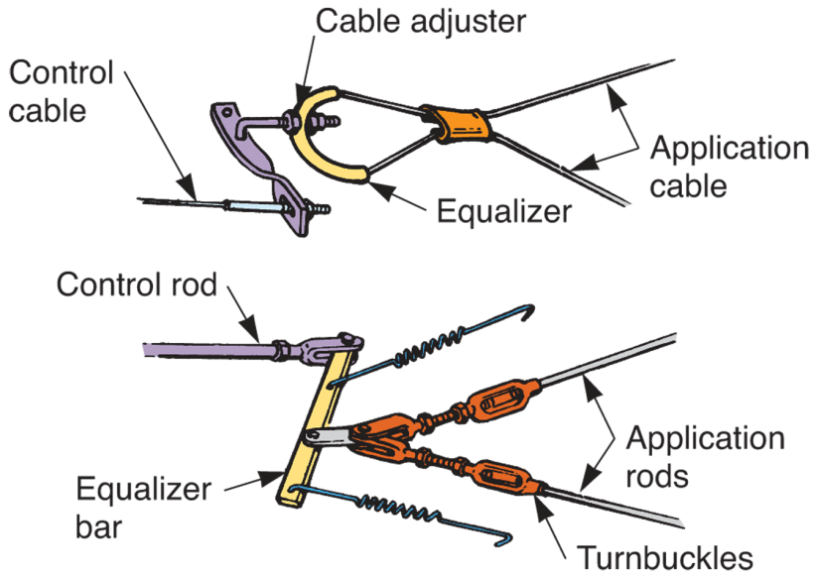
Parking Brake Adjustment
To adjust parking brake, tighten adjustment nut on the cable mechanism
(FMC)

